Slide 1

2016 Kansas Master Naturalist Training
Konza Prairie Chapter

Slide 2
What is the KMN Program?
"The mission of the Kansas Master Naturalist program is to develop knowledgeable and dedicated citizens who are active in promoting awareness, understanding, and stewardship of the natural heritage of Kansas."

Slide 3
Kansas Master Naturalists volunteer their time and expertise throughout the year.
There are over 60 different sites across Kansas that recognize the KMN program and utilize individuals certified as Master Naturalists.
A list of these sites is included in the KMN notebook.

Slide 4
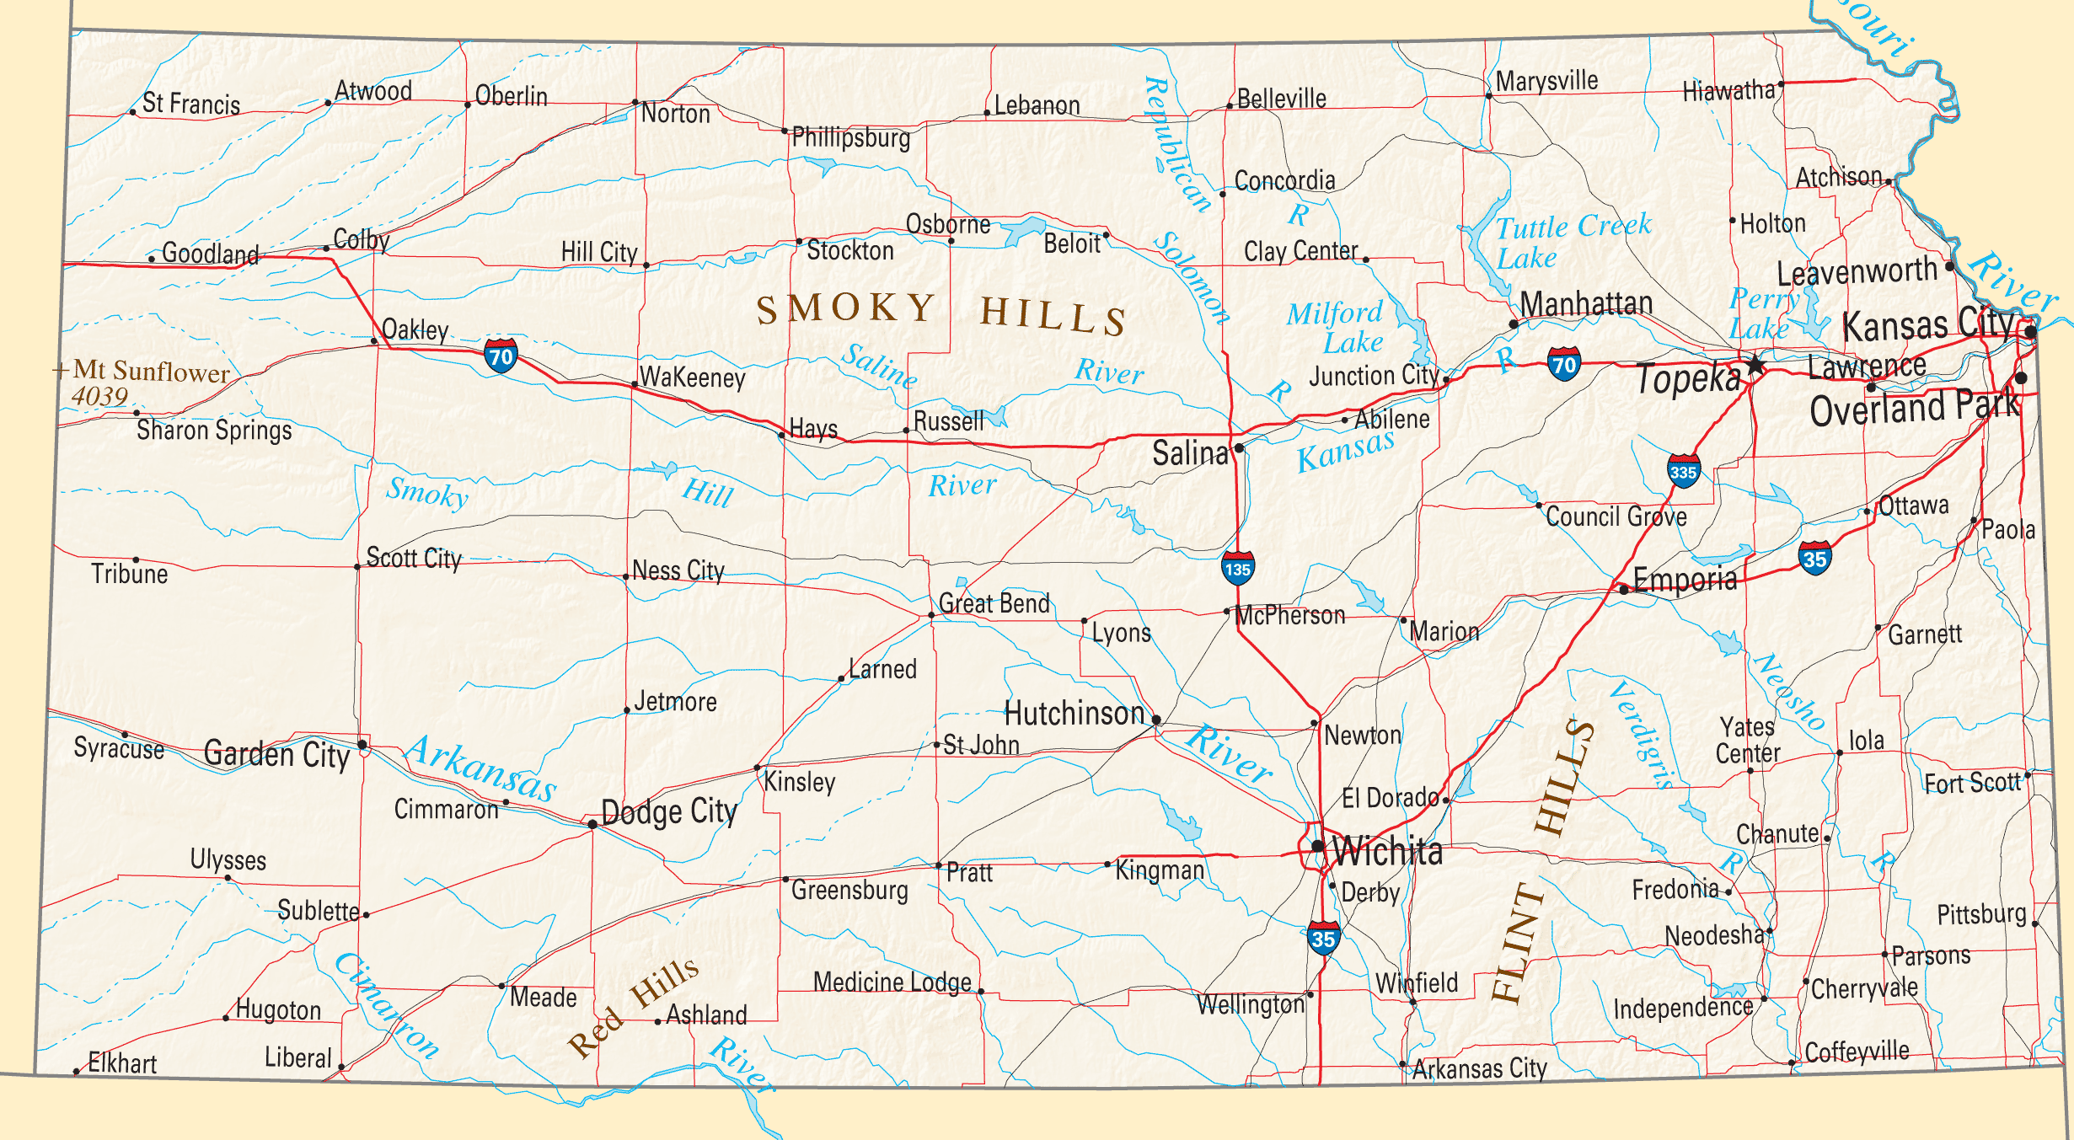
Three chapters of KMN in Kansas
Konza Prairie
Johnson County Extension
Dillon Nature Center

Slide 5
33 other states also have a Master Naturalist program, including:
Arizona
Arkansas
California
Colorado
Delaware
Florida
Georgia
Idaho
Illinois
Indiana
Iowa
Maryland
Michigan
Minnesota
Mississippi
Missouri
Montana
Nebraska
Nevada
New Jersey
New York
North Carolina
Ohio
Oklahoma
Oregon
Pennsylvania
South Carolina
Texas
Utah
Virginia
Washington
West Virginia
Wisconsin

Slide 6
Roles KMN may assume:
Collector of scientific data
Interpreter
Teacher
Advocate
Steward

Slide 7
What you get out of it:
Enhance your love of nature through hands-on training and community-based service.
Practice life-long learning and sharing with new people with similar interest.

Slide 8
Give something back to nature and your local community.
Learn more about local, regional, and state natural resources and conservation.
Learn from and work side-by-side with experts.

Slide 9
What KMN Training Entails:
Paying $100.00 enrollment fee
same for all KS participants
Attendance at weekly training sessions
January 23 – April 2
Donating 30 hours of volunteer service within 2 years of initial training

Slide 10
What you receive:
KMN notebook
40 hours of training from area experts
Guidance and direction on volunteering
Friendship and a sense of belonging

Slide 11
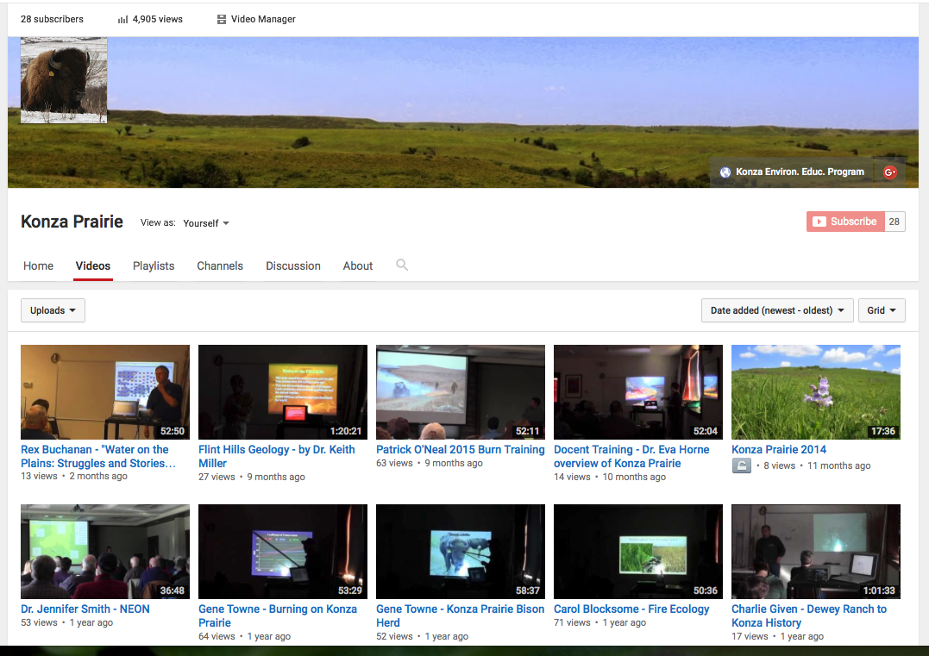
If you can’t attend some of the sessions…
I video-record the speakers and place their talks on the Konza Prairie Channel on YouTube.

Slide 12
Reporting your hours:
Call or email the Konza Environmental Education Program (KEEP) office.
Report the following:
Date of activity
Where the activity took place
Number of hours served
Number of people contacted

Slide 13
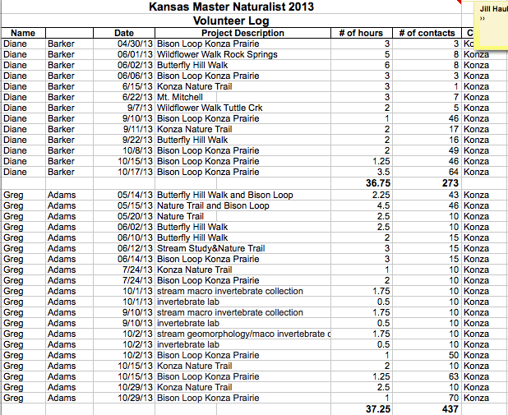
Log of your hours

Slide 14
Topics covered during KMN training:
Interpretation
Ornithology (study of birds)
Entomology (study of insects)
Ecology/Weather & Climate
Fire Ecology
Ichthyology (study of fishes)
Mammalogy (study of mammals)
Geology & Soils
Botany (study of plants)
Herpetology (study of reptiles and amphibians)

Slide 15
Training schedule
Your training will continue every Saturday morning from January 23rd – April 2nd.
You will then have time to garner your 30 hrs. of volunteer time over the spring, summer and early autumn.
KMN graduation with the presentation of name badges and certificates is scheduled for Friday, September 23rd @ 5:00 pm.

Slide 16

Konza Prairie Docent Training
Konza Prairie docents are trained on topics that vary from the KMN training
E.g.:
History of KPBS
Type of research done here
Management of bison
Learning hands-on science activities for children
How to lead a nature trail tour

Slide 17
Konza Prairie Docent Training
New docent training will occur over 2 weeks:
Tuesday, March 1st – Friday, March 4th
Tuesday, March 8th – Friday, March 11th
$40
New docents will then be prepared to assist with the spring educational events at Konza.

Slide 18
How KMN trainees can volunteer at Konza:
Trail maintenance days
Sunday, March 13th @ 1:00 pm
Sunday, October 16th @ 1:00 pm
Bush Honeysuckle (invasive plant) control
Earl Allen, contact

Slide 19
What’s next…
Fill out forms
Make payments
Receive notebooks
Review next weeks’ schedule
Tour headquarters if the weather allows

