Slide 1
Tallgrass Prairie Grasses

Slide 2
Grass Anatomy
Node
Internode
Sheath
Blade
Collar
Ligule (little tongue)
Auricle (little ear)
Spike/Inflorescence
Tiller
Rhizome
Stolon

Slide 3
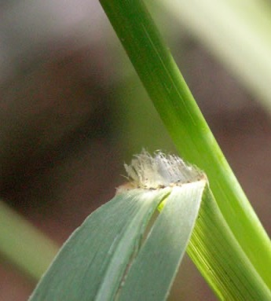
Ligules
Switchgrass ligule
Indiangrass ligule

Slide 5
Seed head type – inflorescence (cluster of flowers)
Spike – flowers & seeds directly attached to the stem. E.g. - Little bluestem
Raceme – flowers and seeds have a stalk that is then attached to the stem. E.g. - Prairie Junegrass
Panicle – flowers and seeds with many branches. E.g. - Switchgrass

Slide 6
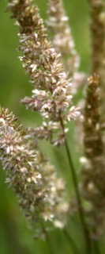
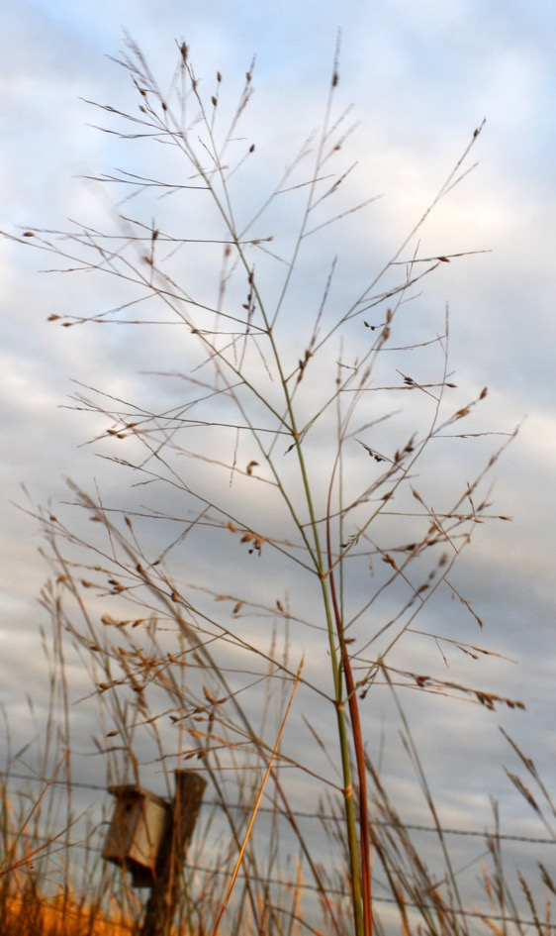
Spike
Raceme
Panicle

Slide 7
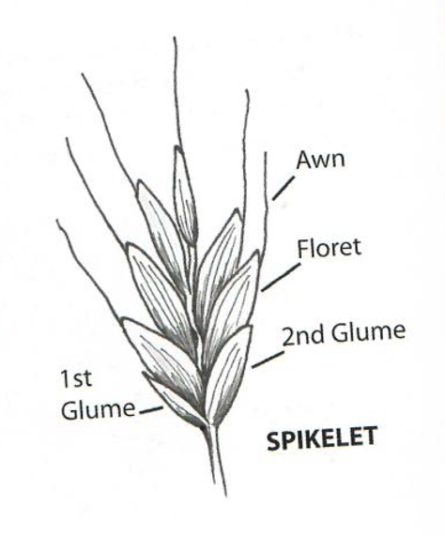
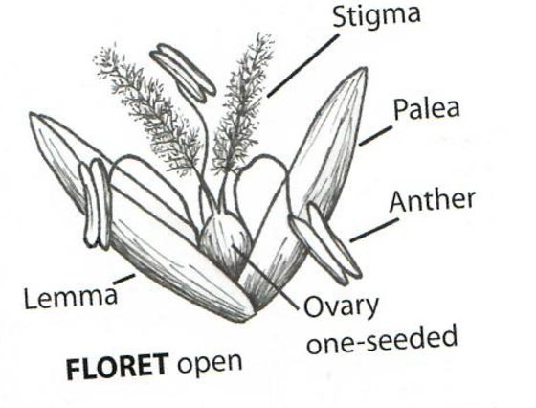
Spikelet
Bract
Glume
Awn
Floret
Stigma
Anther
Ovary

Slide 9
Annual, Biennial, Perennial lifecycles
Annual = germinates from seed, grows, flowers, produces and distributes seed – all in one growing season. Plants die at the end of the growing season, e.g. = white prickly poppy
Biennial = germinates and grows one year; flowers and produces fruits and seeds the second year. Plants die after the 2nd year, e.g. = flannel mullein
Perennial = re-grows from active roots each year and typically produces new flowers and seeds annually. Plants live for many years, e.g. = most prairie plants

Slide 10
Cool season grasses – C3 grasses
= grasses that begin growing in the early spring when temperatures are cool. They will flower and set seed in May and June. These grasses will be green in the spring and golden by August.
E.g.: Smooth brome Scribner’s Panicum
Junegrass Western wheatgrass
Little barley
Downy brome
Canada wildrye

Slide 11
Warm season grasses – C4 grasses
= grasses that begin growing the late spring when soil temperatures reach 60-65 degrees F. They will be green in July and August and begin turning golden in September.
E.g.: Big bluestem Buffalograss Yellow foxtail
Little bluestem Blue grama Caucasian bluestem
Golden Feather Hairy grama Stinkgrass
Switch grass Prairie cordgrass Goosegrass
Indiangrass Purple lovegrass Purpletop

Slide 12
Big 5 tall grasses
Big bluestem
Little bluestem
Golden Feather Grass
Switchgrass
Sideoats grama

Slide 14
1. Big bluestem
Andropogon gerardii
Tallest of the tallgrasses – gets up to 9 ft. tall
Reaches its maximum height in September
Native
Warm season
Purplish-red in the autumn
“W” – ”turkey foot” seedhead

Slide 15
Big bluestem

Slide 16
2. Little bluestem
Schizachyrium scoparium
Grows up to 4 ft. tall
Warm season grass
Blooms in August
Bunch grass
State grass of KS
Seed heads look like curly eyelashes

Slide 17
Little bluestem

Slide 18
Little bluestem

Slide 20
3. Golden Feather Grass
Sorghastrum nutans
Grows up to 7 ft. tall
Seedhead looks like a golden feather
Warm season
Blooms Aug. – Oct.
Previously known as “Indiangrass”

Slide 21
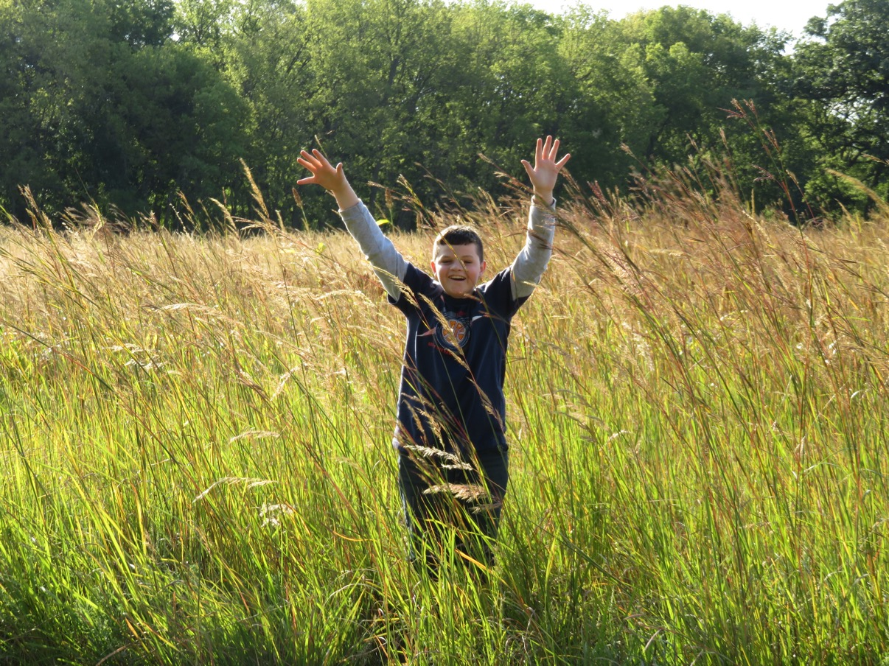
Golden Feather Grass

Slide 22
Golden Feather Grass

Slide 23
Golden Feather Grass

Slide 24
4. Switchgrass
Panicum virgatum
Grows up to 7 ft. tall
Warm season grass
Large, airy seed head

Slide 25
Switchgrass

Slide 26
Switchgrass

Slide 27
5. Sideoats grama
Bouteloua curtipendula
Grows up to 3 ft. tall
Warm season grass
Blooms in the summer
Found in all kinds of prairie
Seed on one side of the stem = sideoats

Slide 28
Sideoats grama

Slide 29
Miscellaneous other grasses…

Slide 30
Eastern Gamagrass

Slide 31
Eastern Gamagrass

Slide 32
Eastern Gamagrass -male flowers

Slide 33
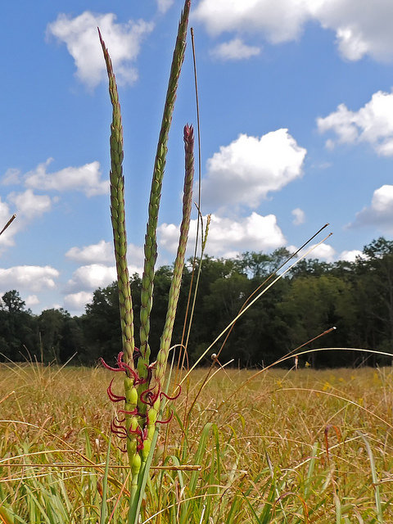
Eastern Gamagrass -female flowers

Slide 34
Smooth Brome

Slide 35
Smooth brome
The “M” on the blade is distinctive
NOTE: it might look like a “W” if the blade is upside down

Slide 36
Smooth brome

Slide 37
Junegrass

Slide 38
Junegrass

Slide 39
Junegrass

Slide 40
Downy brome

Slide 41
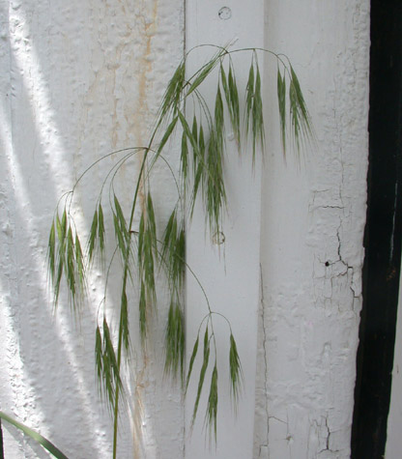
Downy brome

Slide 42
Buffalograss

Slide 43
Hairy grama

Slide 44
Hairy grama
“Hair” sticking out from the top of the seedhead is distinctive for Hairy Grama

Slide 45
Hairy grama

Slide 46
Yellow foxtail – Yellow Bristle-grass

Slide 47
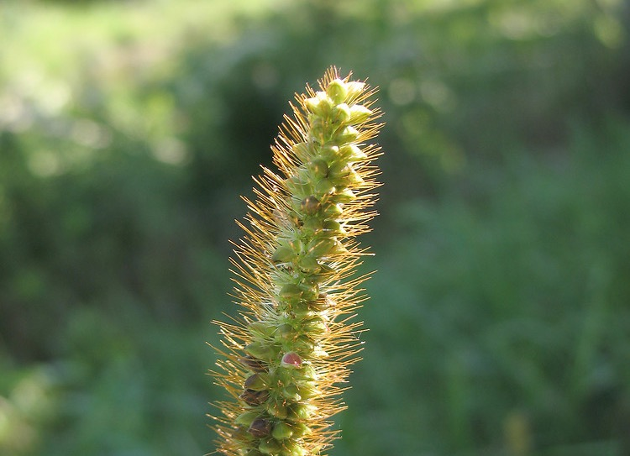
Yellow foxtail

Slide 48
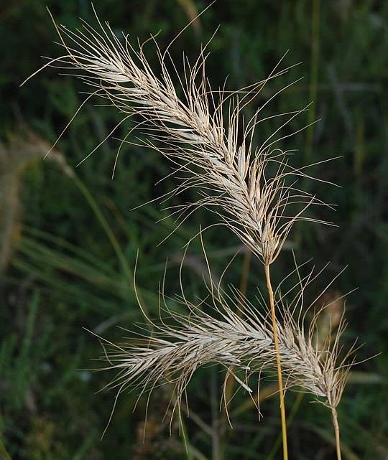
Canada wild rye

Slide 49
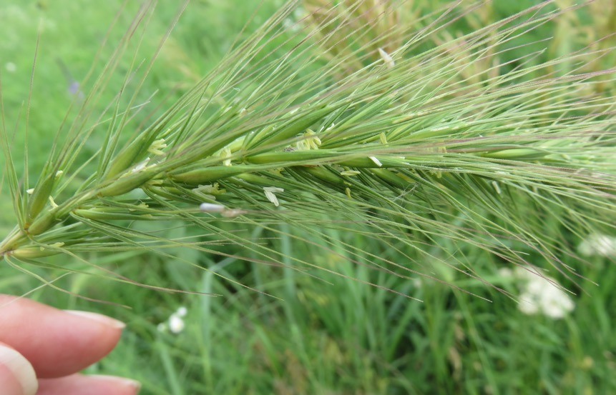
Canada wild rye

Slide 50
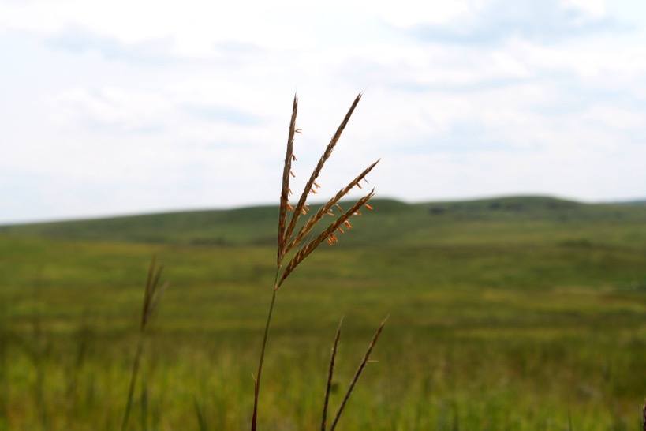
Quiz
1.

Slide 51
Quiz
2.

Slide 52
Quiz
3.

Slide 53
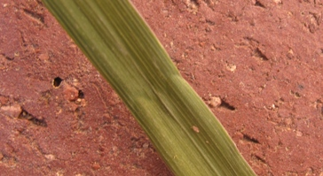
Quiz
4.

Slide 54
Quiz
5.

Slide 55
Quiz
6.

Slide 56
Quiz
7.

Slide 57
Quiz
8.

Slide 58
Quiz
9.

Slide 59
Quiz
10.

Slide 60
Quiz
11.

Slide 61
Quiz
12.

Slide 62
Answers:
1. Big Bluestem
2. Eastern Gamagrass
3. Yellow Foxtail (aka - Yellow Bristlegrass)
4. Smooth Brome
5. Switchgrass
6. Side-oats Grama
Buffalograss
8. Downy Brome
9. Canada Wild Rye
Hairy Grama
Little Bluestem
Golden Feather Grass (aka – Indiangrass)
Author: Jill Haukos, Konza Environmental Education Program

