Slide 1
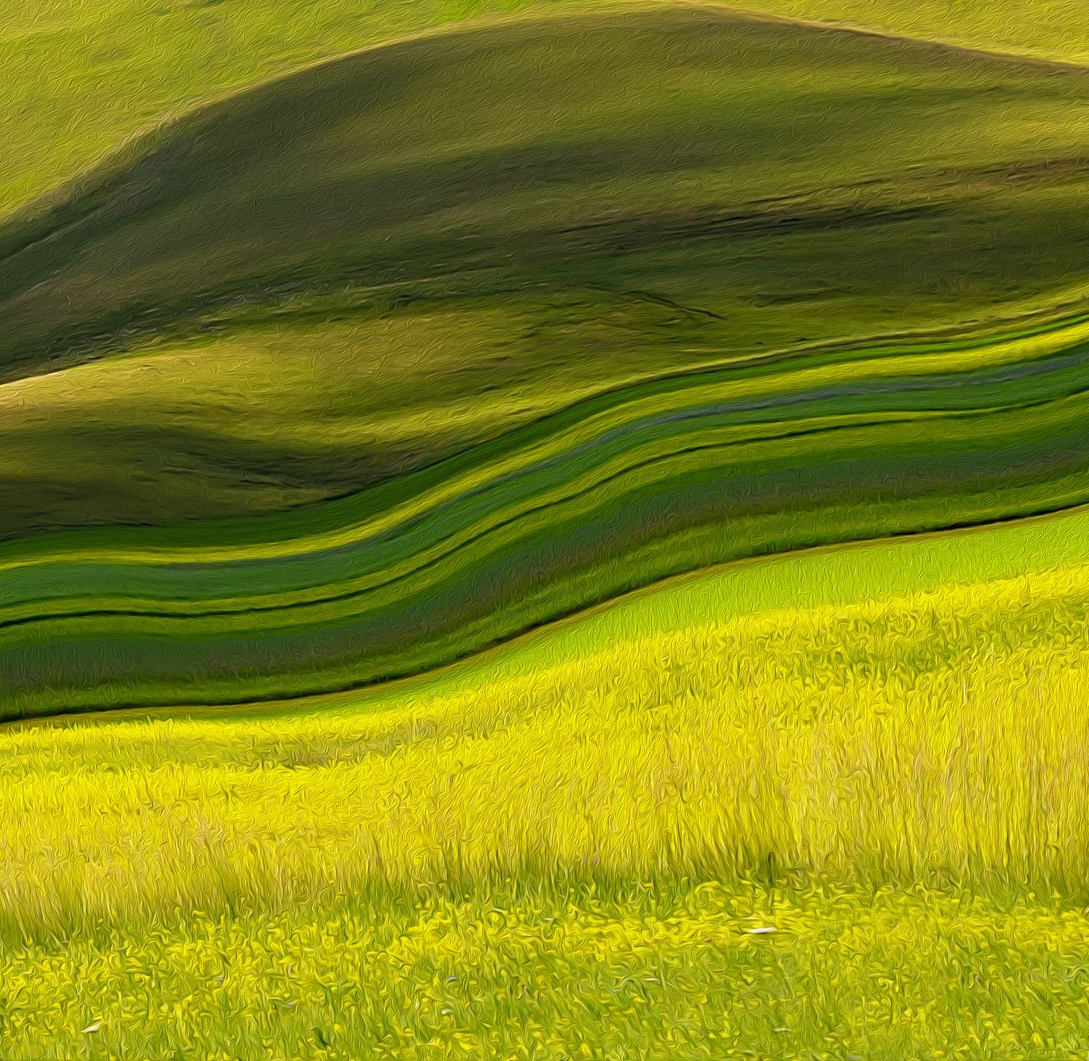
The Prairie
An introduction

Slide 2
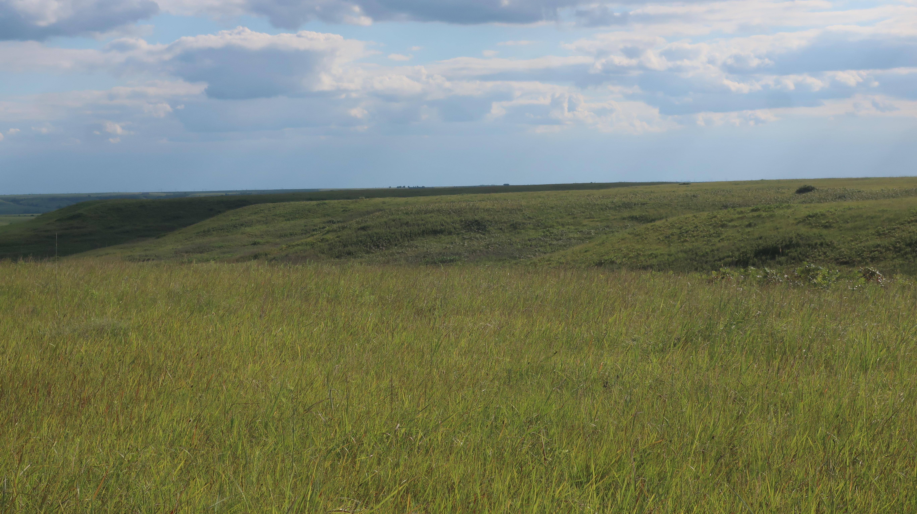
Prairies are part of the Grassland biome
Grasslands are found in the central parts of most of the continents (except Antarctica)
Grasslands are dominated by GRASSES!
Notes:
Other types of plants are also found in prairies – especially wildflowers, also known as “forbs”. We’ll discuss more about the components of the prairie later.

Slide 3
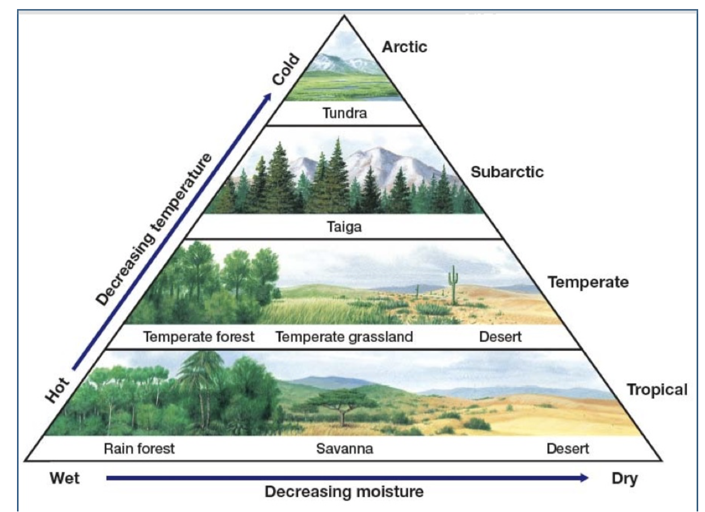
What’s a biome?
= a broad region of land that is home for specific plants and animals
Other biomes:
Temperate forest
Coniferous forest
Desert
Tundra
Notes:
The climate of an area determines the plants that can survive there. The kinds of plants present in an area determines the kinds of animals that may be found in an area. All of life present in an area will be present or absent based on the climate of that area.

Slide 4
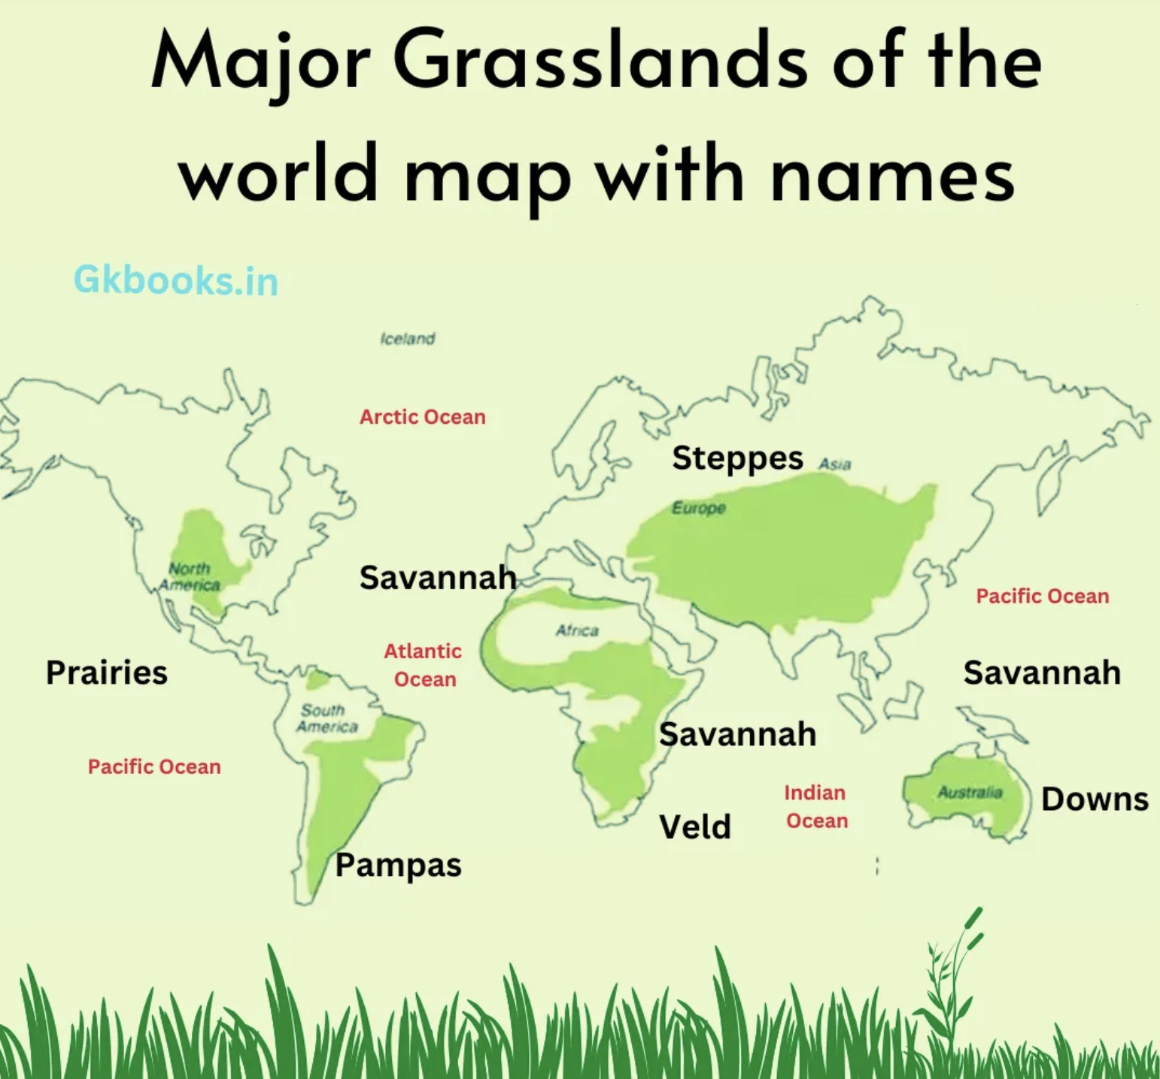
There are different kinds of grasslands – on different continents
Grasslands are usually found in the MIDDLE of the continent – away from oceans and seas.
Notes:
Pampas = South America: extensive treeless grassland in South America
Savannah = Africa: A savanna or savannah is a mixed woodland-grassland ecosystem characterized by the trees being sufficiently widely spaced so that the canopy does not close. The open canopy allows sufficient light to reach the ground to support an unbroken herbaceous layer consisting primarily of grasses.
Steppes = Europe and Asia = broad open grassland between the polar and tropical areas. It has few trees and some shrubs.
Veld = southern Africa = open grassland with few trees
Downs = Australia = mostly humid and substropical grassland

Slide 5
Climate in grasslands…
Grasslands are far away from oceans and seas
Large bodies of water help to moderate a nearby climate, making winters and summers milder
The further away you get from those large bodies of water, the more severe the weather gets

Slide 6
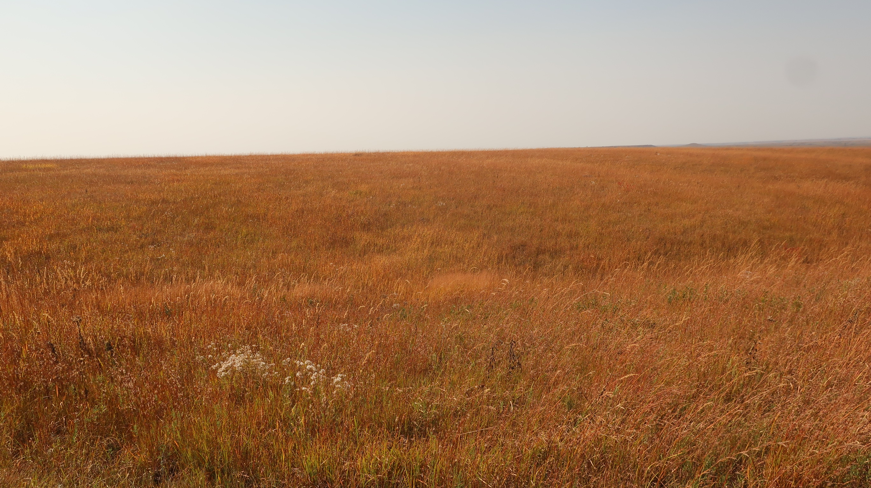
Grasses – why do they do well in tough climates?
They are specialists at surviving in areas that get hot in the summer and cold in the winter.
They also are very good at surviving times of very low rainfall…drought
Notes:
This photo was taken at Konza Prairie Biological Station, Manhattan KS – October 2022. Copyright Jill Haukos

Slide 7
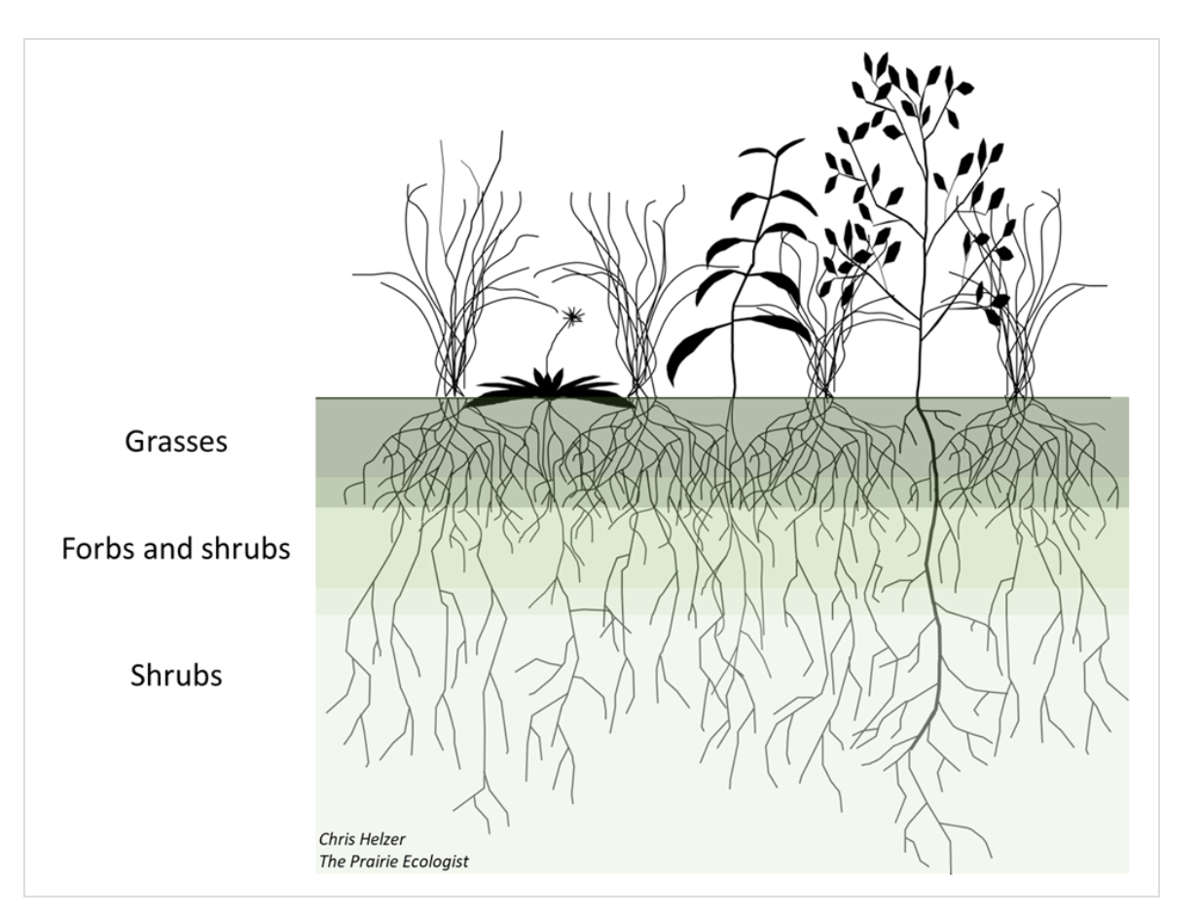
The secret to the survival of grasses…
Their roots!!
The thin, fibrous roots of grasses are concentrated in the first 1’ of soil.
Notes:
Grasses have “fibrous roots” – characterized by many small branching roots capable of rapidly absorbing water in the first 1’ of soil.
Forbs have “taproots” (like a carrot) – characterized by a central large root(s) that reach down to tap into underground stored water.

Slide 8
Grass roots act like sponges, sucking up water super fast when it rains.
Notes:
Photo copyright Jim Richardson

Slide 9
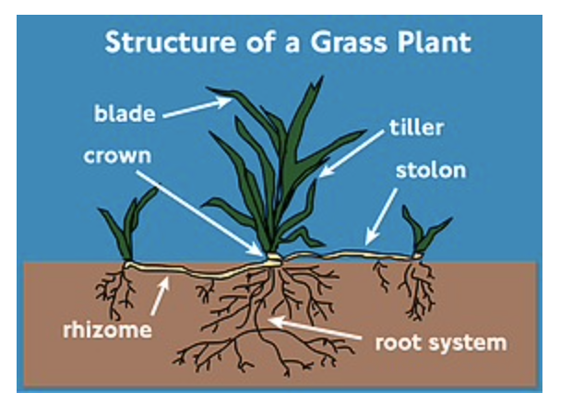
Grasses can live through tough times…
They have underground structures – called rhizomes – that store food and water.
Because of their rhizomes, grasses can survive droughts that last years.
Notes:
Rhizome = underground storage stem. It is a modified stem because it has “nodes” - areas of tissue capable of producing both leaves and roots. For example, a potato is a modified storage stem, with each “eye” being a node, capable of producing both leaf buds and roots.

Slide 10
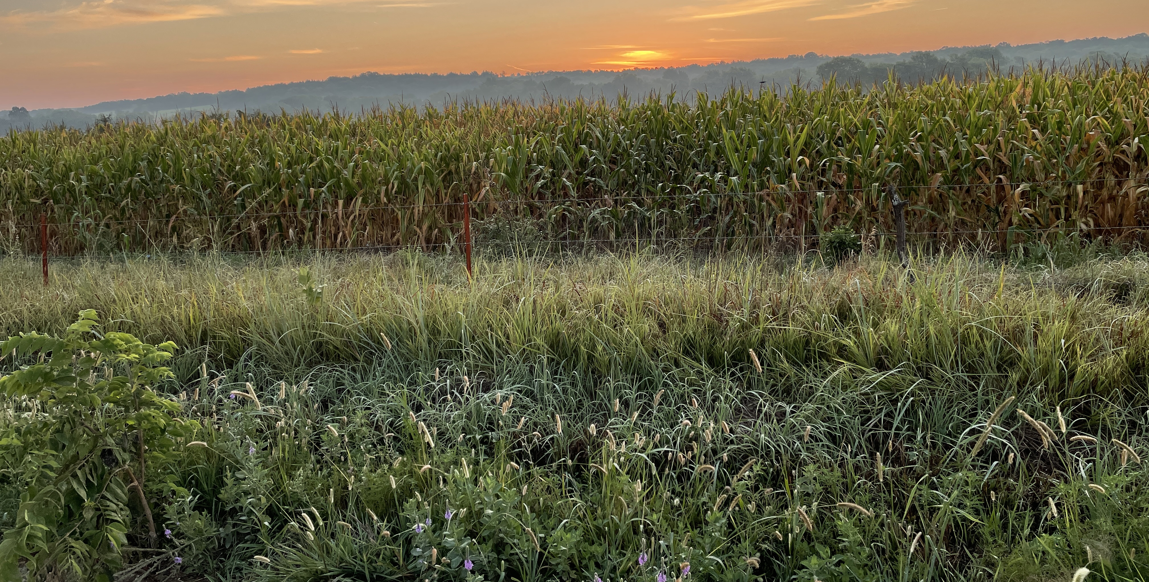
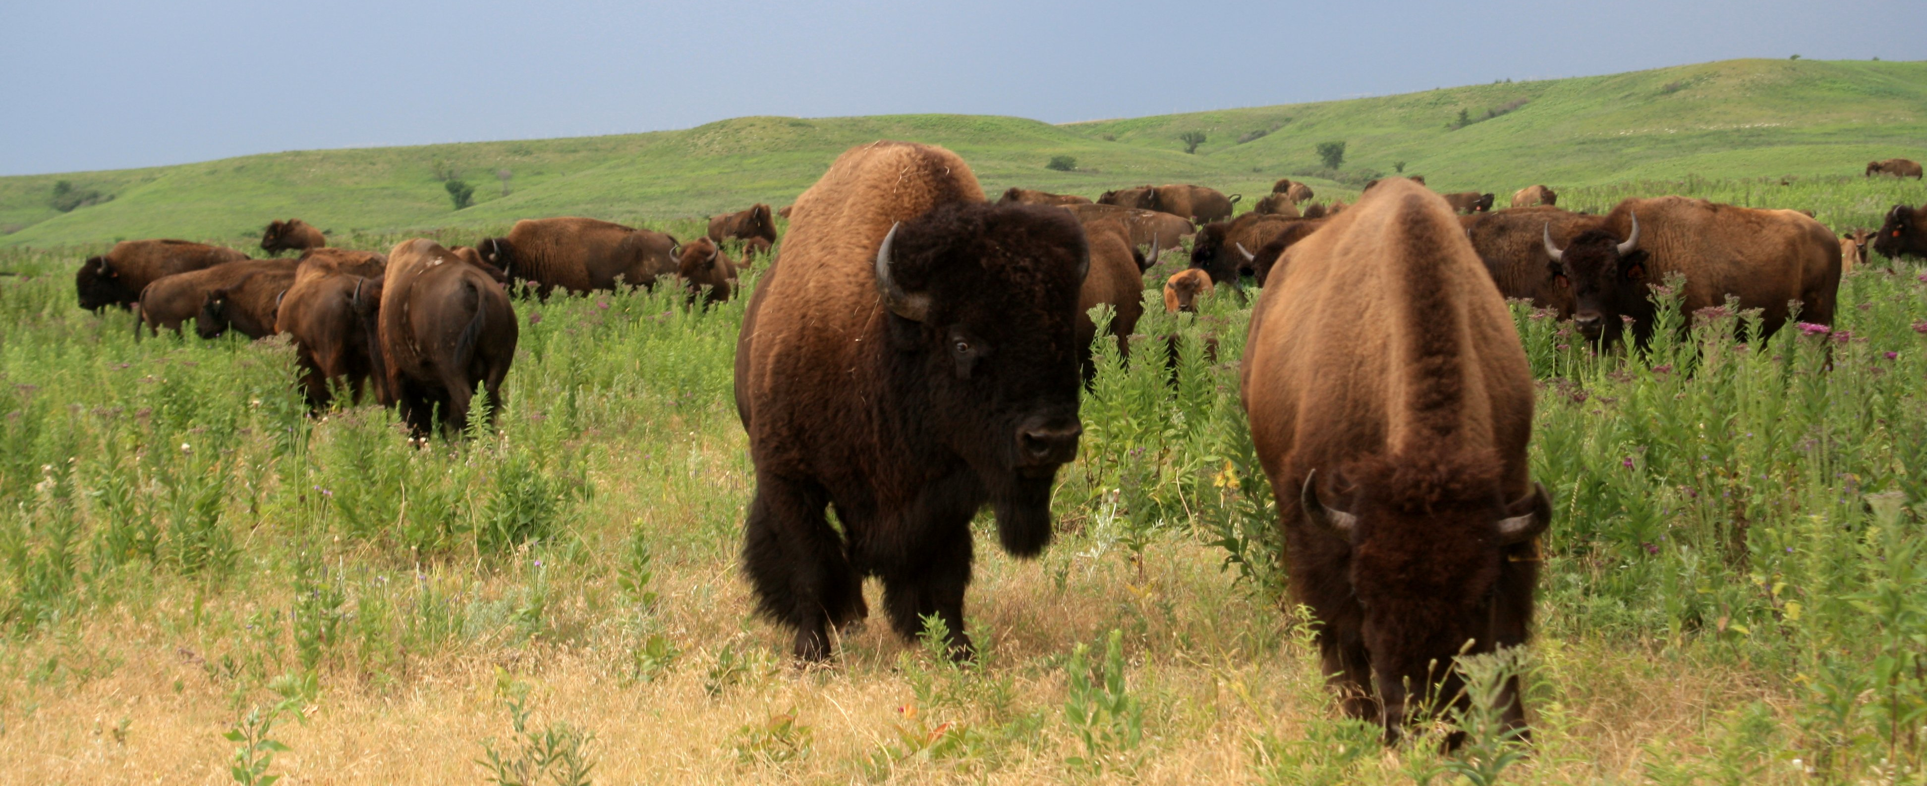
The grassland biome is important to the world’s ecology and to human survival.
This is where most of the world’s agriculture occurs.
Where many large populations of grazing animals may be found – including bison and cattle.
Now, let’s focus on the prairies of North America…

Slide 11
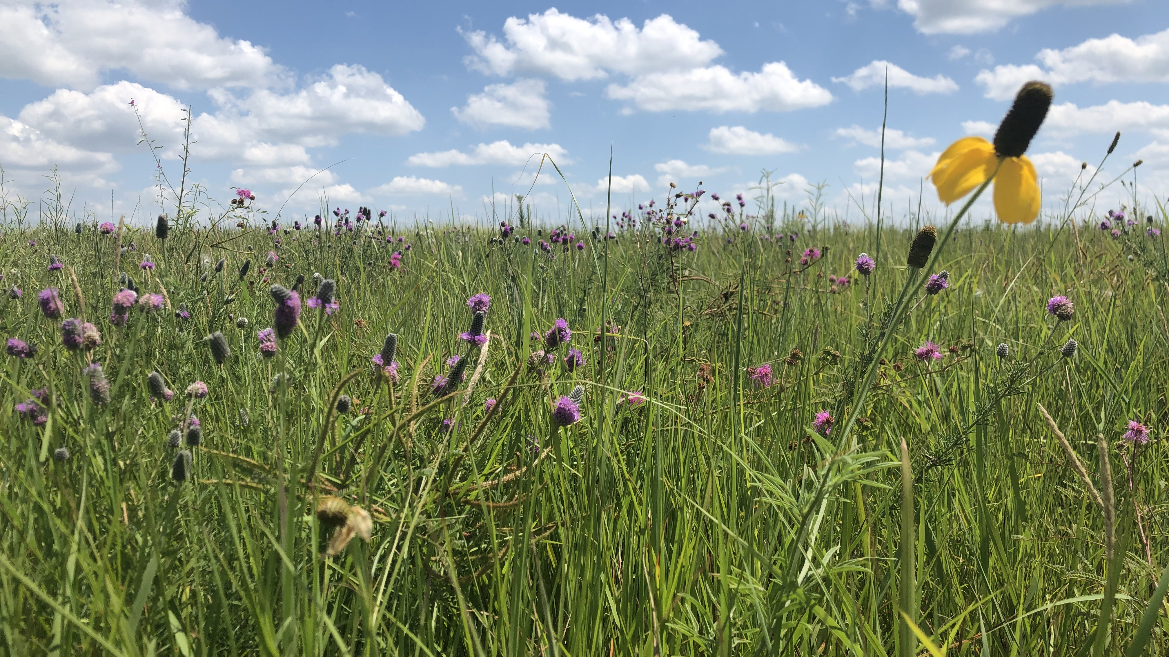
Prairie
Is a French word meaning “meadow”
Is only located on North America
Notes:
“Prairies” are only in North America, but all of the continents (except Antarctica) have grasslands.

Slide 12
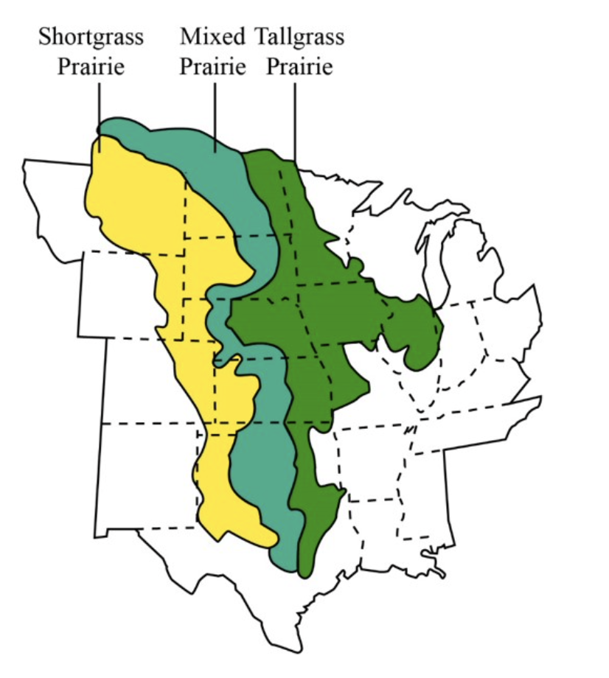
There are 3 types of prairies in North America
Short-grass prairie – yellow area
Mixed-grass prairie – blue-green area
Tallgrass prairie – green area

Slide 13
There is ONE big difference between the 3 different kinds of prairies in North America.
What do you think that difference might be?
ANSWER:
The amount of rainfall!
The western-most prairie (shortgrass) gets the least amount of rain and the eastern-most prairie (tallgrass) gets the most rain.
Simply…the more rain a prairie gets, the taller the grass will grow

Slide 14
But…
Prairies still get less rain than most forests.
AND – the rainfall in a prairie is not predictable.
Trees need lots of water and they need the rain to come at predictable times, like in the spring and summer. That doesn’t always happen in a prairie.

Slide 15
What you should see in a prairie…

Slide 16
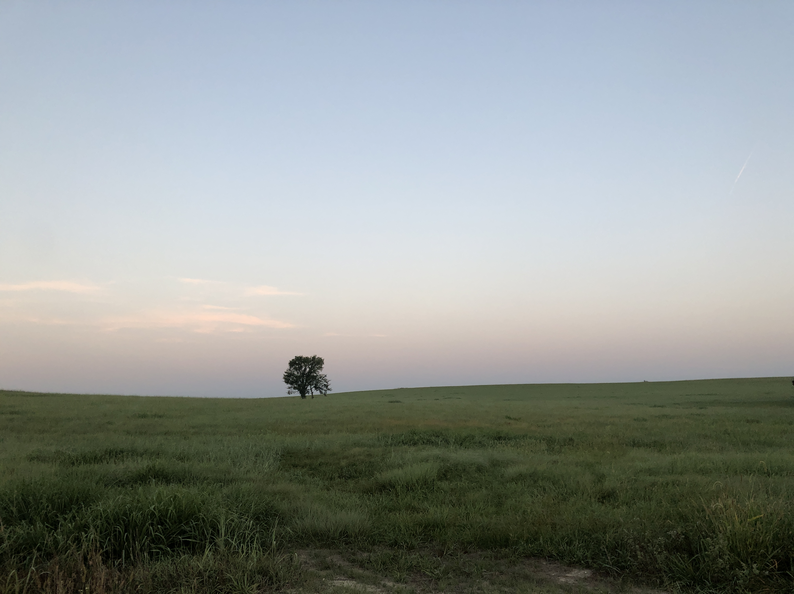
You will see lots of grasses and wildflowers (also known as “forbs”) here
You won’t see many trees – except where there’s a good supply of water (e.g. along a creek)
Trees need LOTS of water and most prairies don’t have much water
Notes:
Photo from Pottawatomie County, Kansas. Copyright Jill Haukos

Slide 17
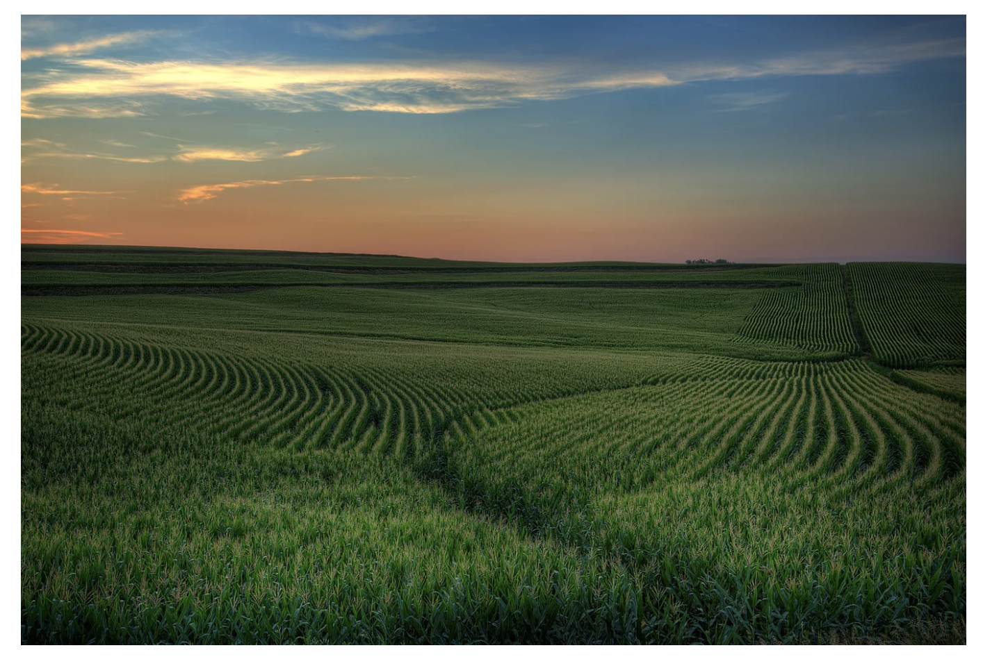
Because prairies can
be flat
have deep, nutritious soil
they became a great place for agricultural crops.
Corn & wheat = large grasses.
Corn kernel and wheat grain = seeds from those grasses.

Slide 18
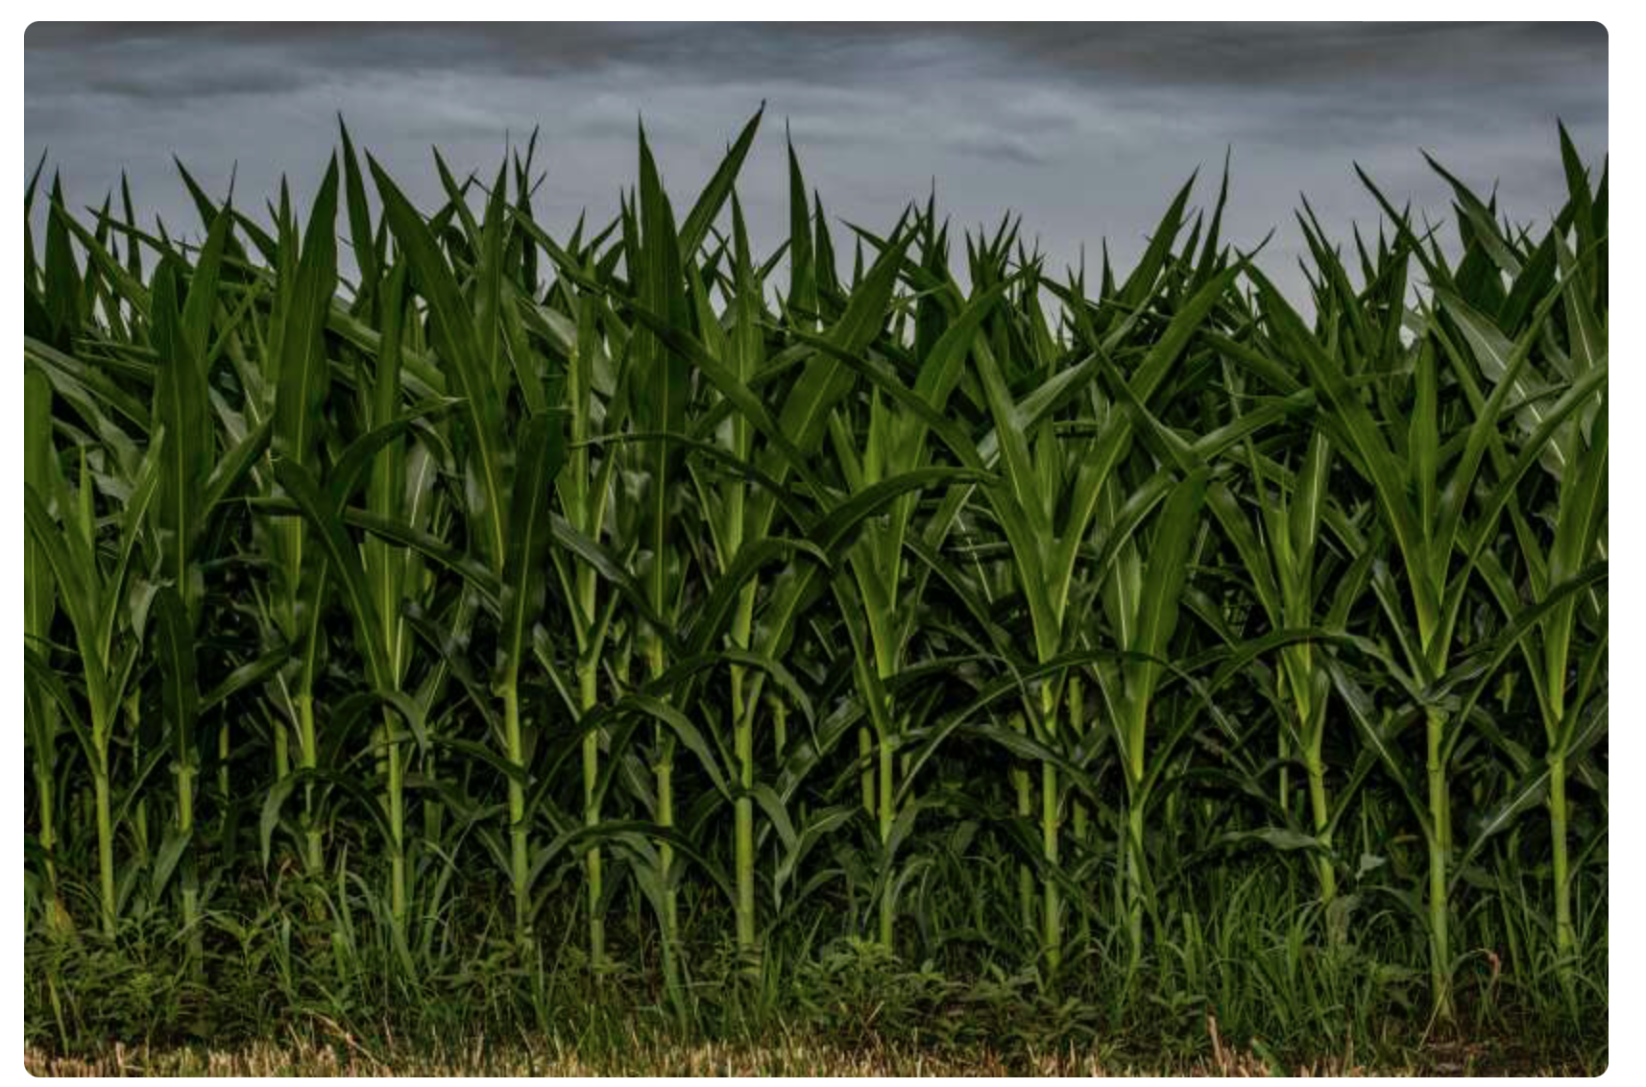
Because prairies are great places for field/row crops, much of the original tallgrass prairie is gone…
The tallgrass prairie especially, gets enough predictable rain to support crops.
Where the soil is rich and deep, the prairie has been plowed, and thus, lost.
Notes:
Over 96% of the original tallgrass prairie is gone – plowed into agricultural fields or paved for roads and houses. It is the most imperiled ecosystem on the planet.

Slide 19
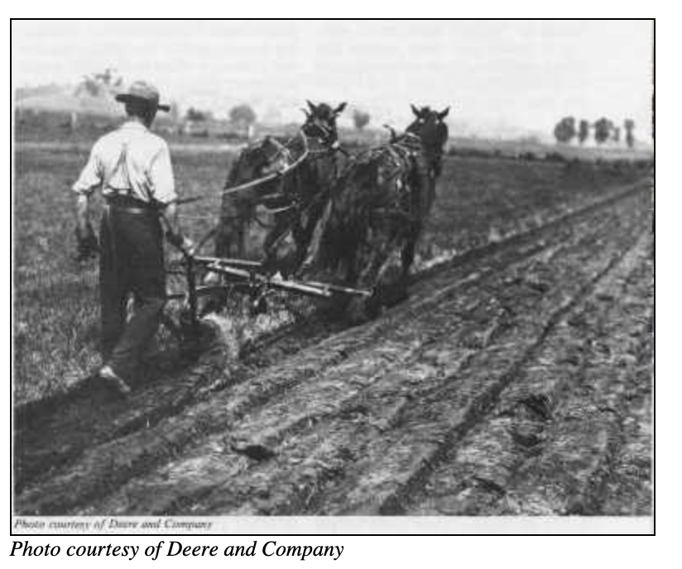
Throughout this material keep in mind that the heart of the prairie is underground, with approximately 75-80% of the body of the prairie plants located below the soil.
If the sod is plowed, then the prairie is gone.

Slide 20
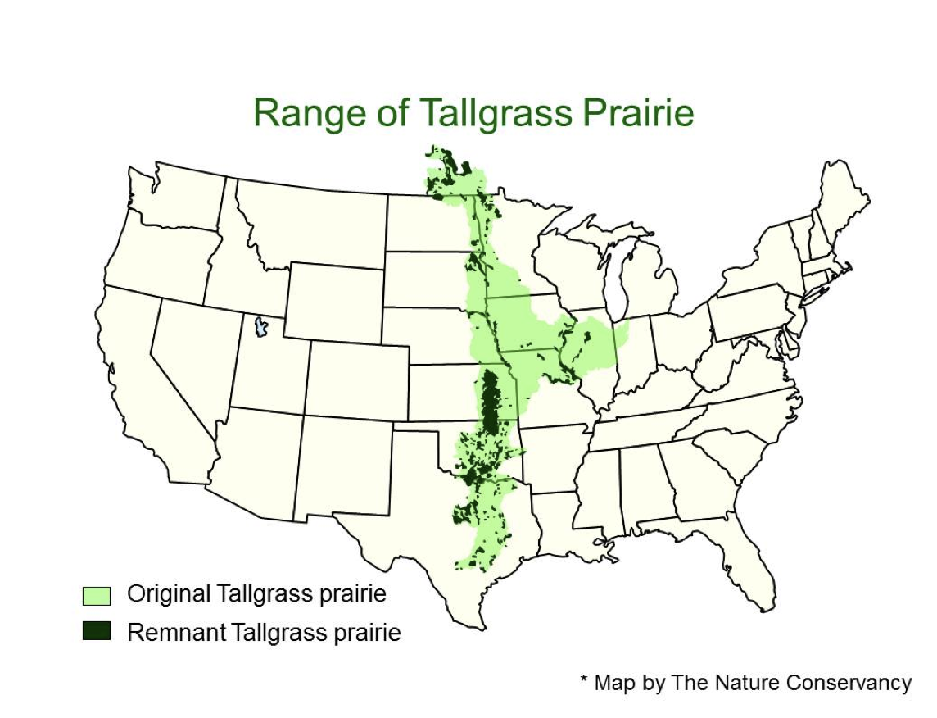
Most of the original tallgrass prairie is gone…
We’re going to learn about the prairie that is left.
What affects its growth.
The connection between the prairie and the grazers who feed on it – including bison.
Where you can go to see some of the remaining tallgrass prairie.

Slide 21
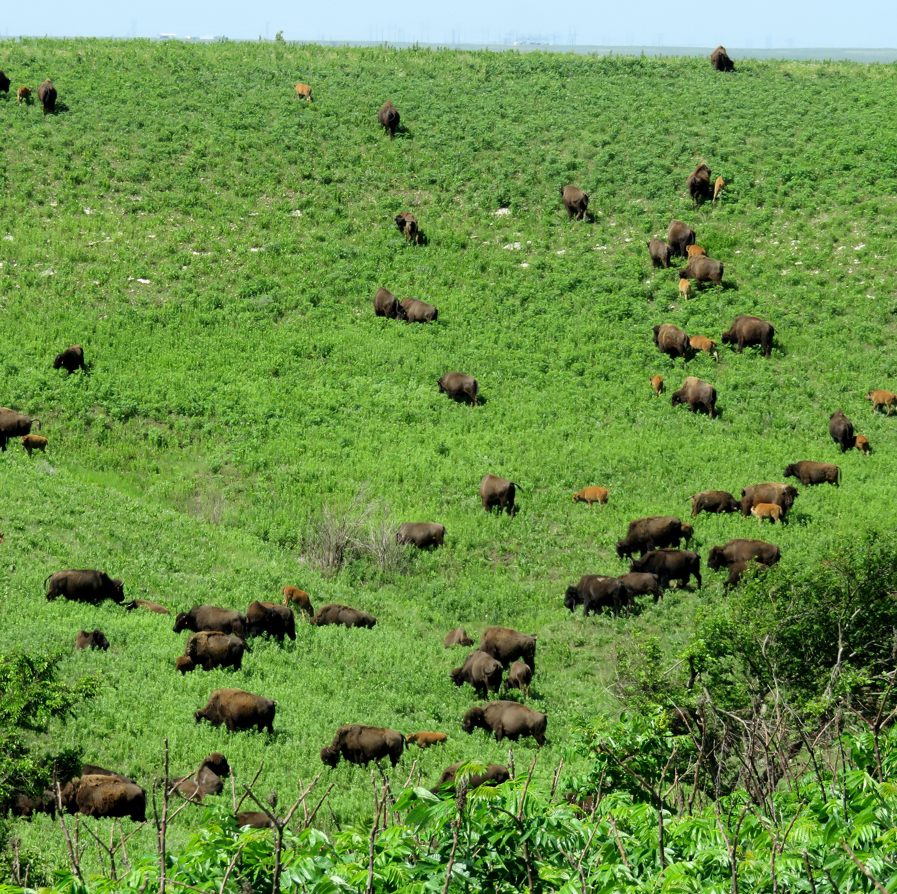
Throughout the week we’ll explore prairie ecology through the data collected on the prairie from the Konza Prairie Biological Station, outside of Manhattan Kansas.
Come join us for the discovery!
Notes:
Photo of the bison herd at the Konza Prairie Biological Station, Manhattan, KS. Photo copyright Jill Haukos

Slide 22
Author:
Jill Haukos
Konza Environmental Education Program
Konza Prairie Biological Station
Manhattan, KS
© 2023

