Slide 1
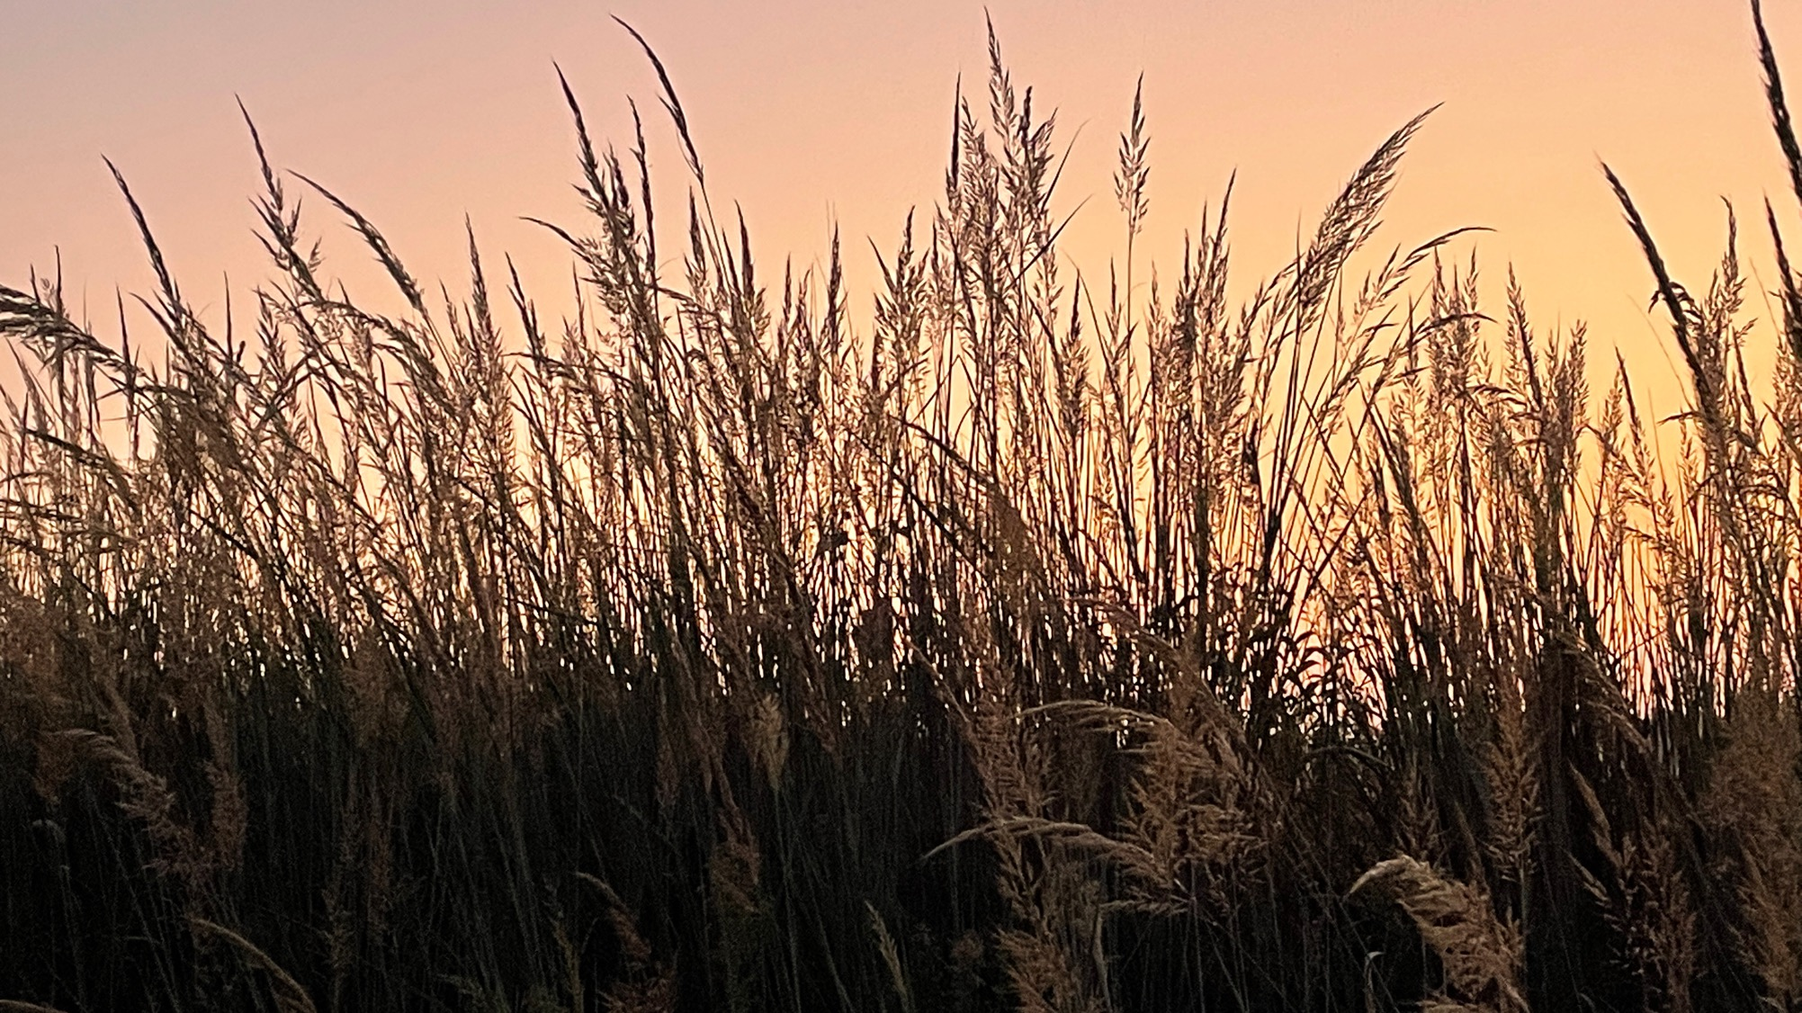

Tallgrass Prairie Grasses

Slide 2
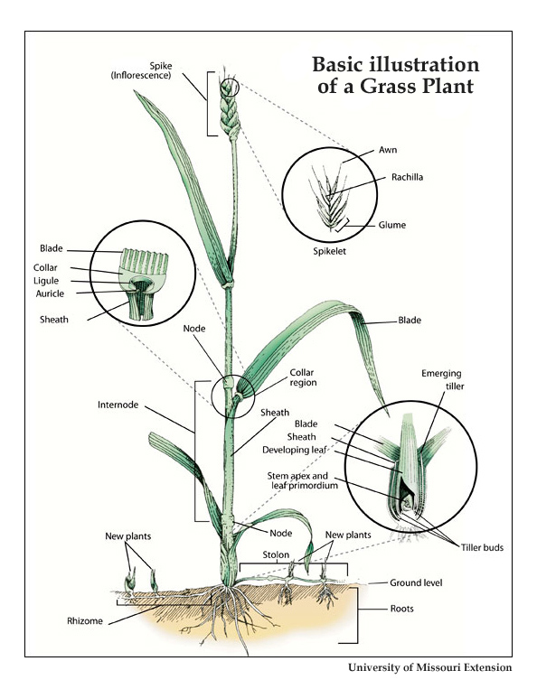
Grass Anatomy
Node
Internode
Sheath
Blade
Collar
  Ligule (little tongue)
  Auricle (little ear)
Spike/Inflorescence
Tiller
Rhizome
Stolon

Slide 3
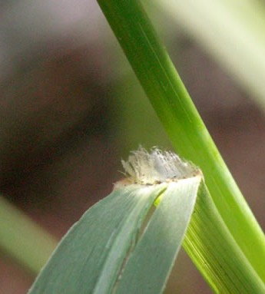
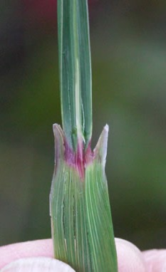
Collar types
Switchgrass ligule
Indiangrass auricles

Slide 4
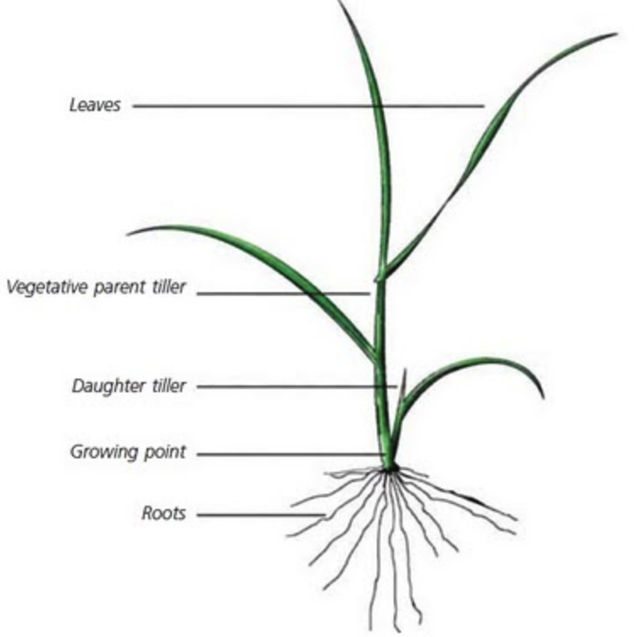

Slide 5
Seed head type – inflorescence (cluster of flowers)
Spike – flowers & seeds directly attached to the stem. E.g. - Little bluestem
Raceme – flowers and seeds have a stalk that is then attached to the stem. E.g. - Prairie Junegrass
Panicle – flowers and seeds with many branches. E.g. - Switchgrass

Slide 6
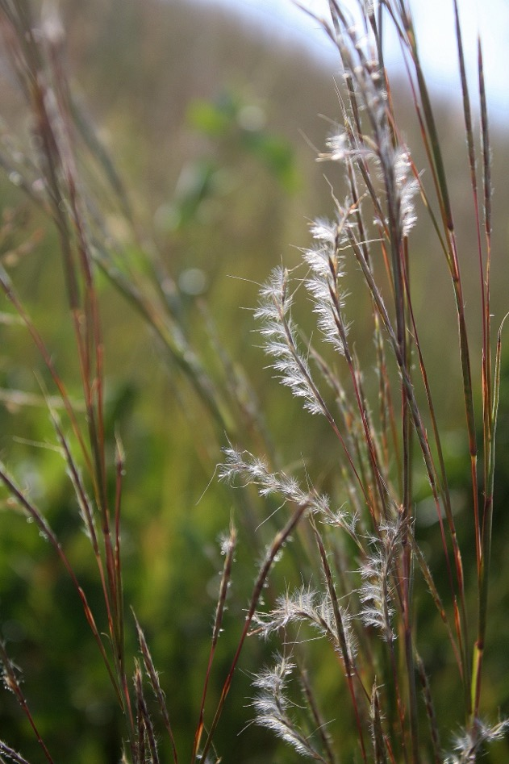
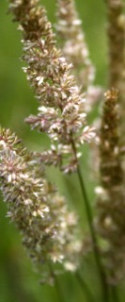
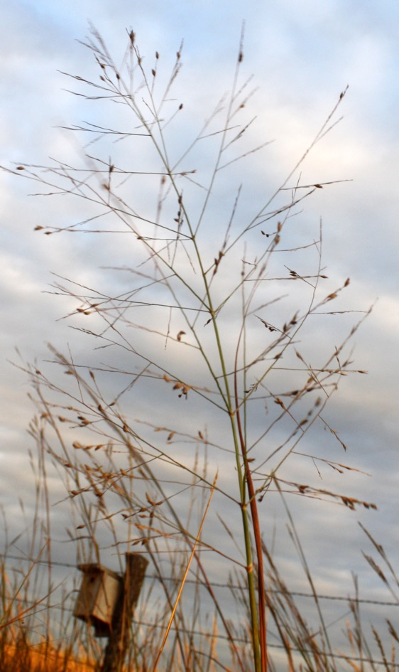
Spike
Raceme
Panicle

Slide 7
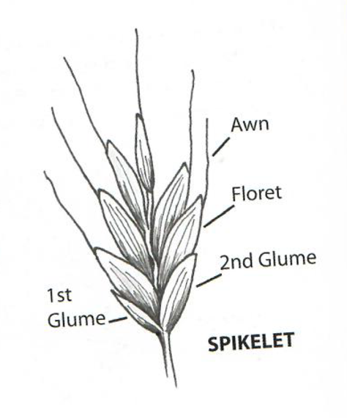
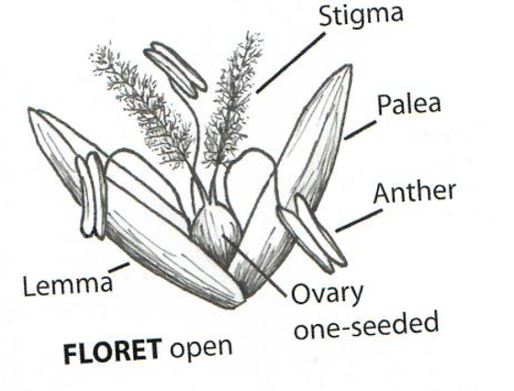
Spikelet
  Bract
    Glume
    Awn
  Floret
    Stigma
    Anther
    Ovary

Slide 8
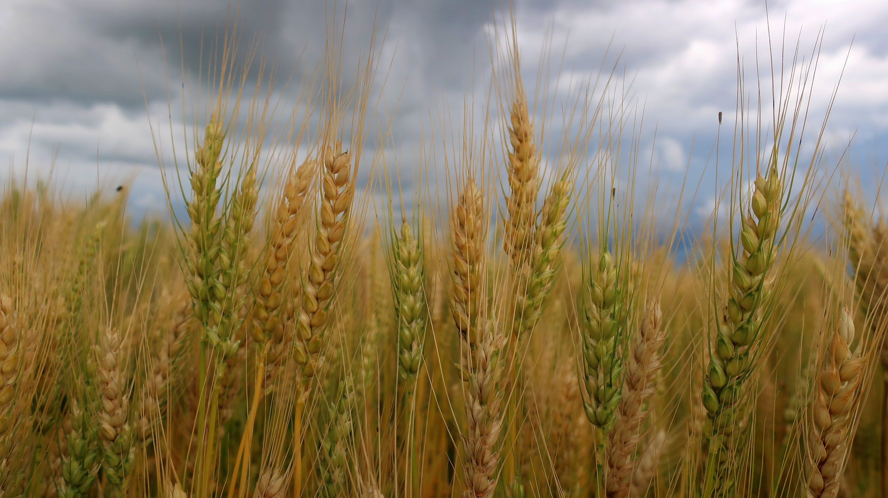

Slide 9
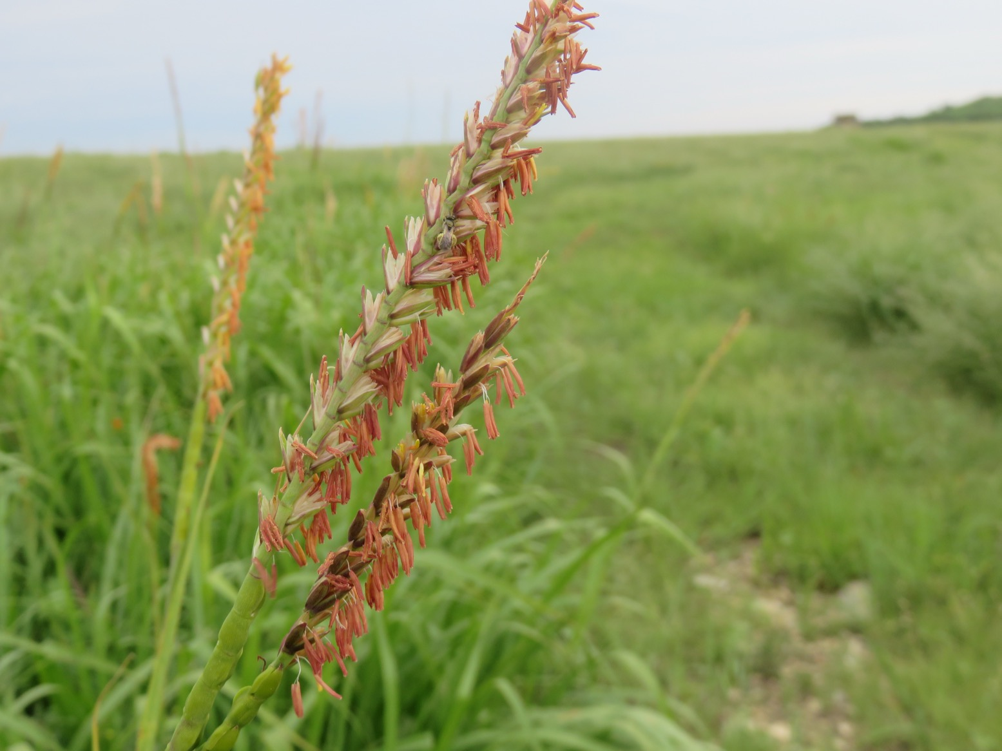

Slide 10
Annual, Biennial, Perennial lifecycles
Annual = germinates from seed, grows, flowers, produces and distributes seed – all in one growing season. Plants die at the end of the growing season, e.g. = white prickly poppy
Biennial = germinates and grows one year; flowers and produces fruits and seeds the second year. Plants die after the 2nd year, e.g. = flannel mullein
Perennial = re-grows from active roots each year and typically produces new flowers and seeds annually. Plants live for many years, e.g. = most prairie plants

Slide 11
Cool season grasses – C3 grasses
These grasses are on average:
  Grow first in early spring – finishing their lifecycles in June and early July.
  Higher in protein than the C4 grasses. Protein is found in new, green leaves of grasses (chlorophyll).
  Responsible for the rapid weight gain in grazing animals in the spring. High protein provides ingredients for muscle production in cattle and bison.
  Have less structural carbohydrates (cellulose) than C4 grasses and are highly digestible.
  Not as able to tolerate the heat and dry conditions of later summer and, thus senesce in June and July.

Slide 12
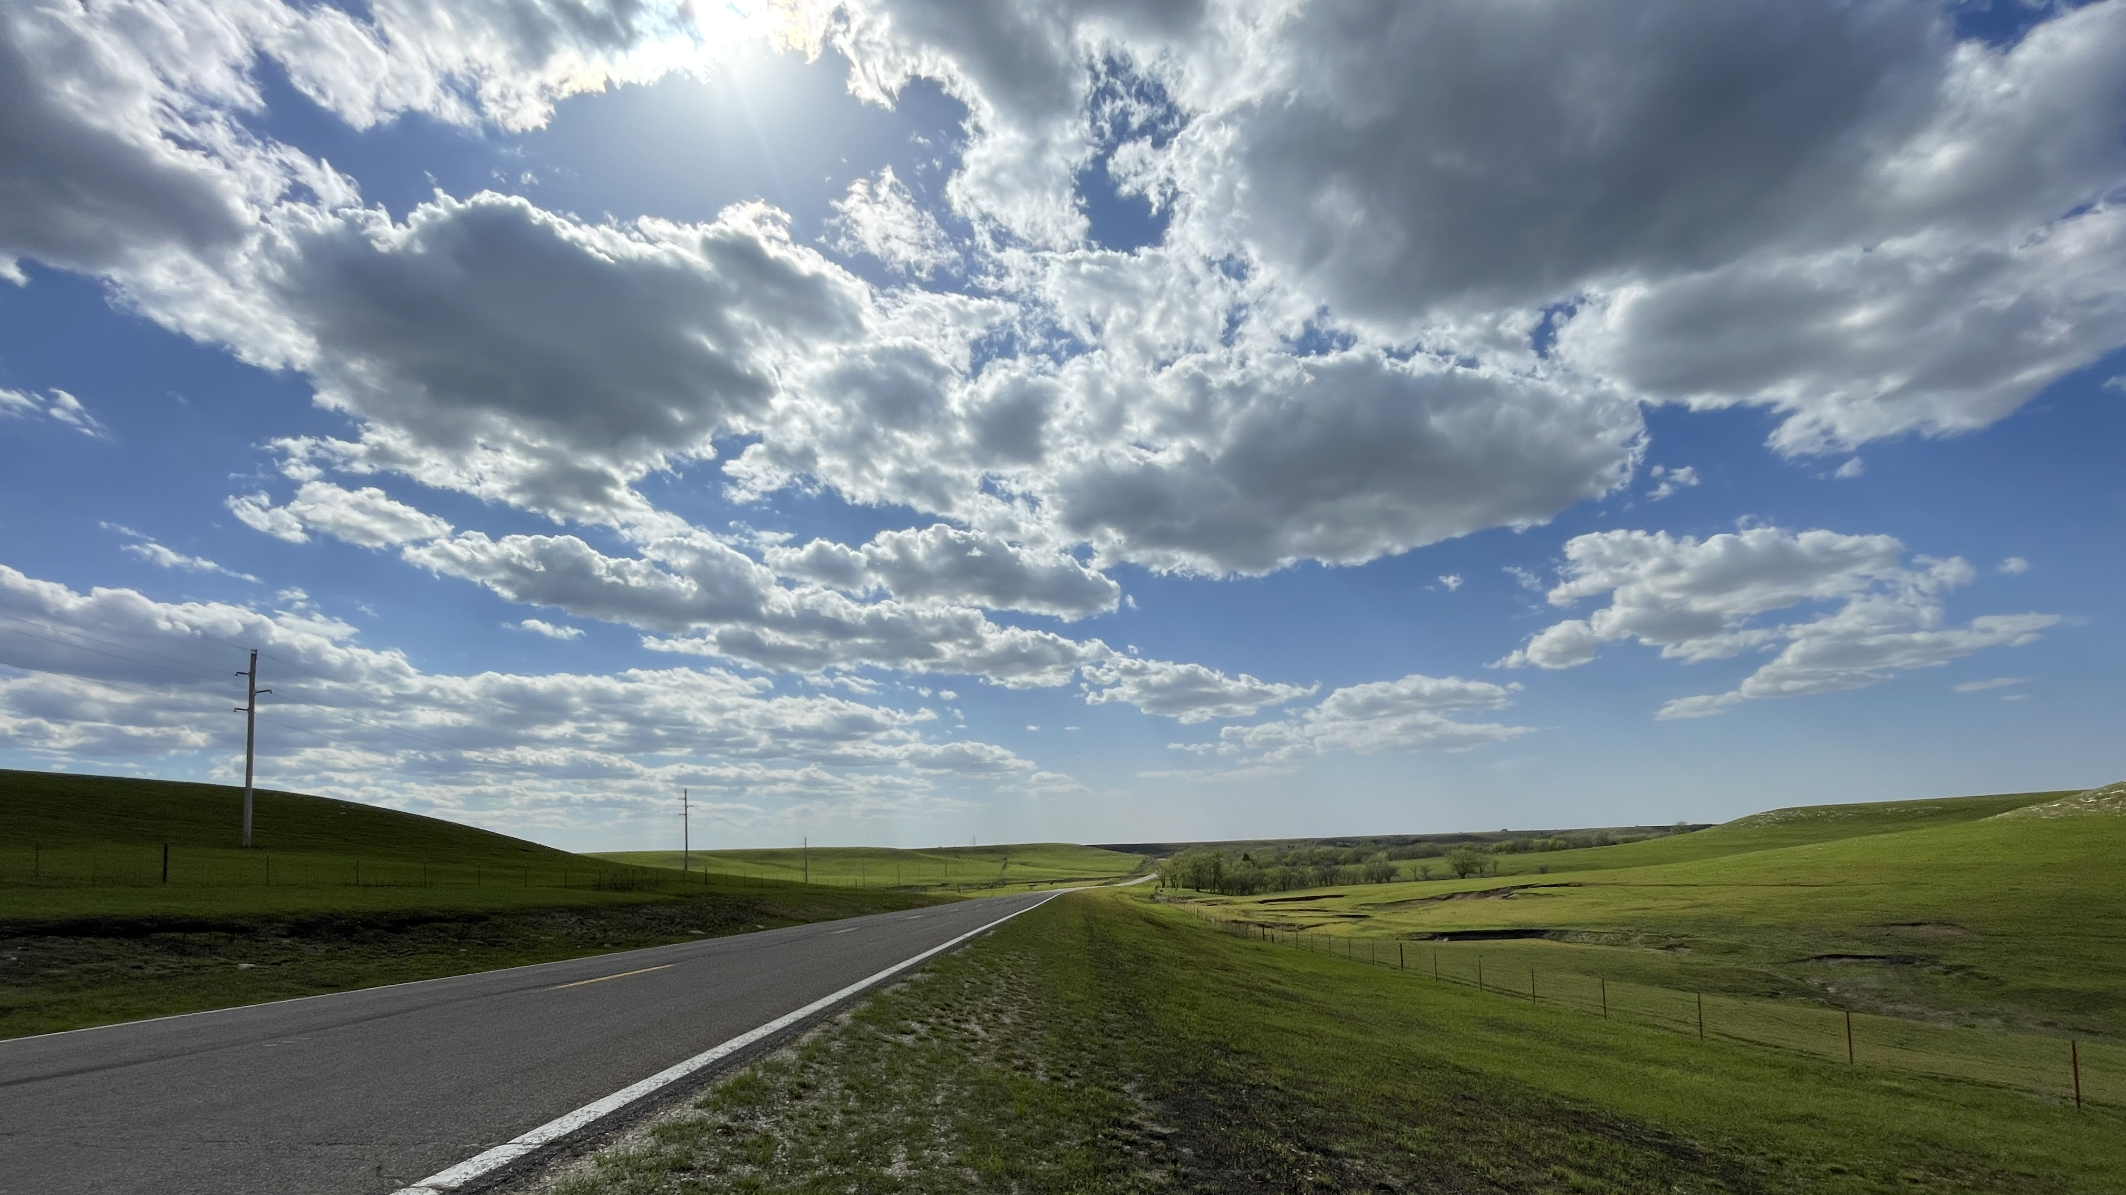

Slide 13
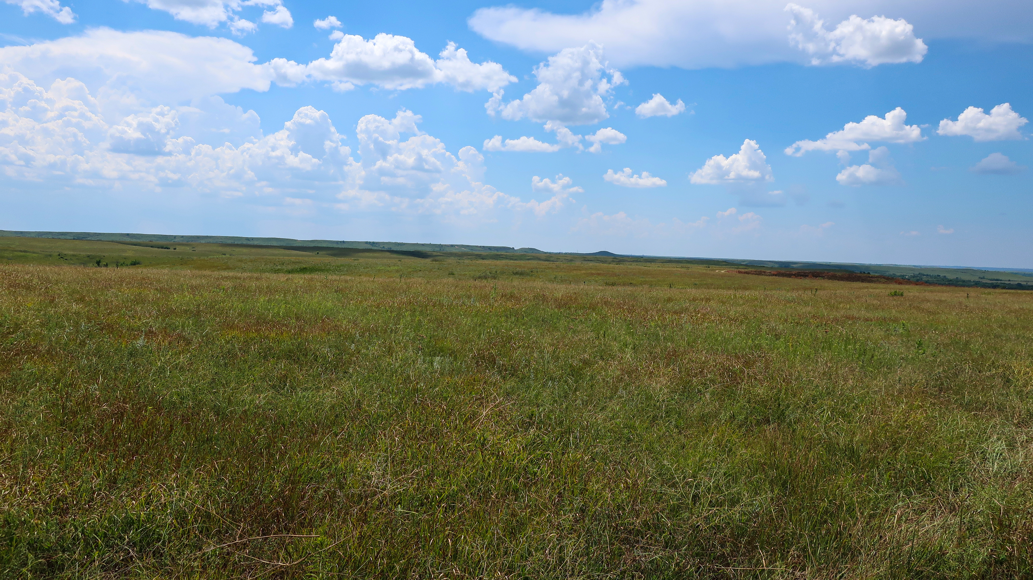

Slide 14
Cool season grasses – C3 grasses
= grasses that begin growing in the early spring when temperatures are cool. They will flower and set seed in May and June. These grasses will be green in the spring and golden (senesced) by August.
E.g.: Smooth brome Scribner’s Panicum
Junegrass Western wheatgrass
Little barley
Downy brome
Canada wildrye

Slide 15
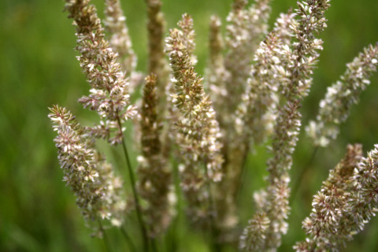
Junegrass

Slide 16
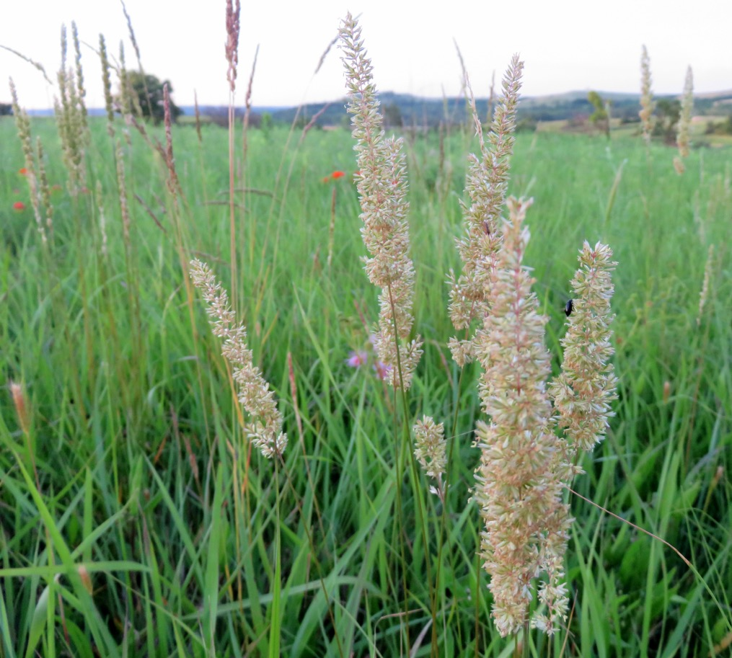
Junegrass

Slide 17
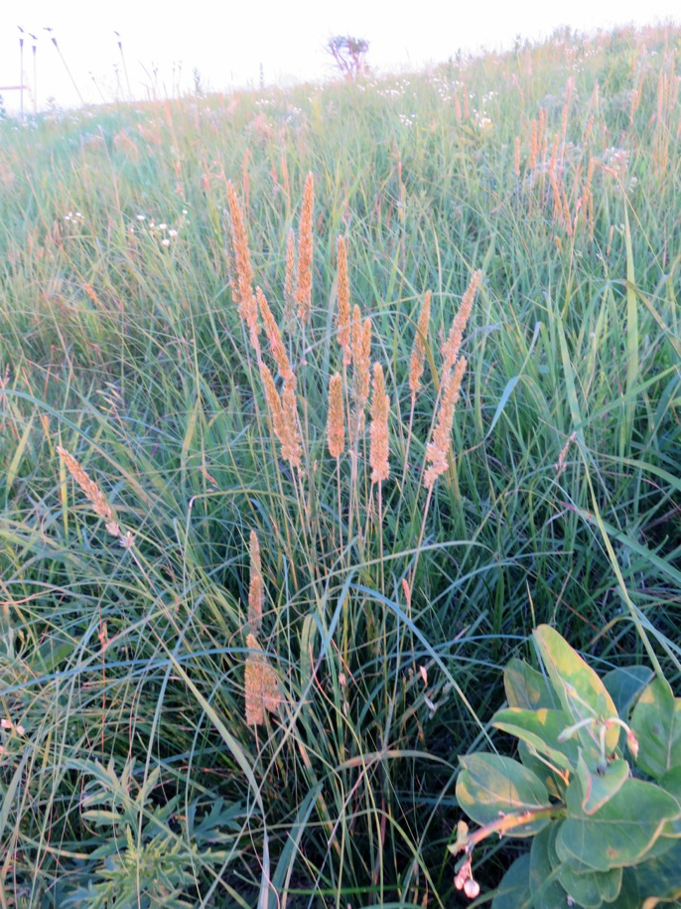
Junegrass

Slide 18
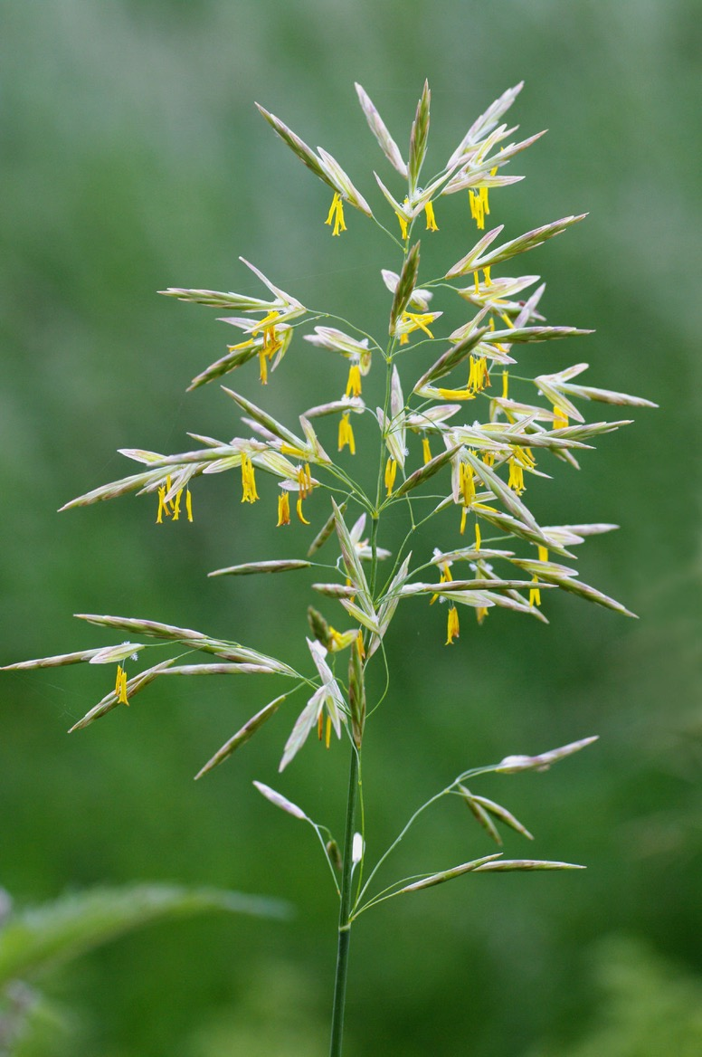
Smooth brome

Slide 19
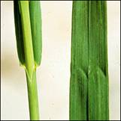
Smooth brome
The “M” on the blade is distinctive
NOTE: it might look like a “W” if the blade is upside down

Slide 20
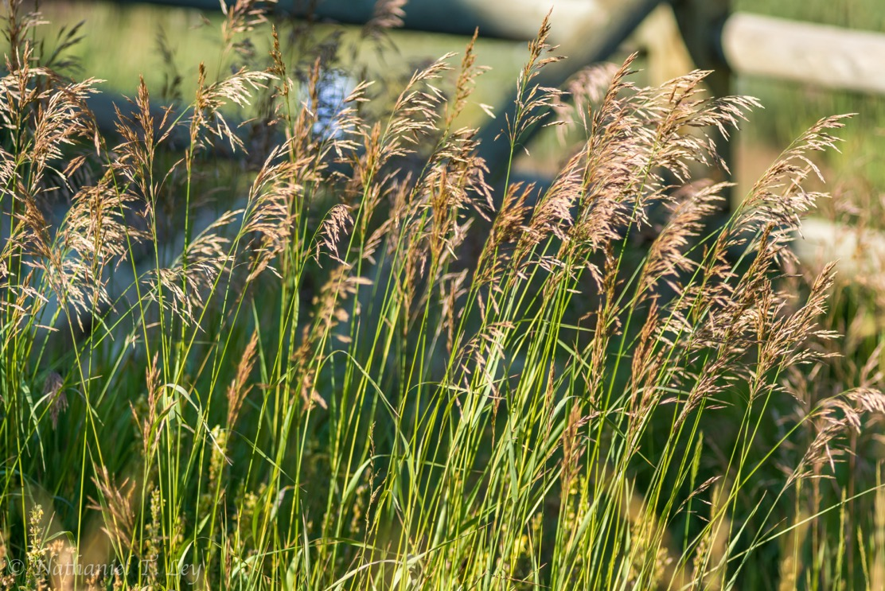
Smooth Brome

Slide 21
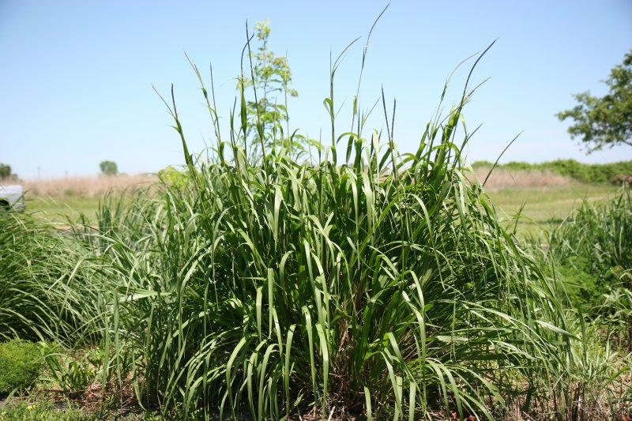
Eastern Gamagrass

Slide 22
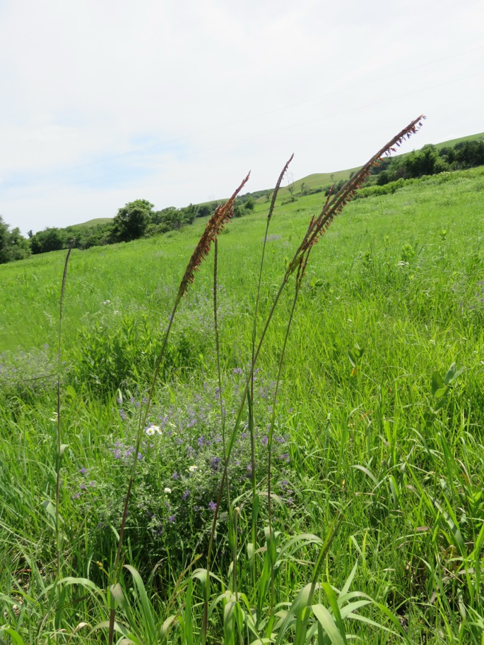
Eastern Gamagrass

Slide 23
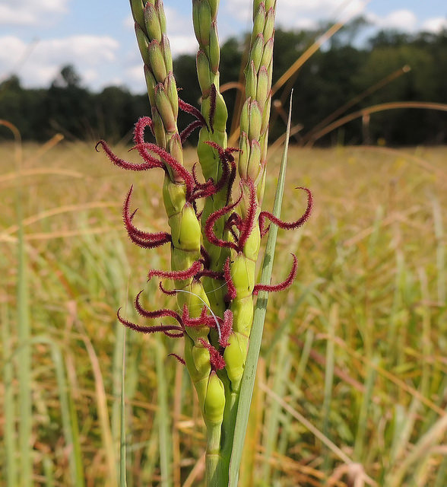
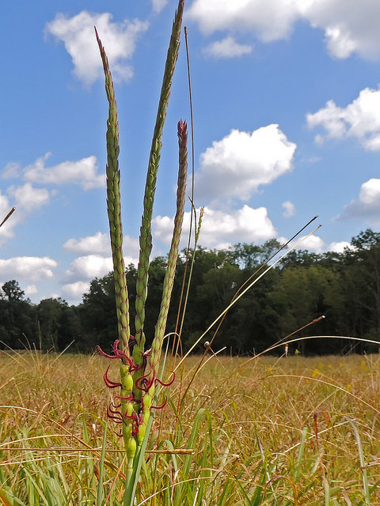
Eastern Gamagrass
-female flowers

Slide 24

Eastern Gamagrass
-male flowers

Slide 25
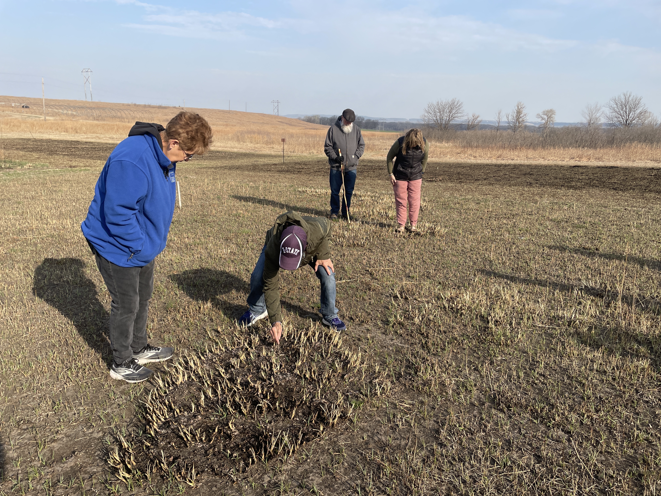
Eastern Gamagrass
-male flowers

Slide 26
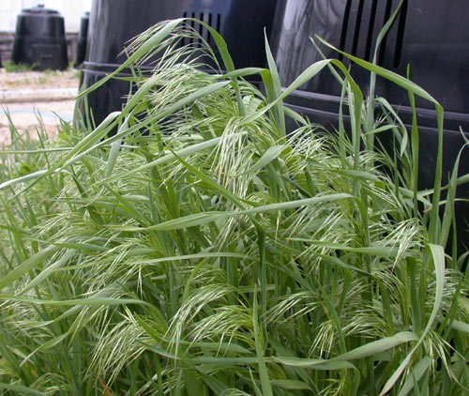
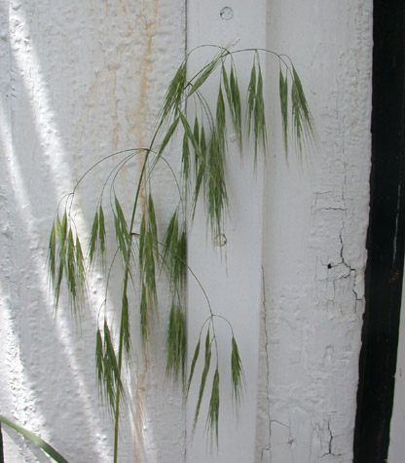
Downy brome

Slide 27
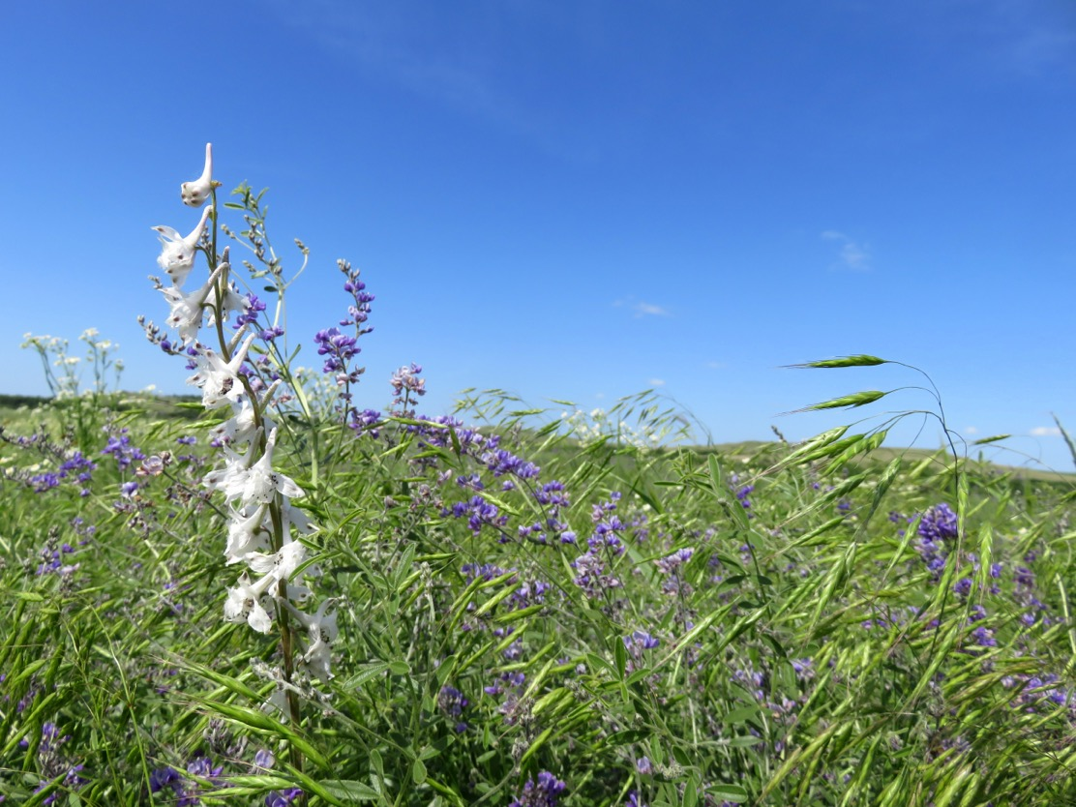
Downy brome

Slide 28
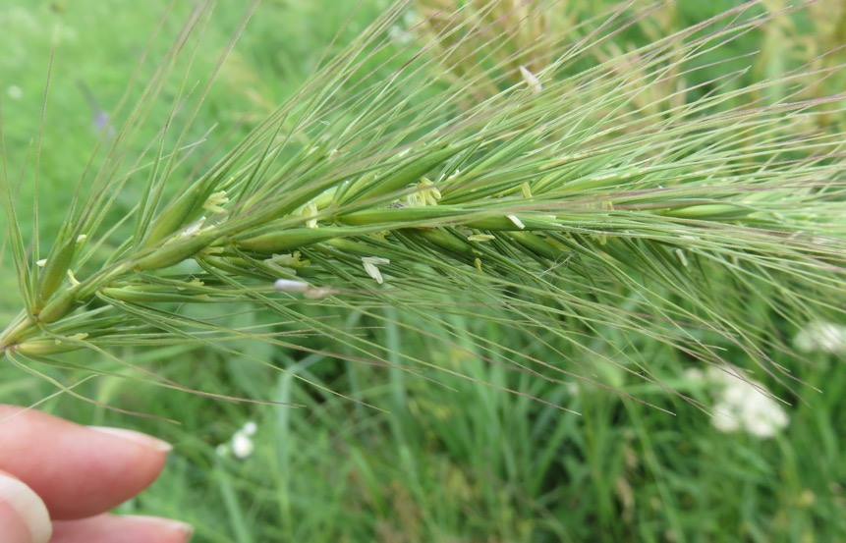
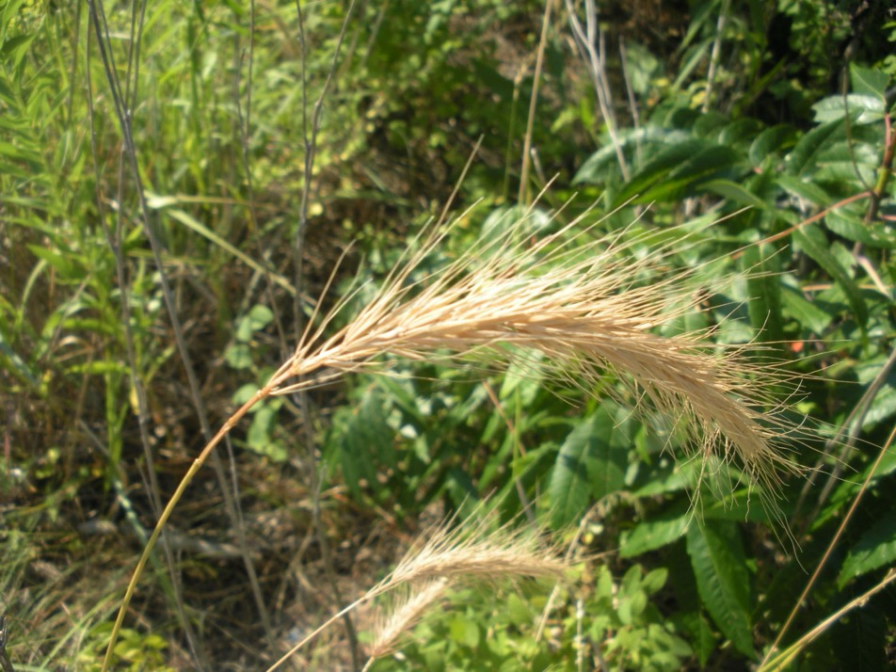
Canada wild rye

Slide 29
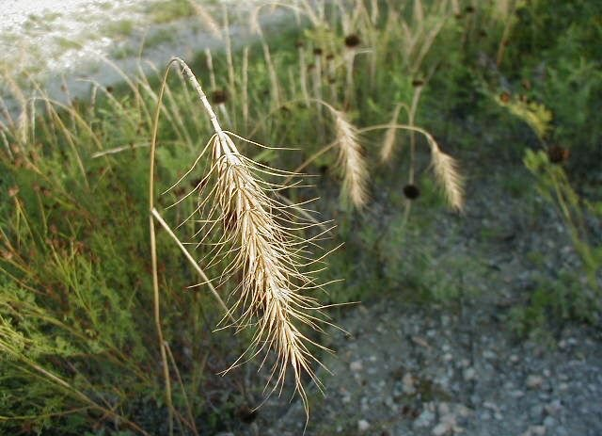
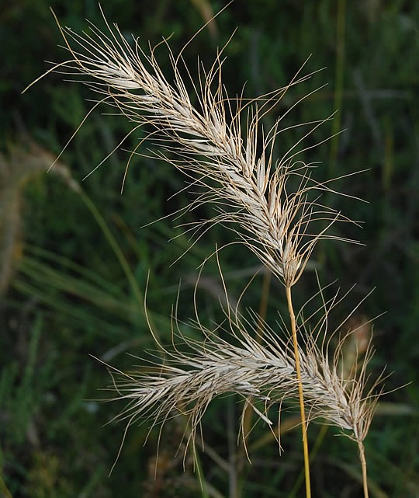
Canada wild rye

Slide 30
Warm season grasses – C4 grasses
These grasses are on average:
  Begin growing in June – continue until the first freeze.
  Utilize enzymes to trap and utilize CO2 in photosynthesis – thus have a high rate of photosynthesis and growth.
  Amount of precipitation in June and July dictates their ultimate heights.
  Have high amounts of structural carbohydrates – cellulose – aren’t as digestible as shorter grasses.
  Have very high heat and drought tolerance.

Slide 31
Warm season grasses – C4 grasses
= grasses that begin growing the late spring when soil temperatures reach 60-65 degrees F. They will be green in July and August and begin turning golden in September.
E.g.: Big bluestem Buffalograss Yellow foxtail
Little bluestem Blue grama Caucasian bluestem
Indiangrass/ Golden Feather Hairy grama Stinkgrass
Switch grass Prairie cordgrass Goosegrass
Purple lovegrass Purpletop

Slide 32
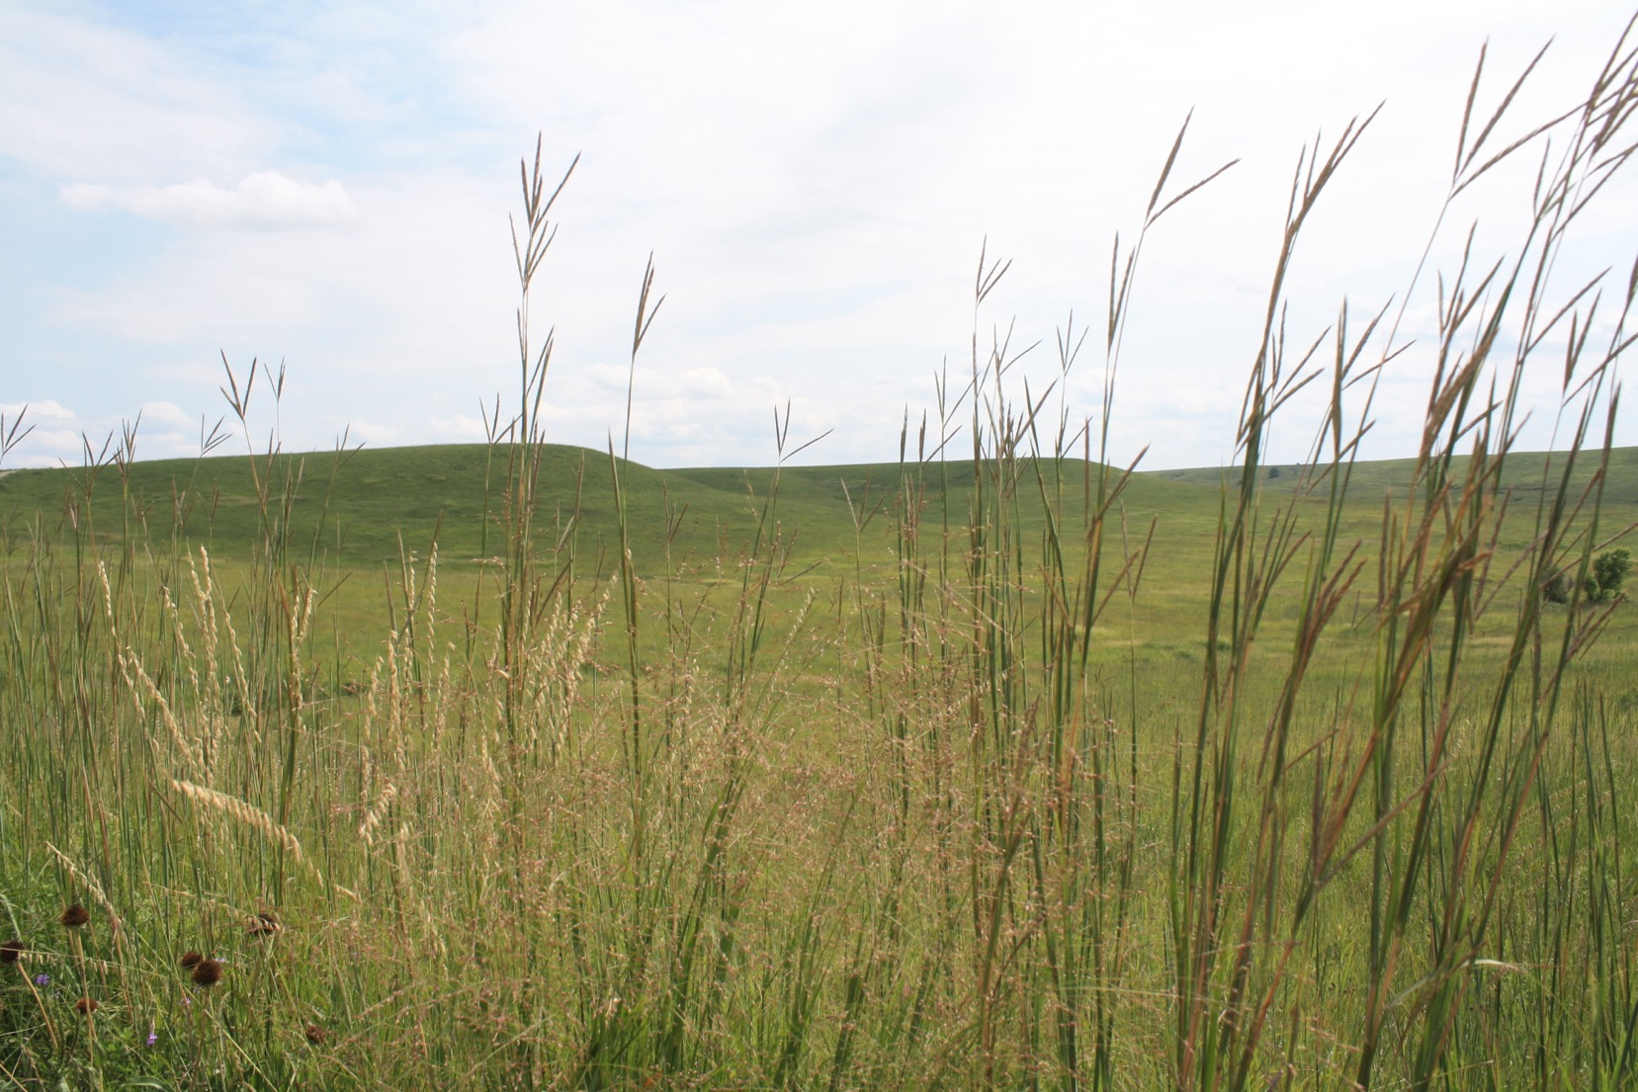

Slide 33
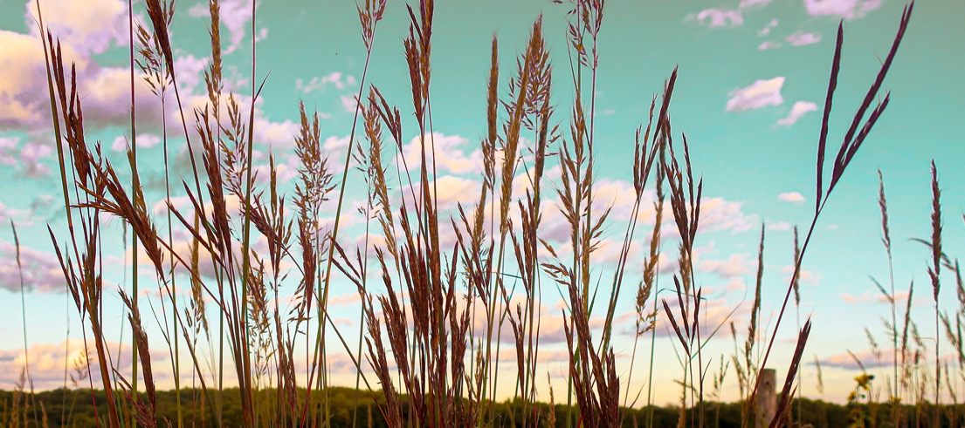
Big 5 tall grasses
Switchgrass
Sideoats grama
Big bluestem
Golden Feather Grass/Indiangrass
Little bluestem

Slide 34
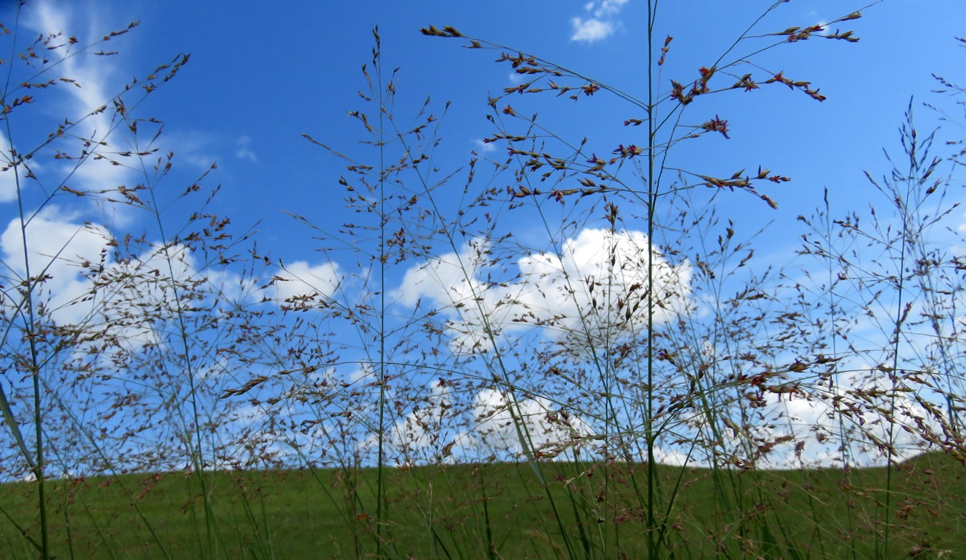
1. Switchgrass
Panicum virgatum
Grows up to 7 ft. tall
Large, airy seed head
June & July
Likes moist soil

Slide 35
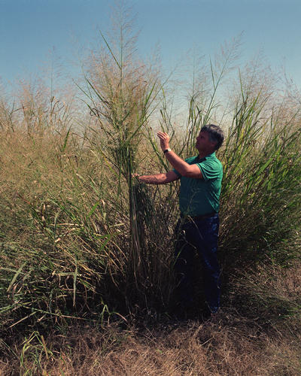
Switchgrass

Slide 36
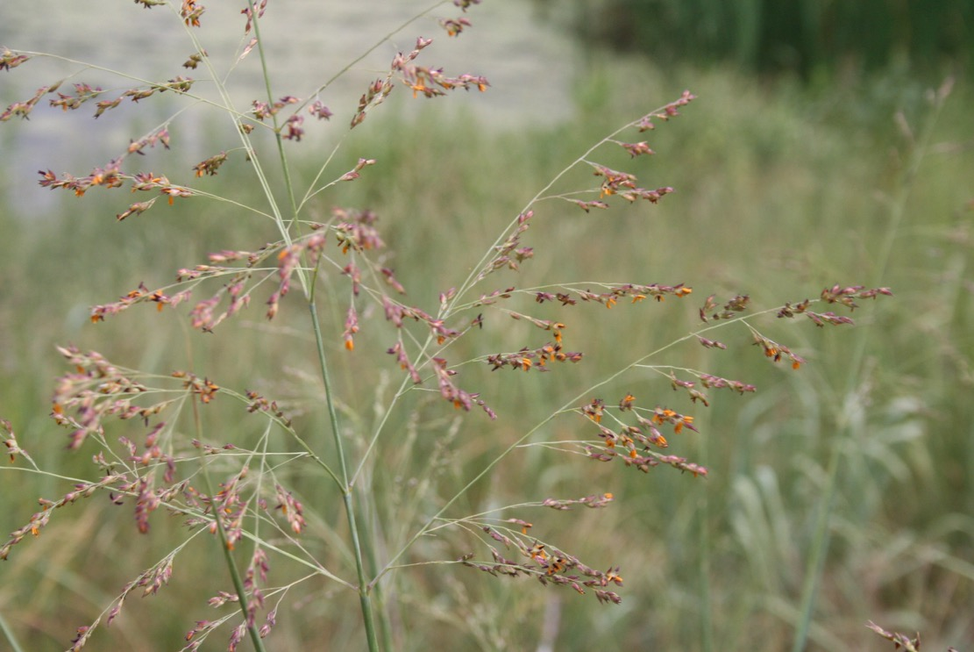
Switchgrass

Slide 37
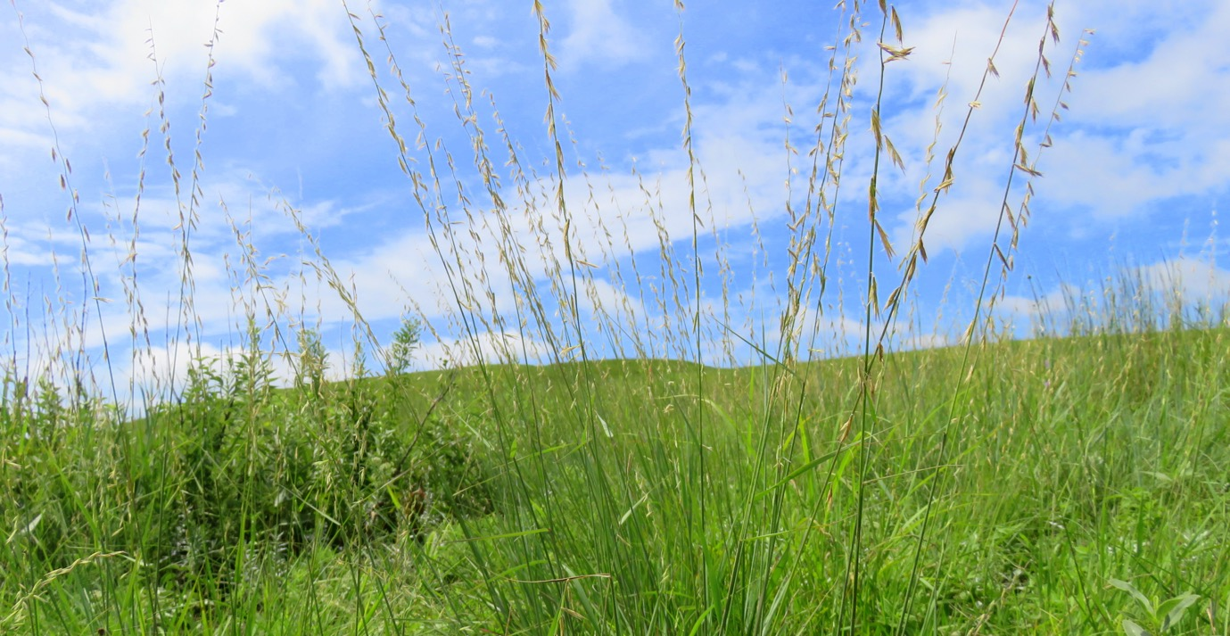
2. Sideoats grama
Bouteloua curtipendula
Grows up to 3 ft. tall
Blooms in the summer – July & August
Found in all kinds of prairie
Seed on one side of the stem = sideoats

Slide 38
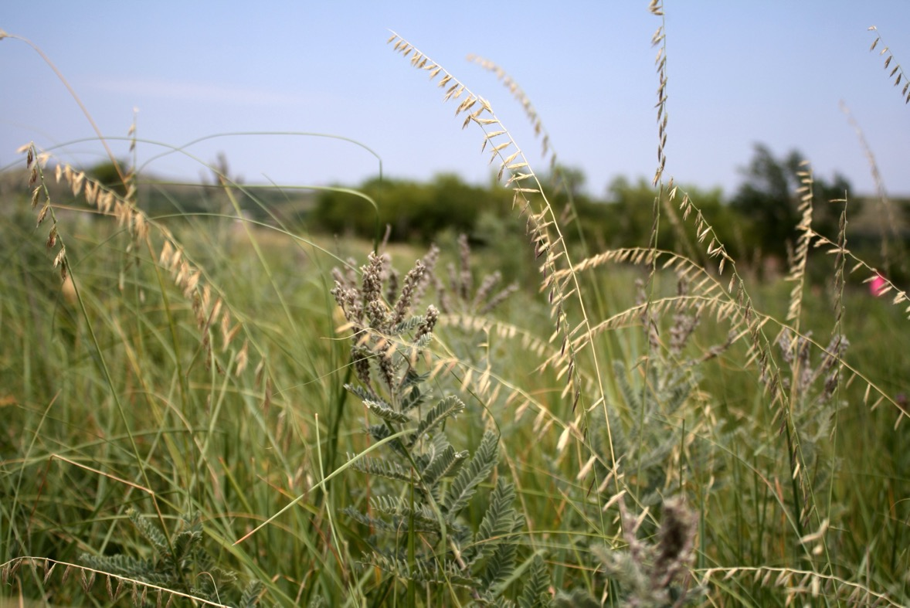
Sideoats grama

Slide 39
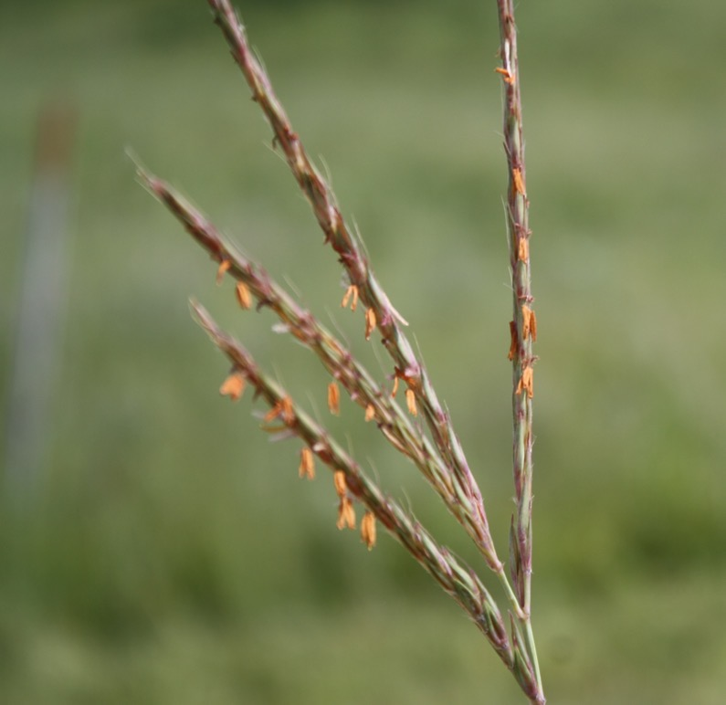
3. Big bluestem
Andropogon gerardii
Tallest of the tallgrasses – gets up to 9 ft. tall
Reaches its maximum height in September
Purplish-red in the autumn
“W” – ”turkey foot” seedhead

Slide 40
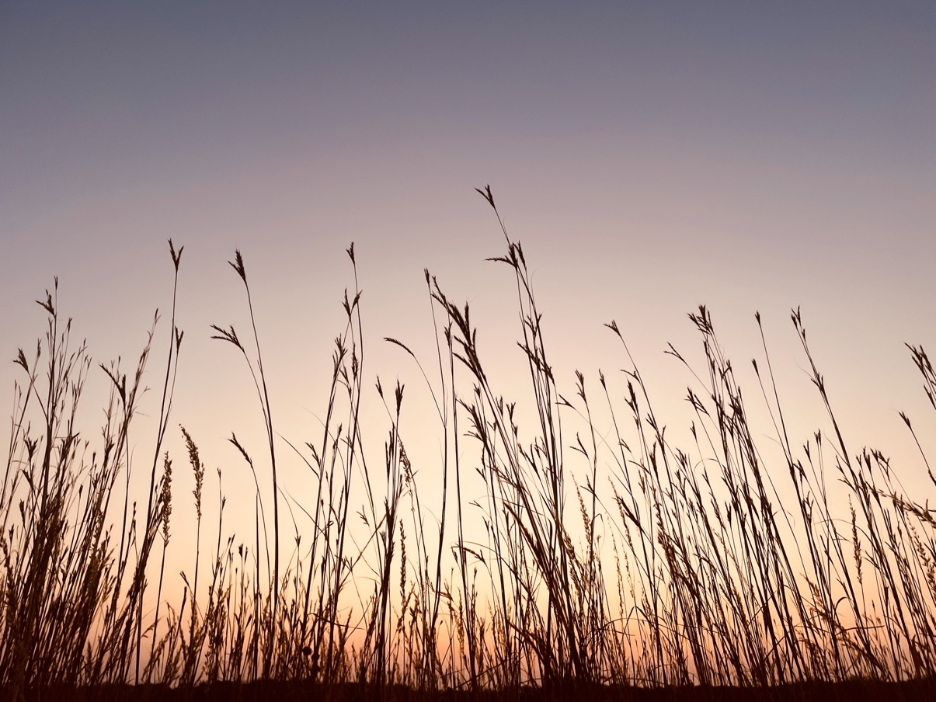
Big bluestem

Slide 41
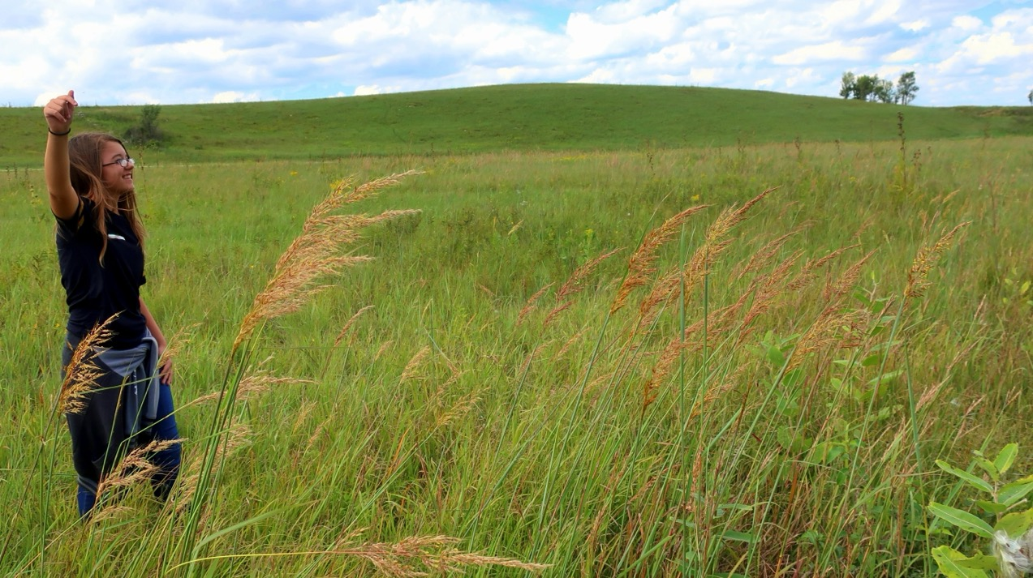
4. Golden Feather Grass/Indiangrass
Sorghastrum nutans
Grows up to 7 ft. tall
Seedhead looks like a golden feather
Blooms Aug. – Oct.

Slide 42
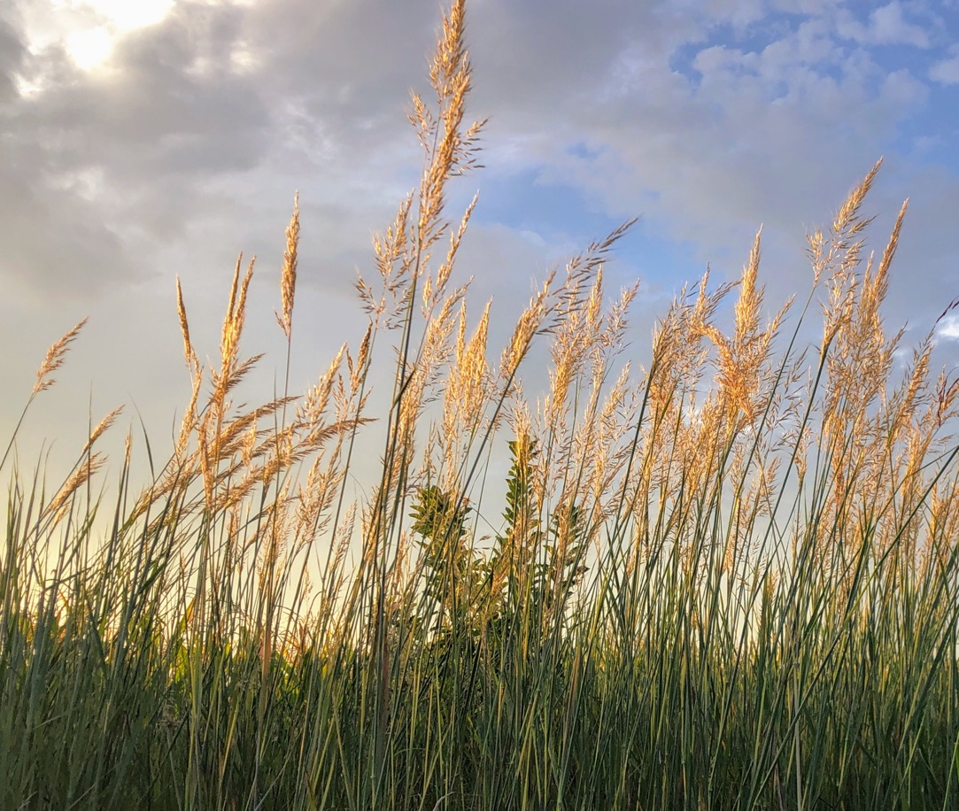
Golden Feather Grass

Slide 43
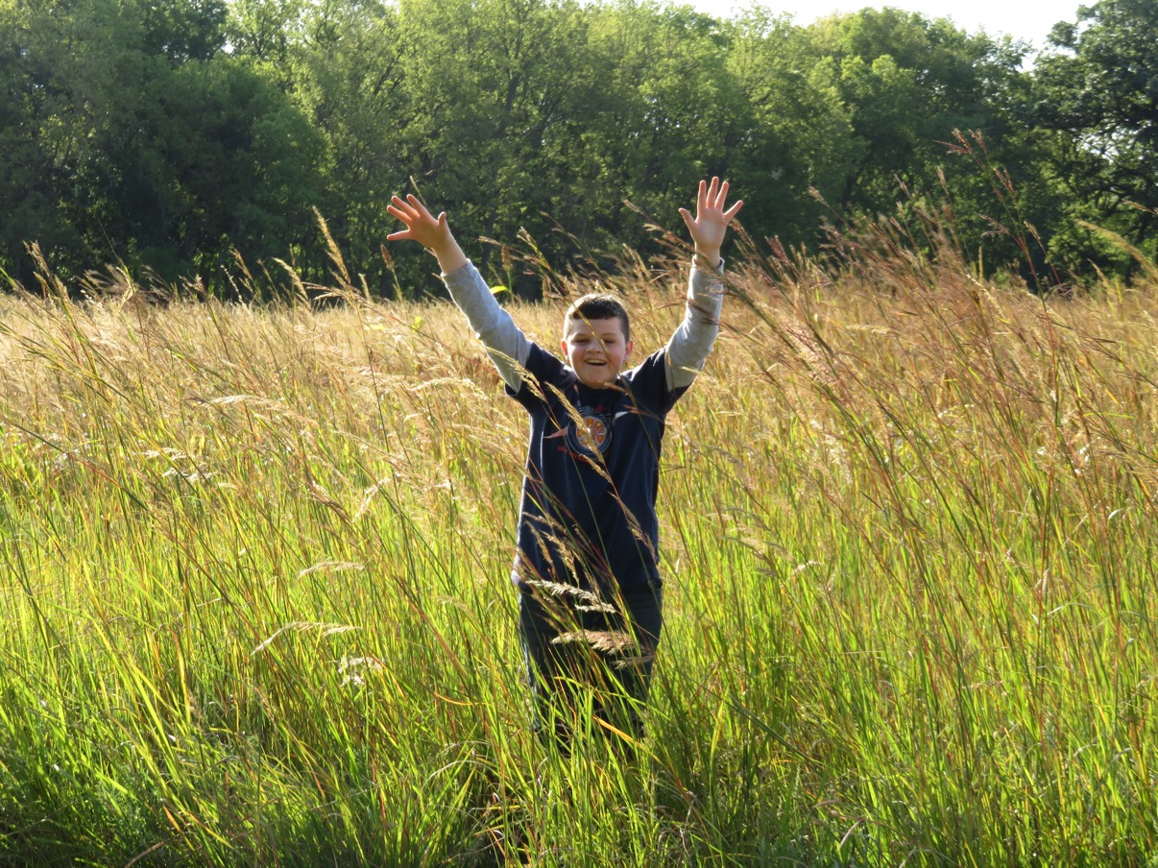
Golden Feather Grass

Slide 44
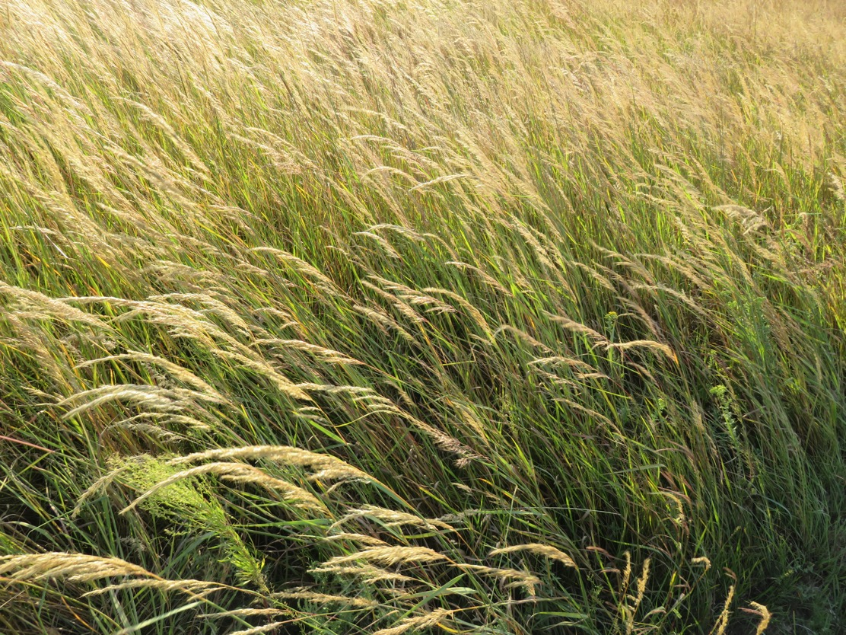
Golden Feather Grass

Slide 45
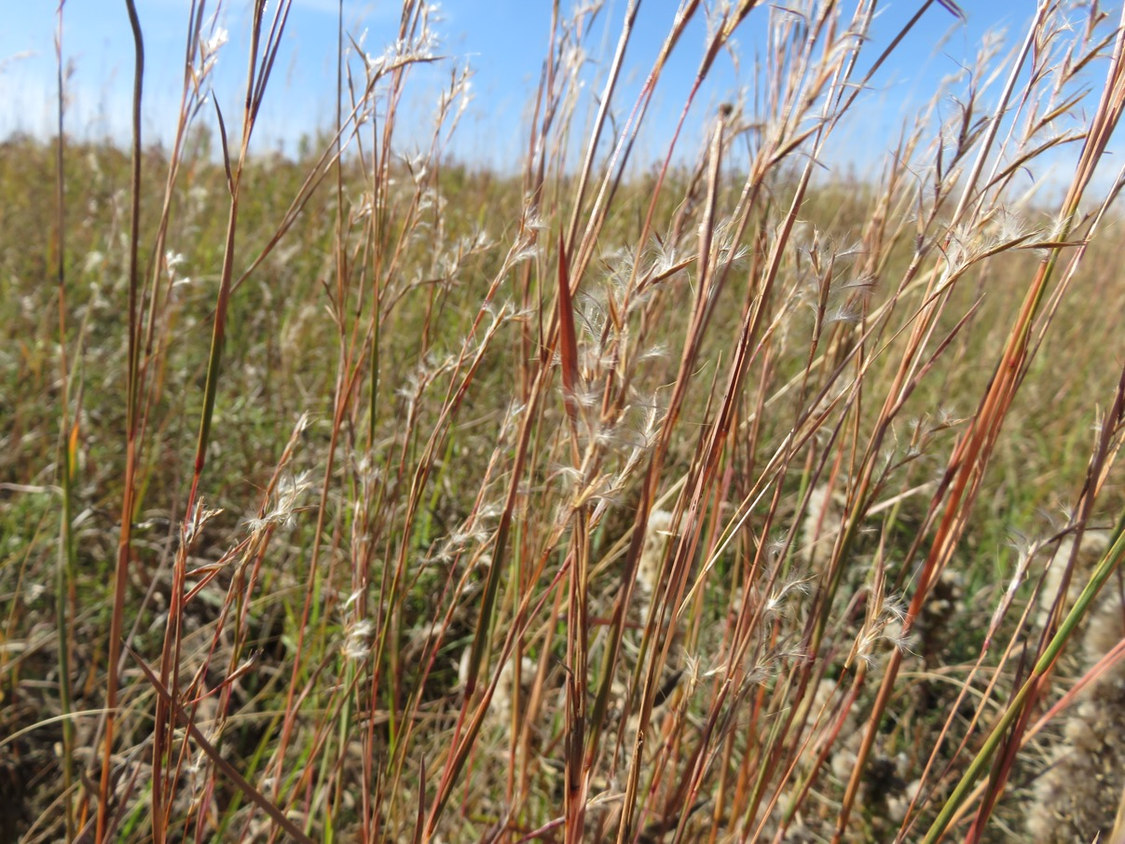
5. Little bluestem
Schizachyrium scoparium
Grows up to 4 ft. tall
Blooms in late September - October
Bunch grass
State grass of KS
Seed heads look like curly eyelashes

Slide 46

Little bluestem

Slide 47
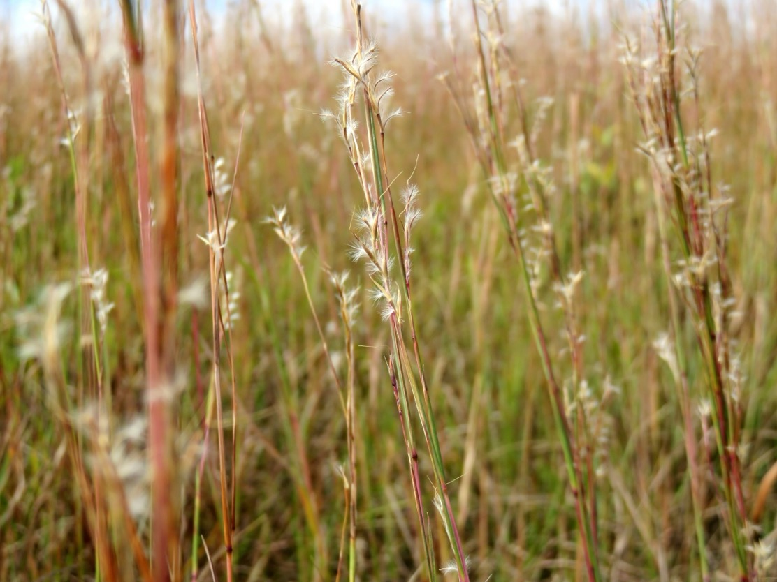
Little bluestem

Slide 48
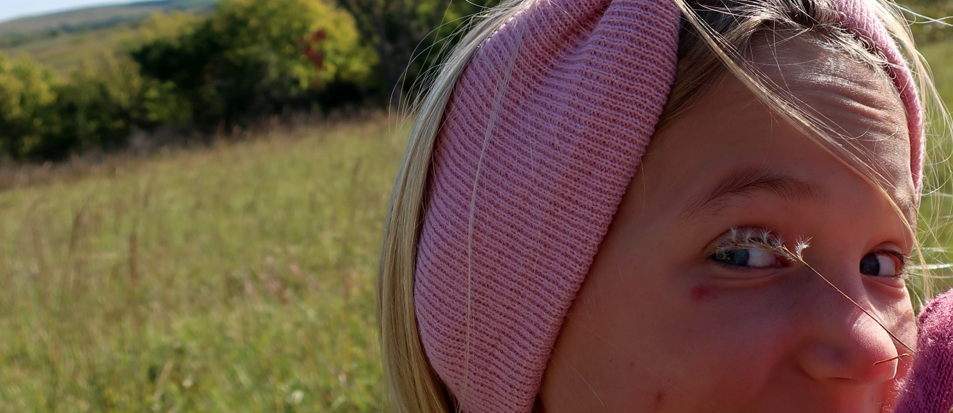

Slide 49
Other warm season (C4) grasses…

Slide 50
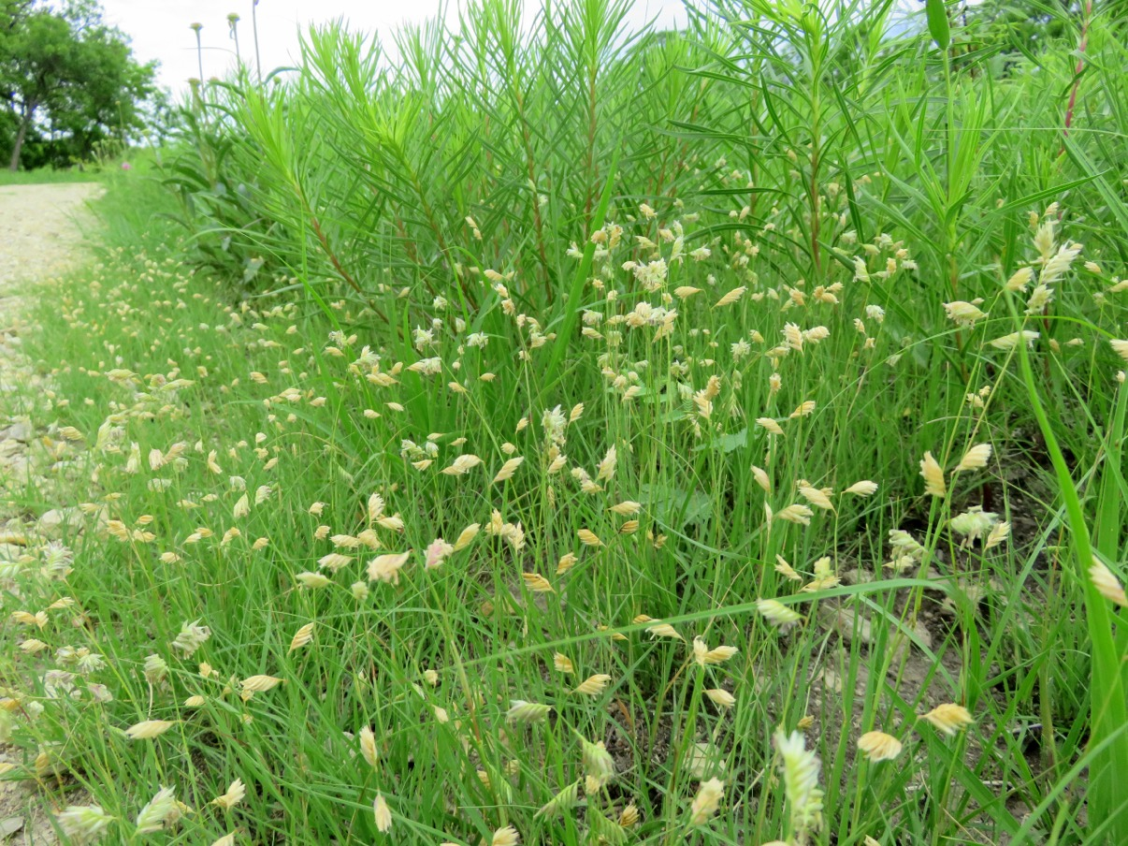
Buffalograss

Slide 51
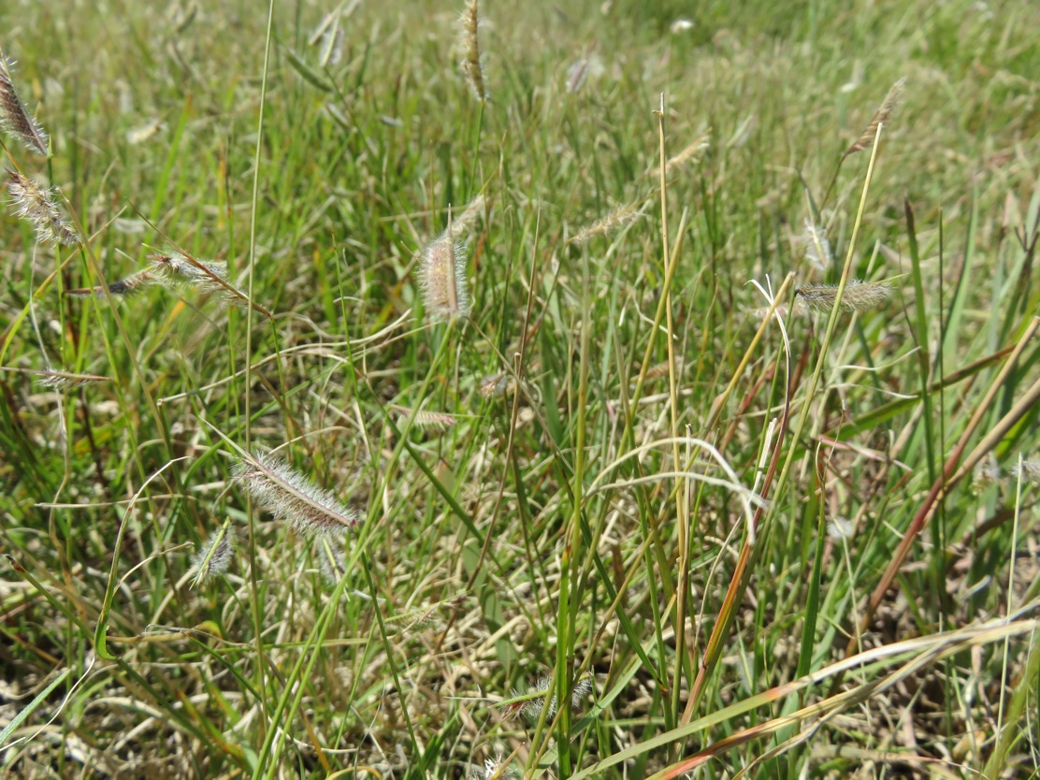
Hairy grama

Slide 52

Hairy grama
“Hair” sticking out from the top of the seedhead is distinctive for Hairy Grama

Slide 53

Hairy grama

Slide 54

Yellow foxtail – Yellow Bristle-grass

Slide 55


Yellow foxtail

Slide 56


Quiz
1.

Slide 57
Quiz
2.

Slide 58
Quiz
3.

Slide 59


Quiz
4.

Slide 60

Quiz
5.

Slide 61

Quiz
6.

Slide 62

Quiz
7.

Slide 63

Quiz
8.

Slide 64

Quiz
9.

Slide 65

Quiz
10.

Slide 66

Quiz
11.

Slide 67

Quiz
12.

Slide 68
Answers:
1. Big Bluestem
2. Eastern Gamagrass
3. Yellow Foxtail (aka - Yellow Bristlegrass)
4. Smooth Brome
5. Switchgrass
6. Side-oats Grama
Buffalograss
8. Downy Brome
9. Canada Wild Rye
Hairy Grama
Little Bluestem
Golden Feather Grass (aka – Indiangrass)
Author: Jill Haukos, Konza Environmental Education Program

