Slide 1
Grasses of the Prairie
They RULE!!!

Slide 2
Grasses rule the prairie…
2.
Why do you think grasses rule the prairie?
Notes:
Answer: There could be a large number of different answers here and most of them will be correct! Grasses provide food for a large number of different animals, including us! Grasses are capable of surviving in an area of the world where rain doesn’t always appear when it’s needed and the temperatures can get both very hot and very cold.
The ultimate reason why grasses rule the prairie = their roots
We’ll learn more about the roots of grasses as we move along.

Slide 3
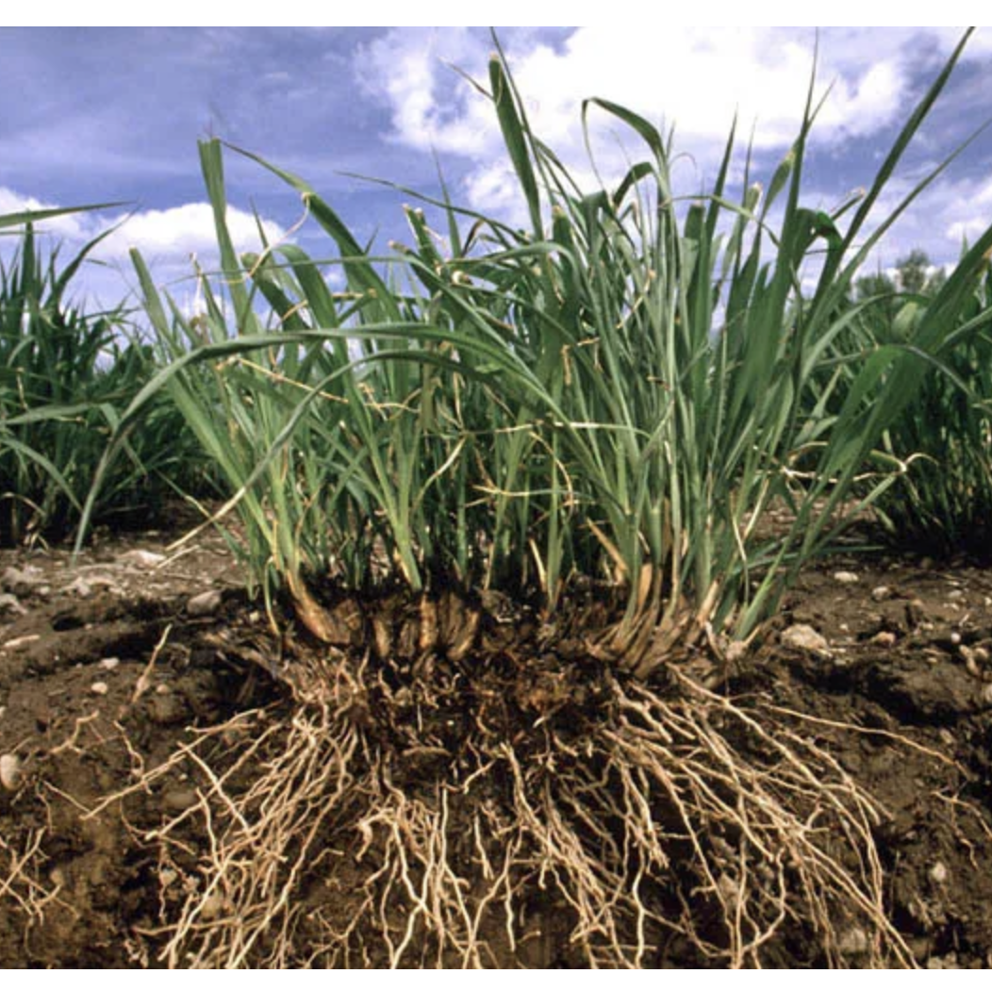
Roots!
3.
The roots of the grasses – called “fibrous roots” - act like a sponge
They are very dense in the first 12” of soil and can quickly absorb water when it rains
Those spongy roots can stop the water from going deeper into the soil
Why would it be good for plants to have spongy roots?

Slide 4
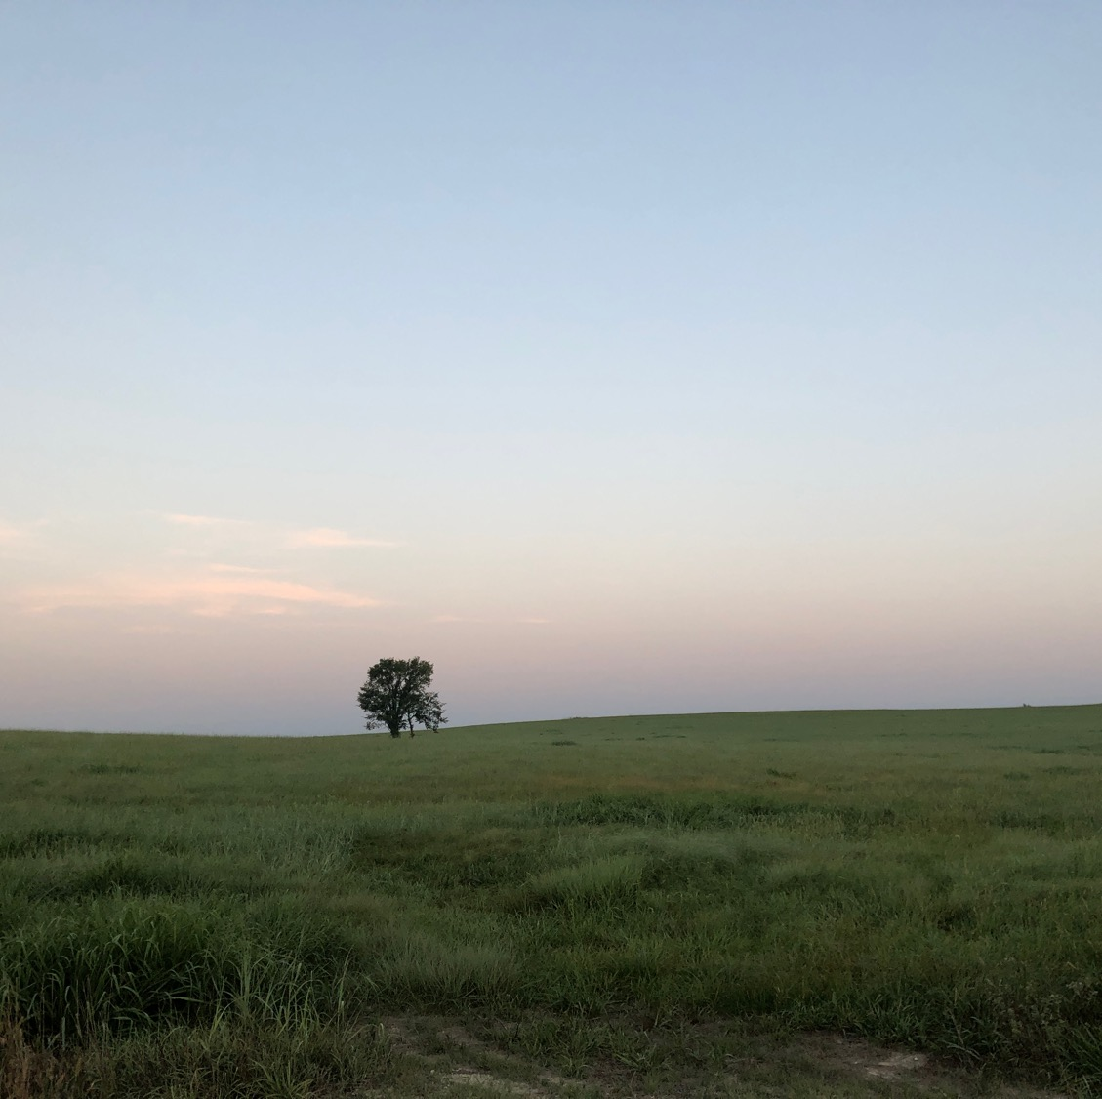
Grass roots can keep water away from other plants
4.
Draw what you think the roots of prairie grasses look like under the soil.
Grasses can out-compete other plants by quickly and efficiently absorbing the water before it can go to other plants.
Trees, especially, have a very difficult time living on a prairie when the grasses keep the water from them.

Slide 5
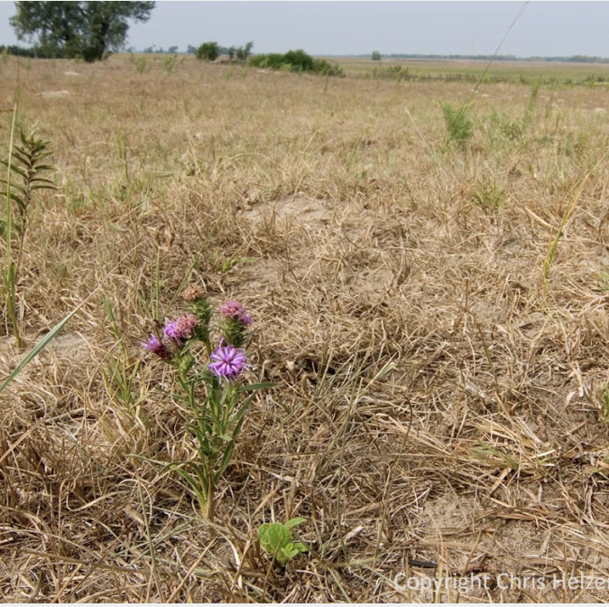
Grasses have a super-power!
5.
Grasses can pretend to be dead if the weather is very hot and dry - they turn yellow.
But, once it rains again, the grasses start growing, and they can grow really fast!

Slide 6
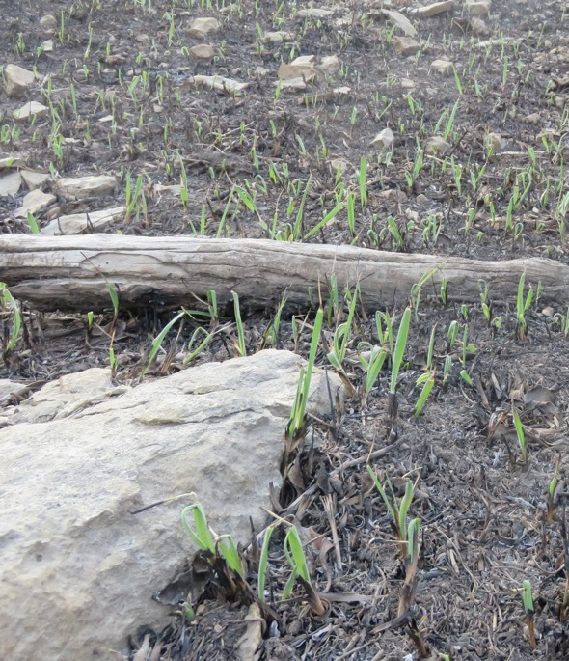
Grasses store food and water underground
6.
Grasses can survive very bad conditions
Hot
Dry
Cold
Fire
They can use their underground food and water to survive (go into “dormancy”) and begin to grow again when conditions improve.

Slide 7
In the tallgrass prairie, there are two seasons for grasses:
7.
Cool-season grasses
Warm-season grasses
What months do you think the cool-season grasses grow? How about the warm-season grasses?
Notes:
Answer: Cool-season grasses grow right away in the spring – March – June
Warm-season grasses take over when the summer kicks in – June - September
They don’t compete with each other because they have different seasons for growing – this is a good thing for both types of grasses.

Slide 8
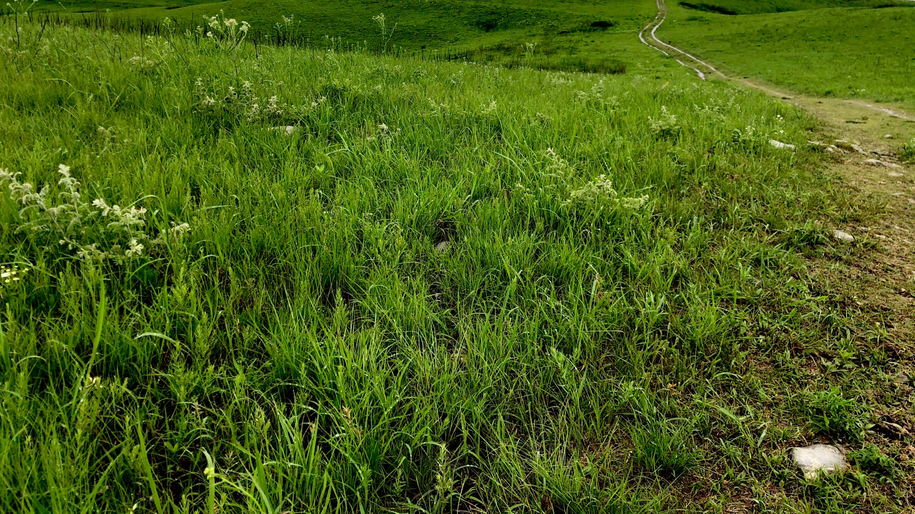
The cool-season grasses begin growing in early spring – during the month of March
8.
This is when the prairie is bright green!

Slide 9
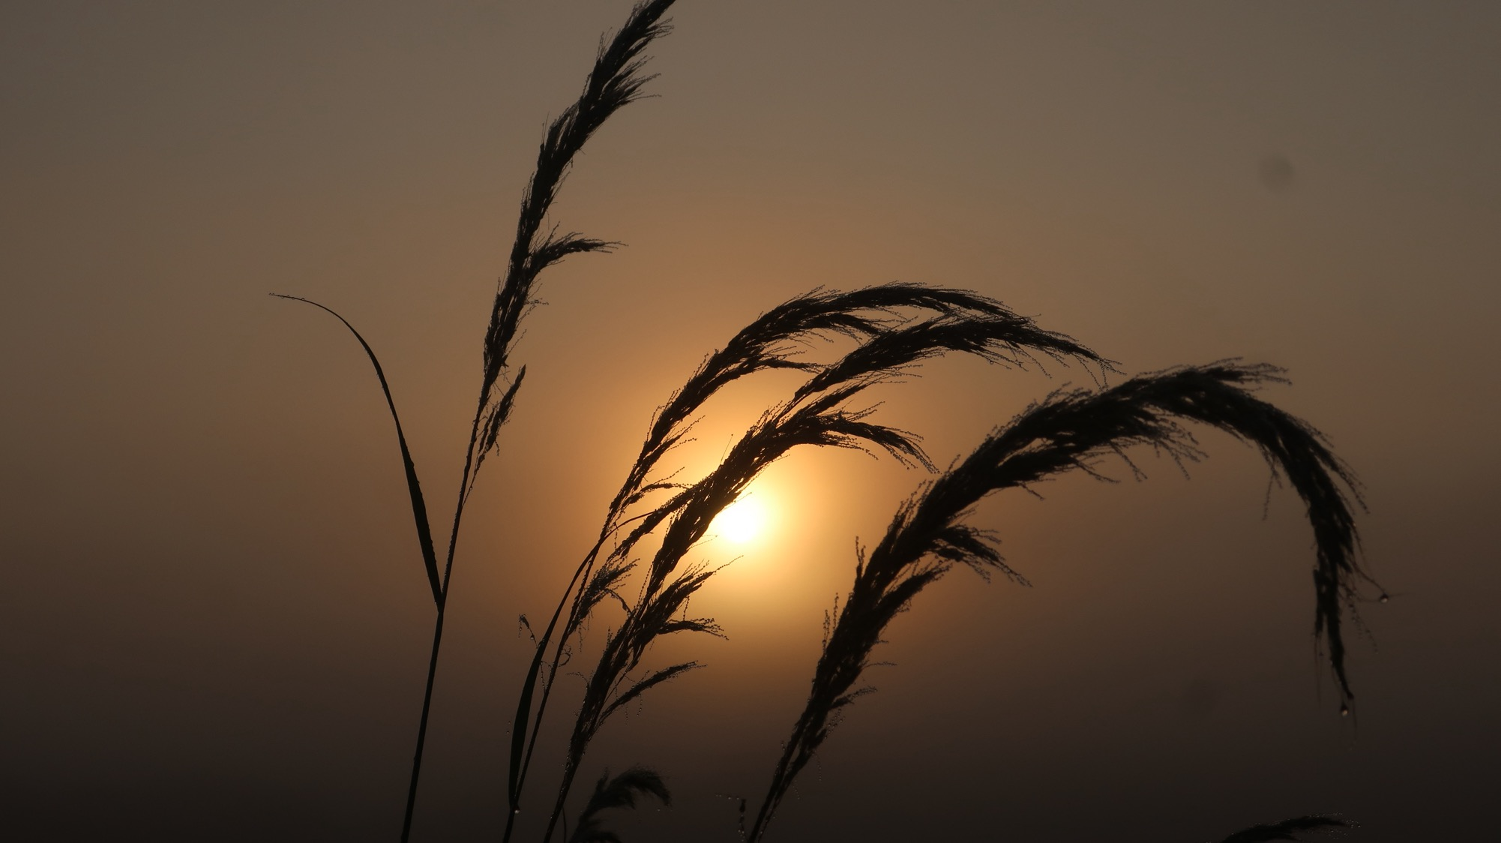
Grasses grow for a couple of months
9.
At the end of their season of growth, they make seeds at the very tops of their stems
These are called “seed heads”
Different kinds of grasses have different shapes and sizes of seed heads

Slide 10
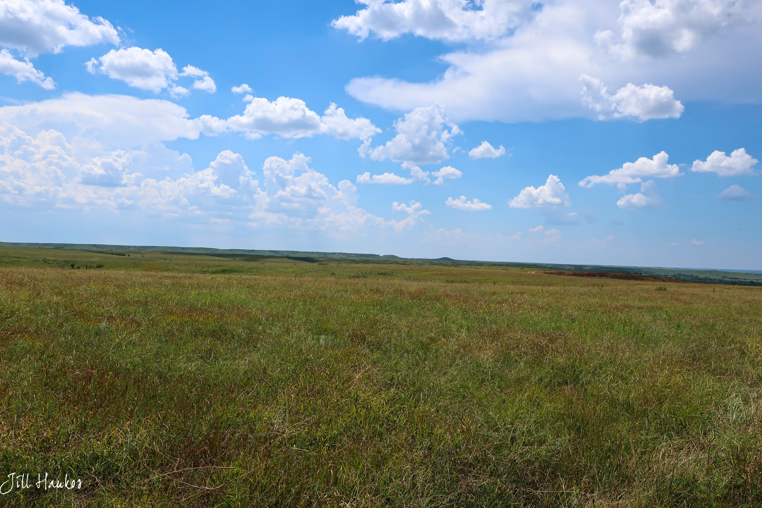
When the cool-season grasses are done growing and have made their seeds, they begin to turn from green to gold
10.
This is when the prairie turns yellowish-green
Notes:
TEACHER HELP: the prairie turns from bright green (May) to yellowish-green
in July. This signals the transition between the cool-season plants
and the warm-season plants. There is another transition in the color of
the prairie after the first freeze of autumn – which usually occurs at the
end of October or first couple weeks of November. This is when all of the
above-ground vegetation dies and the prairie turns golden. The prairie
will remain this color until the next spring when it is burned and the new
growth comes up a lush green color.

Slide 11
The warm-season grasses begin growing in early summer and can get very tall in July
11.
No seed heads yet = the grass isn’t done growing!

Slide 12
The tallgrasses sometimes don’t get very tall…
12.
What do you think determines whether the tallgrasses get tall, or not?
Notes:
Answer = you’ll find the answer on the next slide, but it will be interesting to hear what the students think the answer might be.

Slide 13
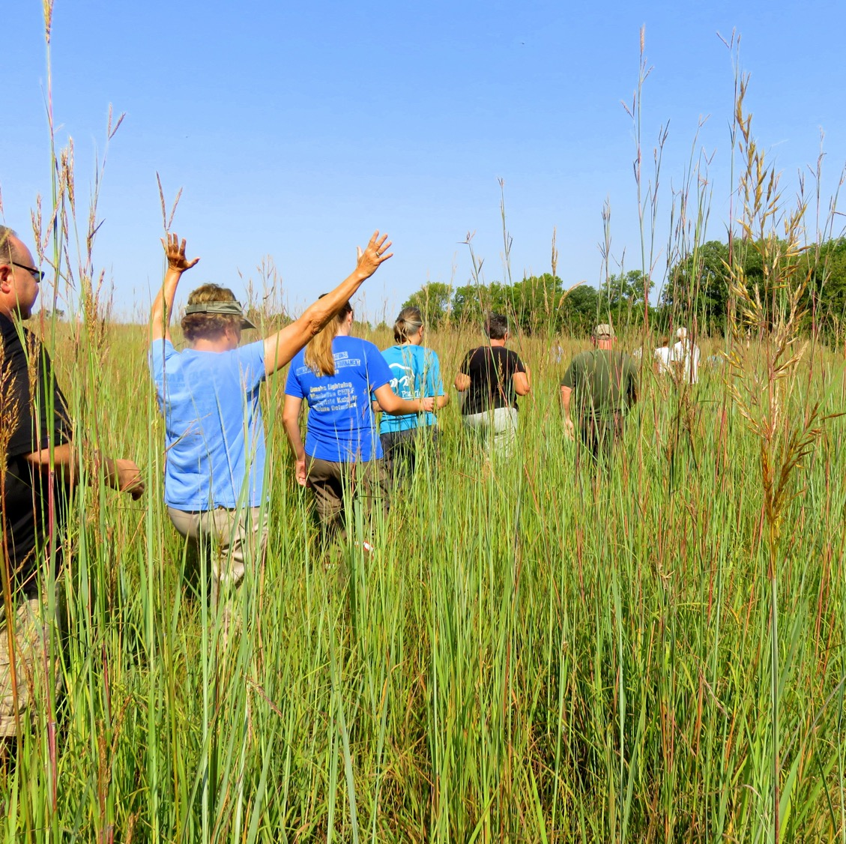
RAIN!
13.
The more rain the prairie gets in July, the taller the warm-season grasses get.
Notes:
TEACHER HELP = Now that you know that the prairie grasses need to get rain in July in order to get REALLY tall, ask the students if they think the grasses will get tall THIS year. It will require them remembering what the weather was like in July – this might be a real challenge for them!

Slide 14
Next – let’s learn some of the different grasses…
14.
We use three things to help us identify them
Whether they are cool-season or warm-season grasses
How tall they are
What their seed head looks like
The grasses we learn here will all be warm-season grasses

Slide 15
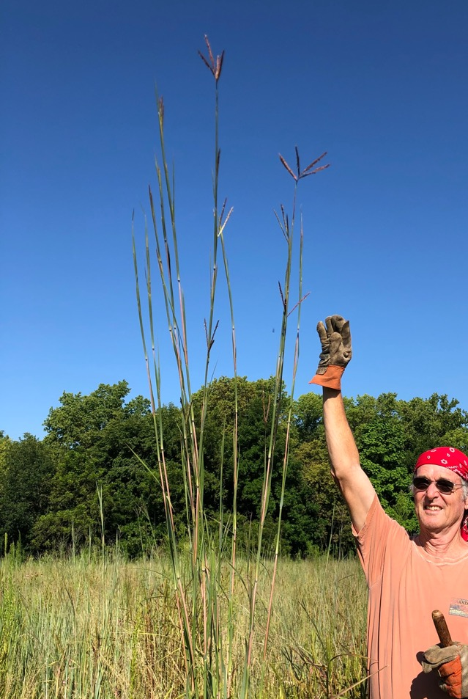
Big Bluestem
15.
Is the tallest warm-season grass – it can get over 9’ tall!
It’s seed head looks like a “W”
Because Wild Turkey feet look like a “W” – this grass is often called “Turkey Foot”

Slide 16
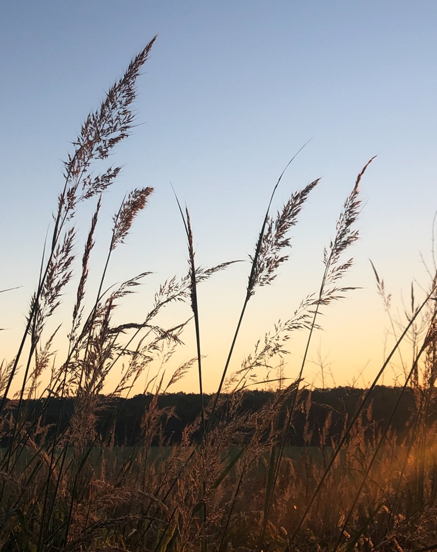
Indiangrass
16.
It’s seed head looks like a golden feather
We see a LOT of Indiangrass in September and October
It gets over 7’ tall

Slide 17
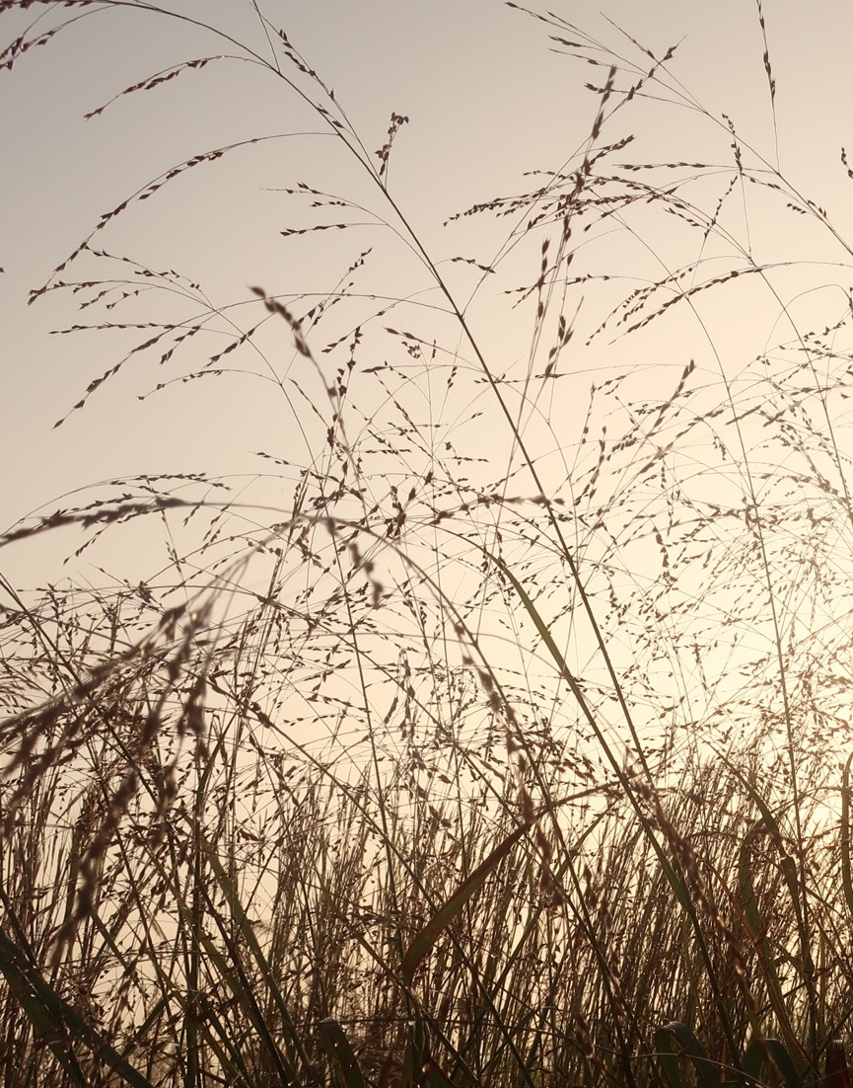
Switchgrass
17.
This grass is also tall – often over 7 ‘ tall
Its seed head is really distinctive – it looks like exploding fireworks!

Slide 18
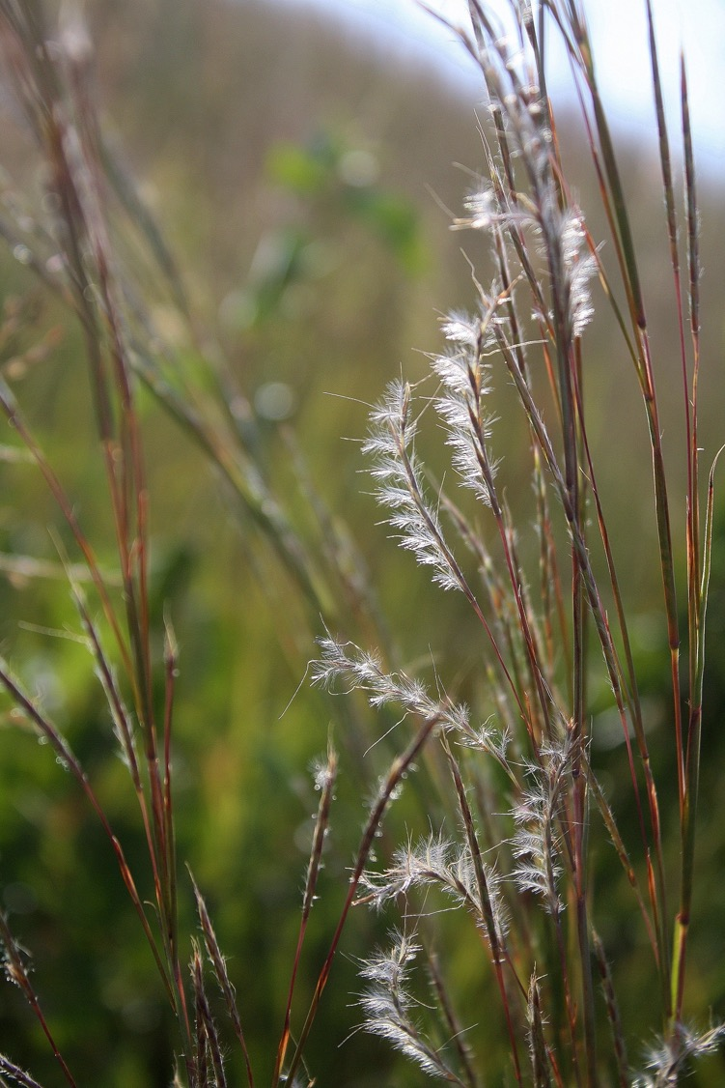
Little Bluestem
18.
This grass is shorter than the others
It can still get over 5’ tall
It is the state grass of Kansas
Its seed head looks like curly eyelashes

Slide 19
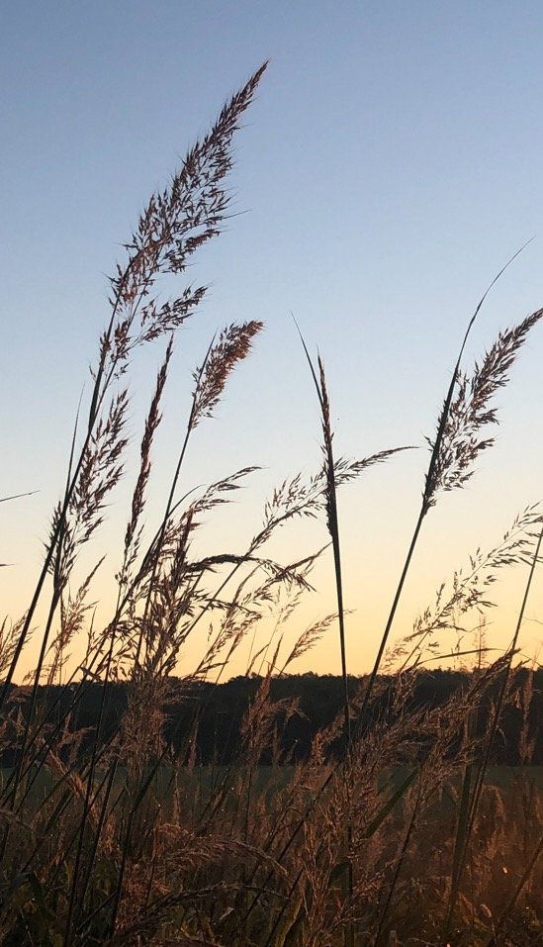
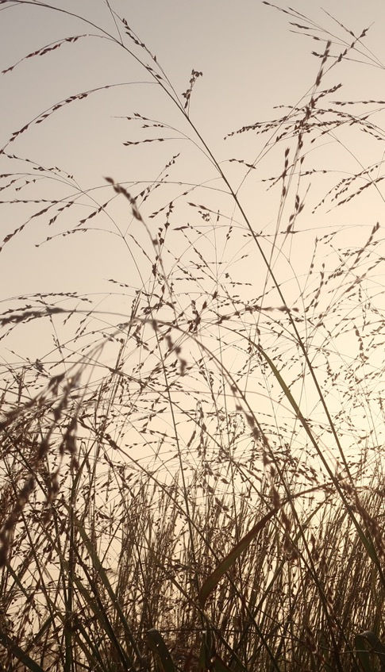
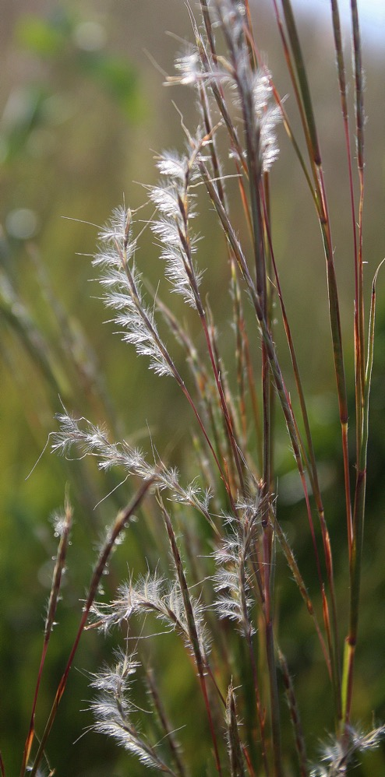
Can you remember the names of these grasses?
19.
Notes:
Answers:
Big Bluestem
Indiangrass
Switchgrass
Little Bluestem

Slide 20
We hope you get a chance to go to the prairie in the autumn to find these grasses!
20.

Slide 21
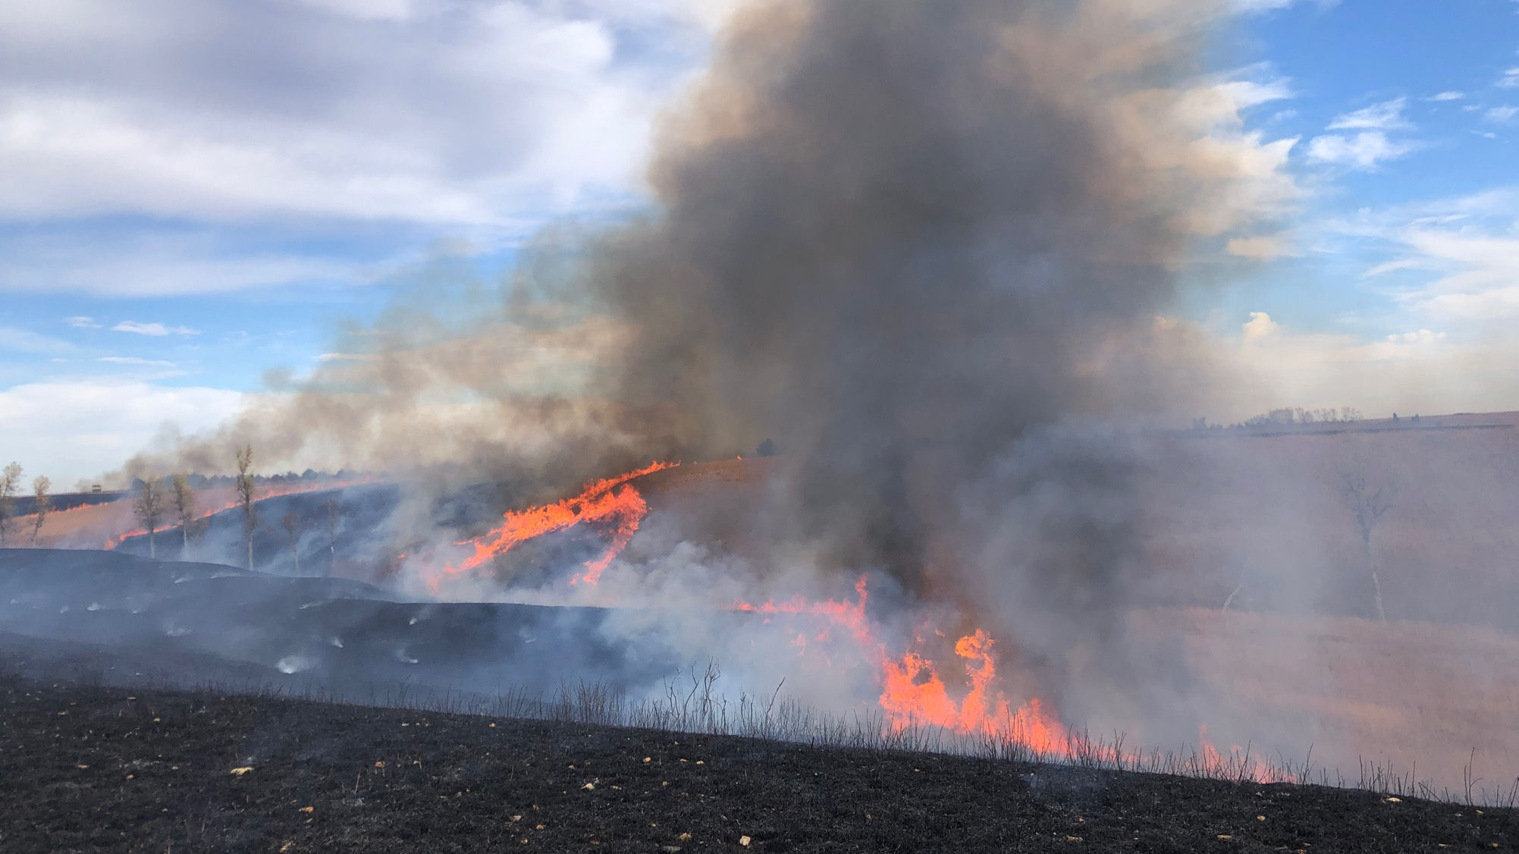
Next – we’ll learn about fire and the prairie!

Slide 22
Author:
Jill Haukos
Konza Environmental Education Program
Konza Prairie Biological Station
Manhattan, KS
© 2023

