Slide 1
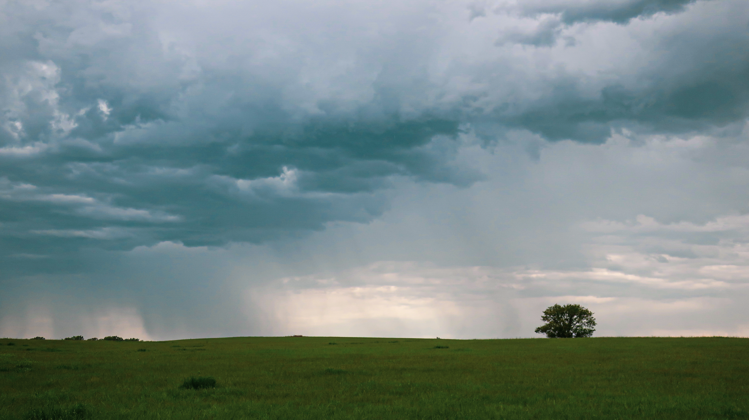
Precipitation on the Prairie
Day 2
Prairie Week
Notes:
Photo of a summer rain storm moving over the prairie – Pottawatomie County, Kansas. Photo copyright Jill Haukos

Slide 2
Water is a BIG DEAL for the prairie
Notes:
Photo showing rain sitting on the surface of the prairie at the Konza Prairie Biological Station, Manhattan, KS. Photo copyright Jill Haukos

Slide 3
Question #1
Why do you think water is so important for a prairie?

Slide 4
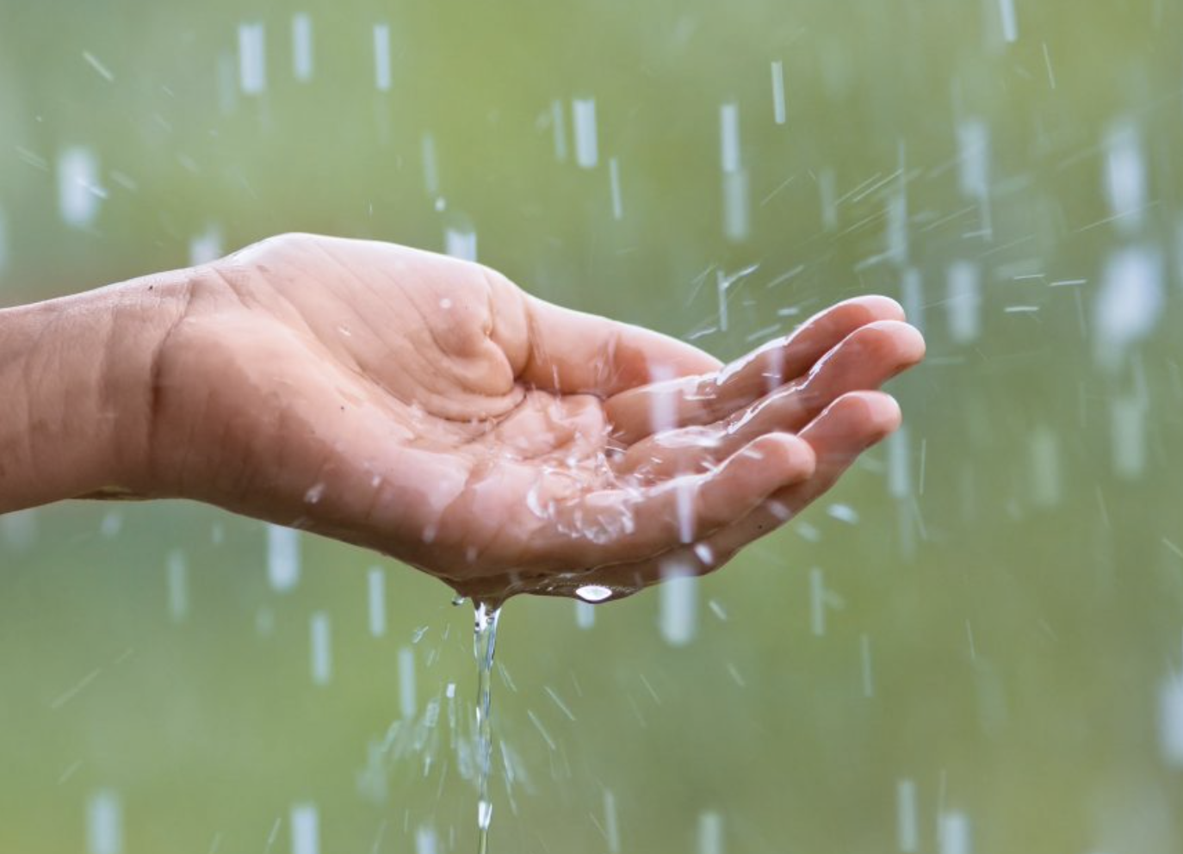
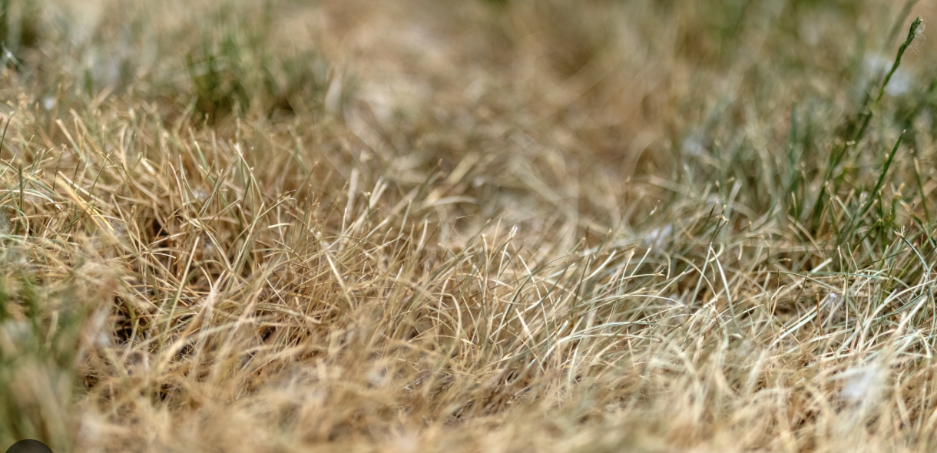
Answer
Water is essential for life.
Precipitation (rain, sleet, snow) is unpredictable in a prairie and when it does arrive, the roots of the prairie plants absorb the water VERY quickly!
The presence of water allows the prairie plants to grow. Plants won’t grow much - or at all – if there isn’t water available.
Notes:
Potential question for students: Why do plants need water?
Answer: Photosynthesis, transport of nutrients from the soil to the plant cells, and structure (water pressure/turgor pressure hold the plants upright. When plants loose turgor pressure, they wilt).

Slide 5
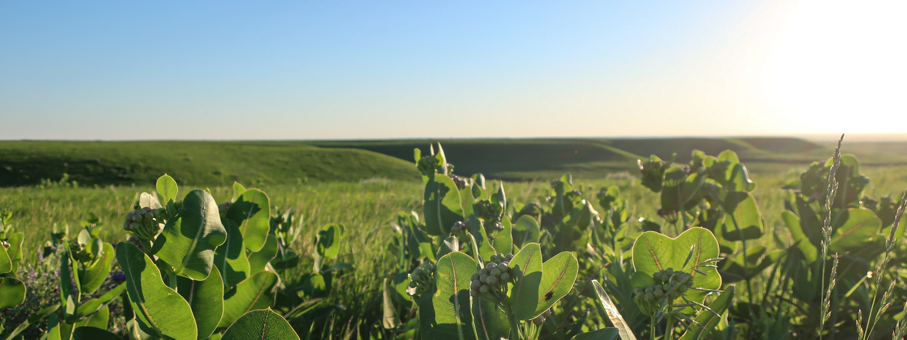
All plants must have water for …
Photosynthesis = making their food from CO₂ + H₂O and sunlight = glucose (sugar)

Slide 6
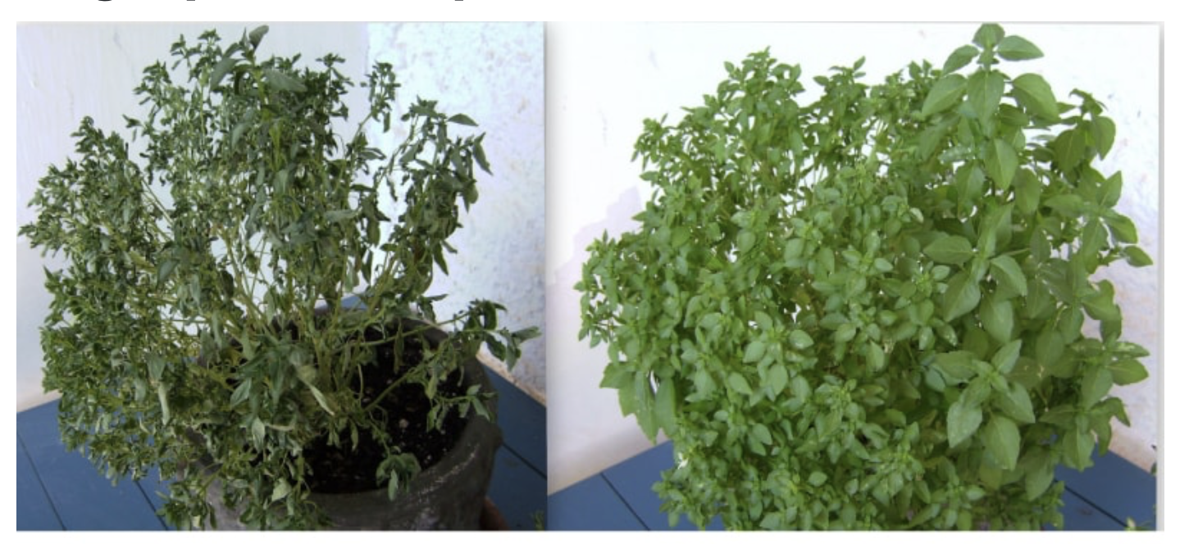
All plants must have water…
Structure = plants don’t have bones, they use internal water pressure (“turgor pressure”) in their cells to hold up the plant. Loss of the internal turgor pressure = wilting

Slide 7
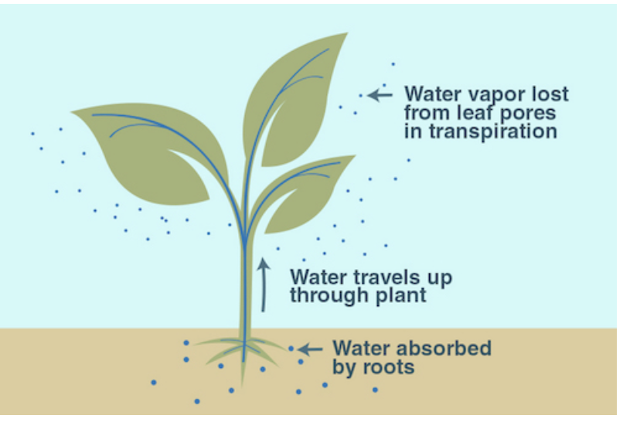
All plants must have water for…
Transportation = plants don’t have blood, in order to get nutrients from the soil to all of the cells of the plant, they need water moving through the plant to deliver it.

Slide 8
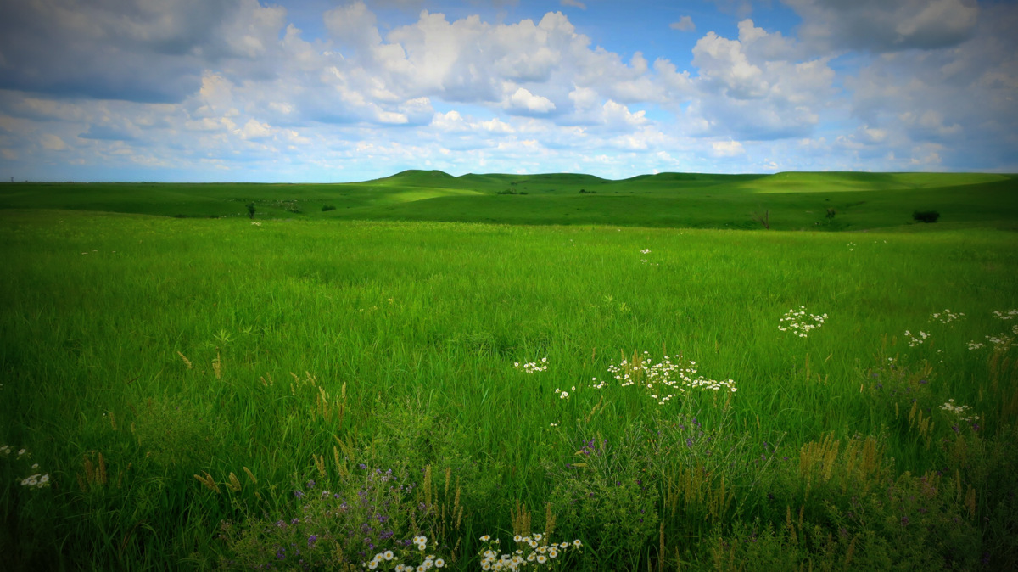
Question #2
What are the main kinds of plants that are found on a prairie?
Notes:
Answer on the following slide. Answer = grasses and forbs (wildflowers)
Photo of the Konza Prairie Biological Station, Manhattan, KS. June 2019 – photo copyright Jill Haukos

Slide 9
Answer:
The main kinds of plants that are found on a prairie are:
Grasses
Wildflowers – also known as “Forbs”
A healthy prairie won’t have many trees.

Slide 10
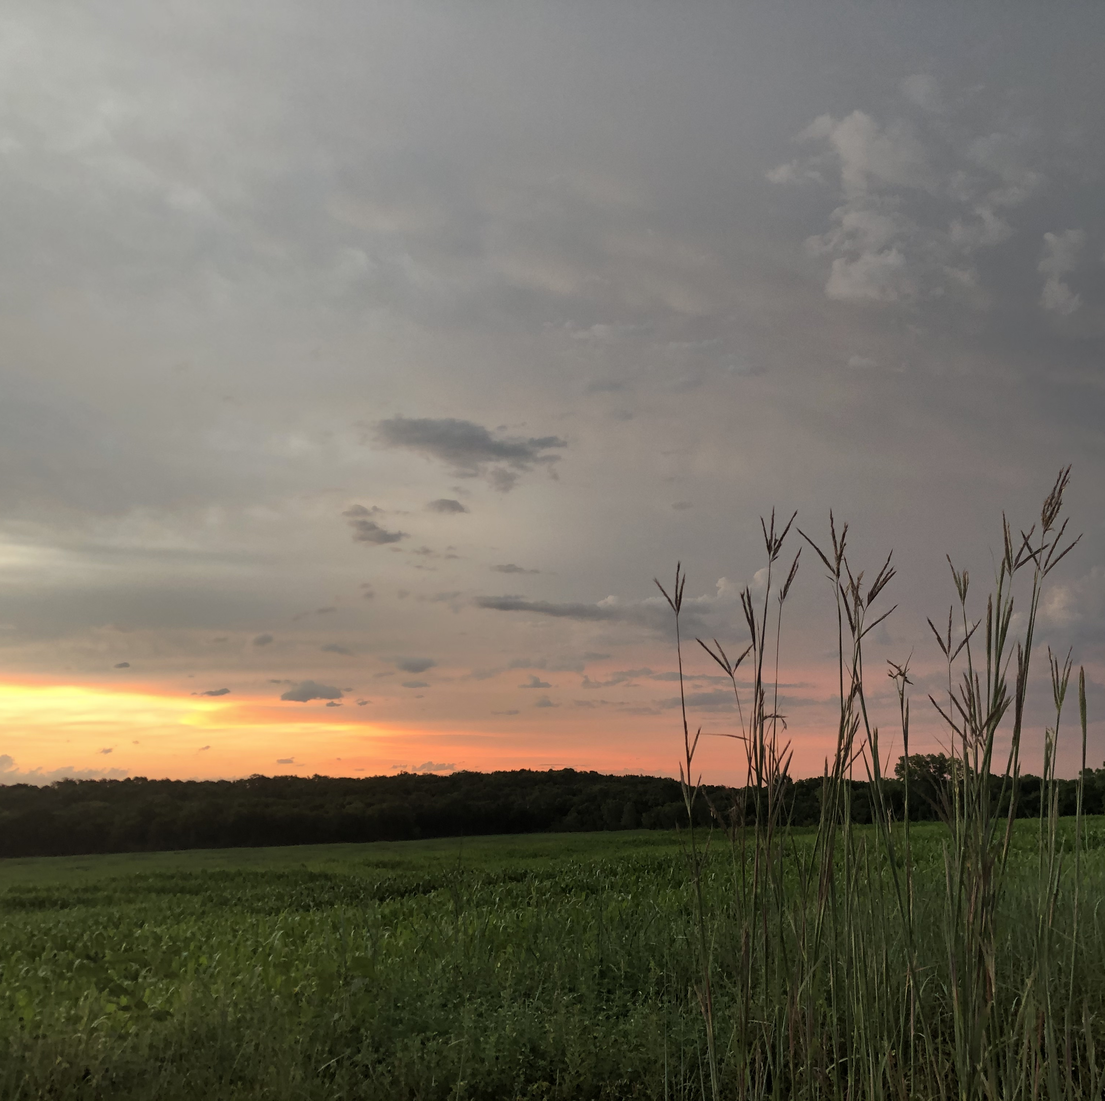
Question #3
Why are grasses so great at quickly absorbing the rain, when it does arrive?
Notes:
Answer on following slide. Answer = because of their fibrous root systems that allow the grasses to very quickly and efficiently absorb rain water. So efficient, the fibrous roots can keep the water away from the taproots of the forbs.
Photo of Big Bluestem in silhouette against the pre-dawn morning – Pottawatomie County, KS. Photo copyright Jill Haukos

Slide 11
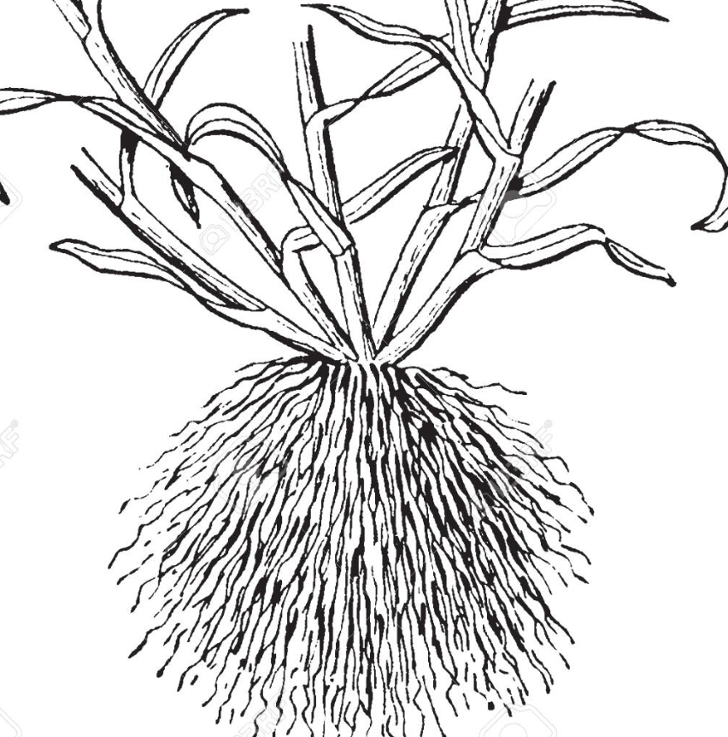
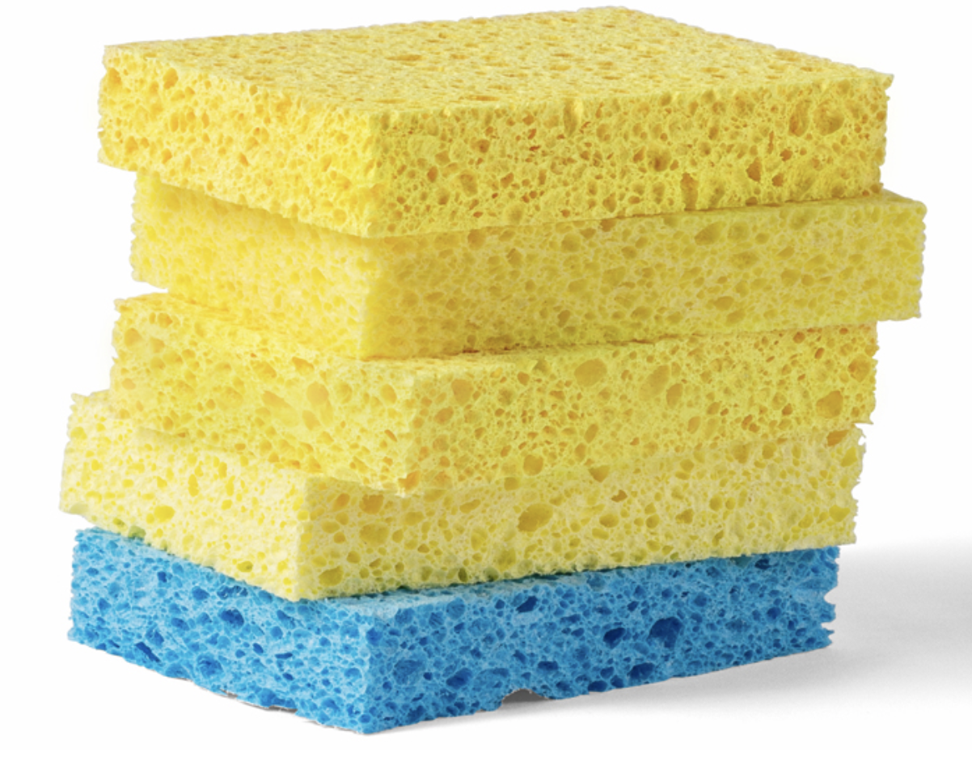
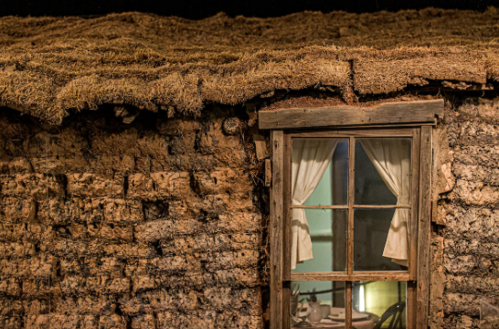
Answer
Because of their root systems.
Grass “fibrous roots” are concentrated in the first 1’ of soil.
Grass roots act like a sponge to quickly absorb the rain that hits the soil.
That first foot of prairie soil is called “sod”. The soil is held to the grass roots and forms a dense clump. Early settlers of the prairie used sod to build their houses because there were no trees to provide wood.

Slide 12
Scientists at the Konza Prairie Biological Station (outside of Manhattan, KS) do research on the ecology of the tallgrass prairie.
They collect data to help us understand how the tallgrass prairie works and what things affect its health.
One of the main things that scientists look at is the role that precipitation plays on the health of the prairie.
So, the total amount of annual precipitation at Konza Prairie is collected…
Rain gauge on the prairie

Slide 13
Precipitation data from the Konza Prairie Biological Station
Annual Total Precipitation at Konza Prairie – in inches
2007 |  | 39.21
2008 |  | 41.21
2009 |  | 38.01
2010 |  | 33.4
2011 |  | 32.14
2012 |  | 22.5
2013 |  | 31.67
2014 |  | 28.09
2015 |  | 39.28
2016 |  | 38.64
2017 |  | 29.29
2018 |  | 32.69
2019 |  | 47.1
2020 |  | 33.96
2021 |  | 29.94
2022 |  | 33.47
15 years of precipitation data
Give students Data Set #1

Slide 14
A. From the precipitation data set, answer these questions…
What is the average amount of precipitation received at Konza Prairie for the last 15 years?
What 5 years had the highest precipitation? Put the top 5 years in order from highest to lowest.
What 5 years had the lowest precipitation? Put the lowest 5 years in order from lowest to highest.
Answer = 34.41 inches
Answer = 2019, 2008, 2015, 2007, 2016
Answer = 2012, 2014, 2017, 2021, 2013

Slide 15
A. Open discussion questions:
4. What year do you think had the most grass growth on the prairie?
Why did you pick that year?
6. Do you think the amount of precipitation that occurs the previous year has any impact on the plant growth the following year?

Slide 16
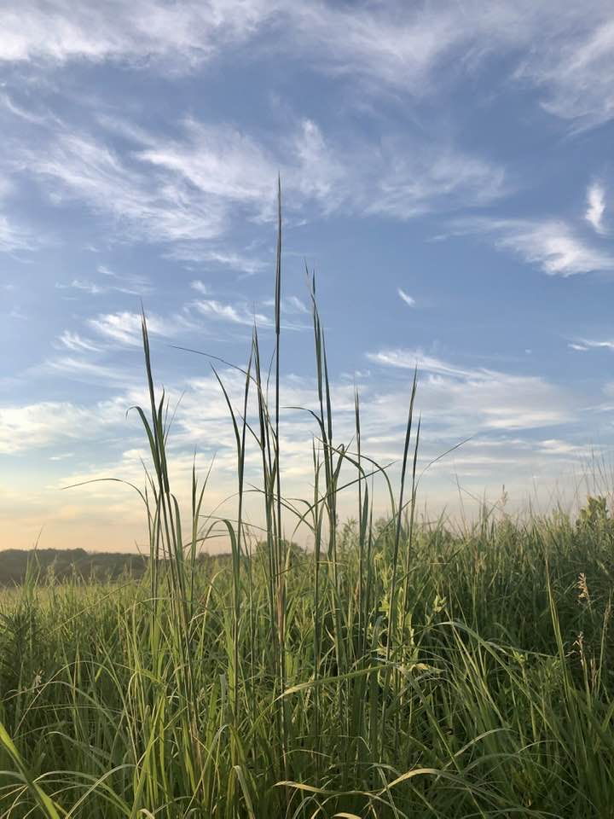
Precipitation DOES Affect Plant Growth…
Plants need precipitation to grow, and grass will grow more/taller with more rain.
Researchers at Konza Prairie looked at the TIMING of the arrival of the precipitation and its affects on the grass growth.
Notes:
Photo showing the prairie’s tallgrasses in their initial growth stage, before they put out their seedheads. This occurs in July.
Photo from Pottawatomie County, KS – copyright Jill Haukos

Slide 17
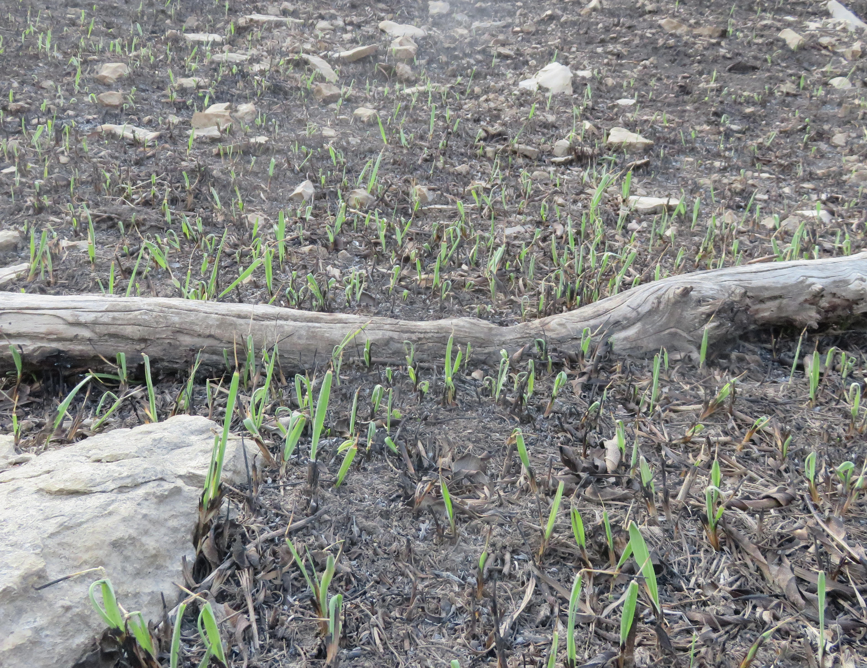
The ”growing season” for the prairie is March - October
The prairie grasses, for the most part, are “perennial” = they come back year after year.
They begin their growth from underground rhizomes usually beginning in March
Some prairie plants (~ 20% of species) are “annuals” = germinate from seeds
Notes:
Photo of emerging grasses from the prairie soil after a recent burn; at the Konza Prairie Biological Station. Photo copyright Jill Haukos

Slide 18
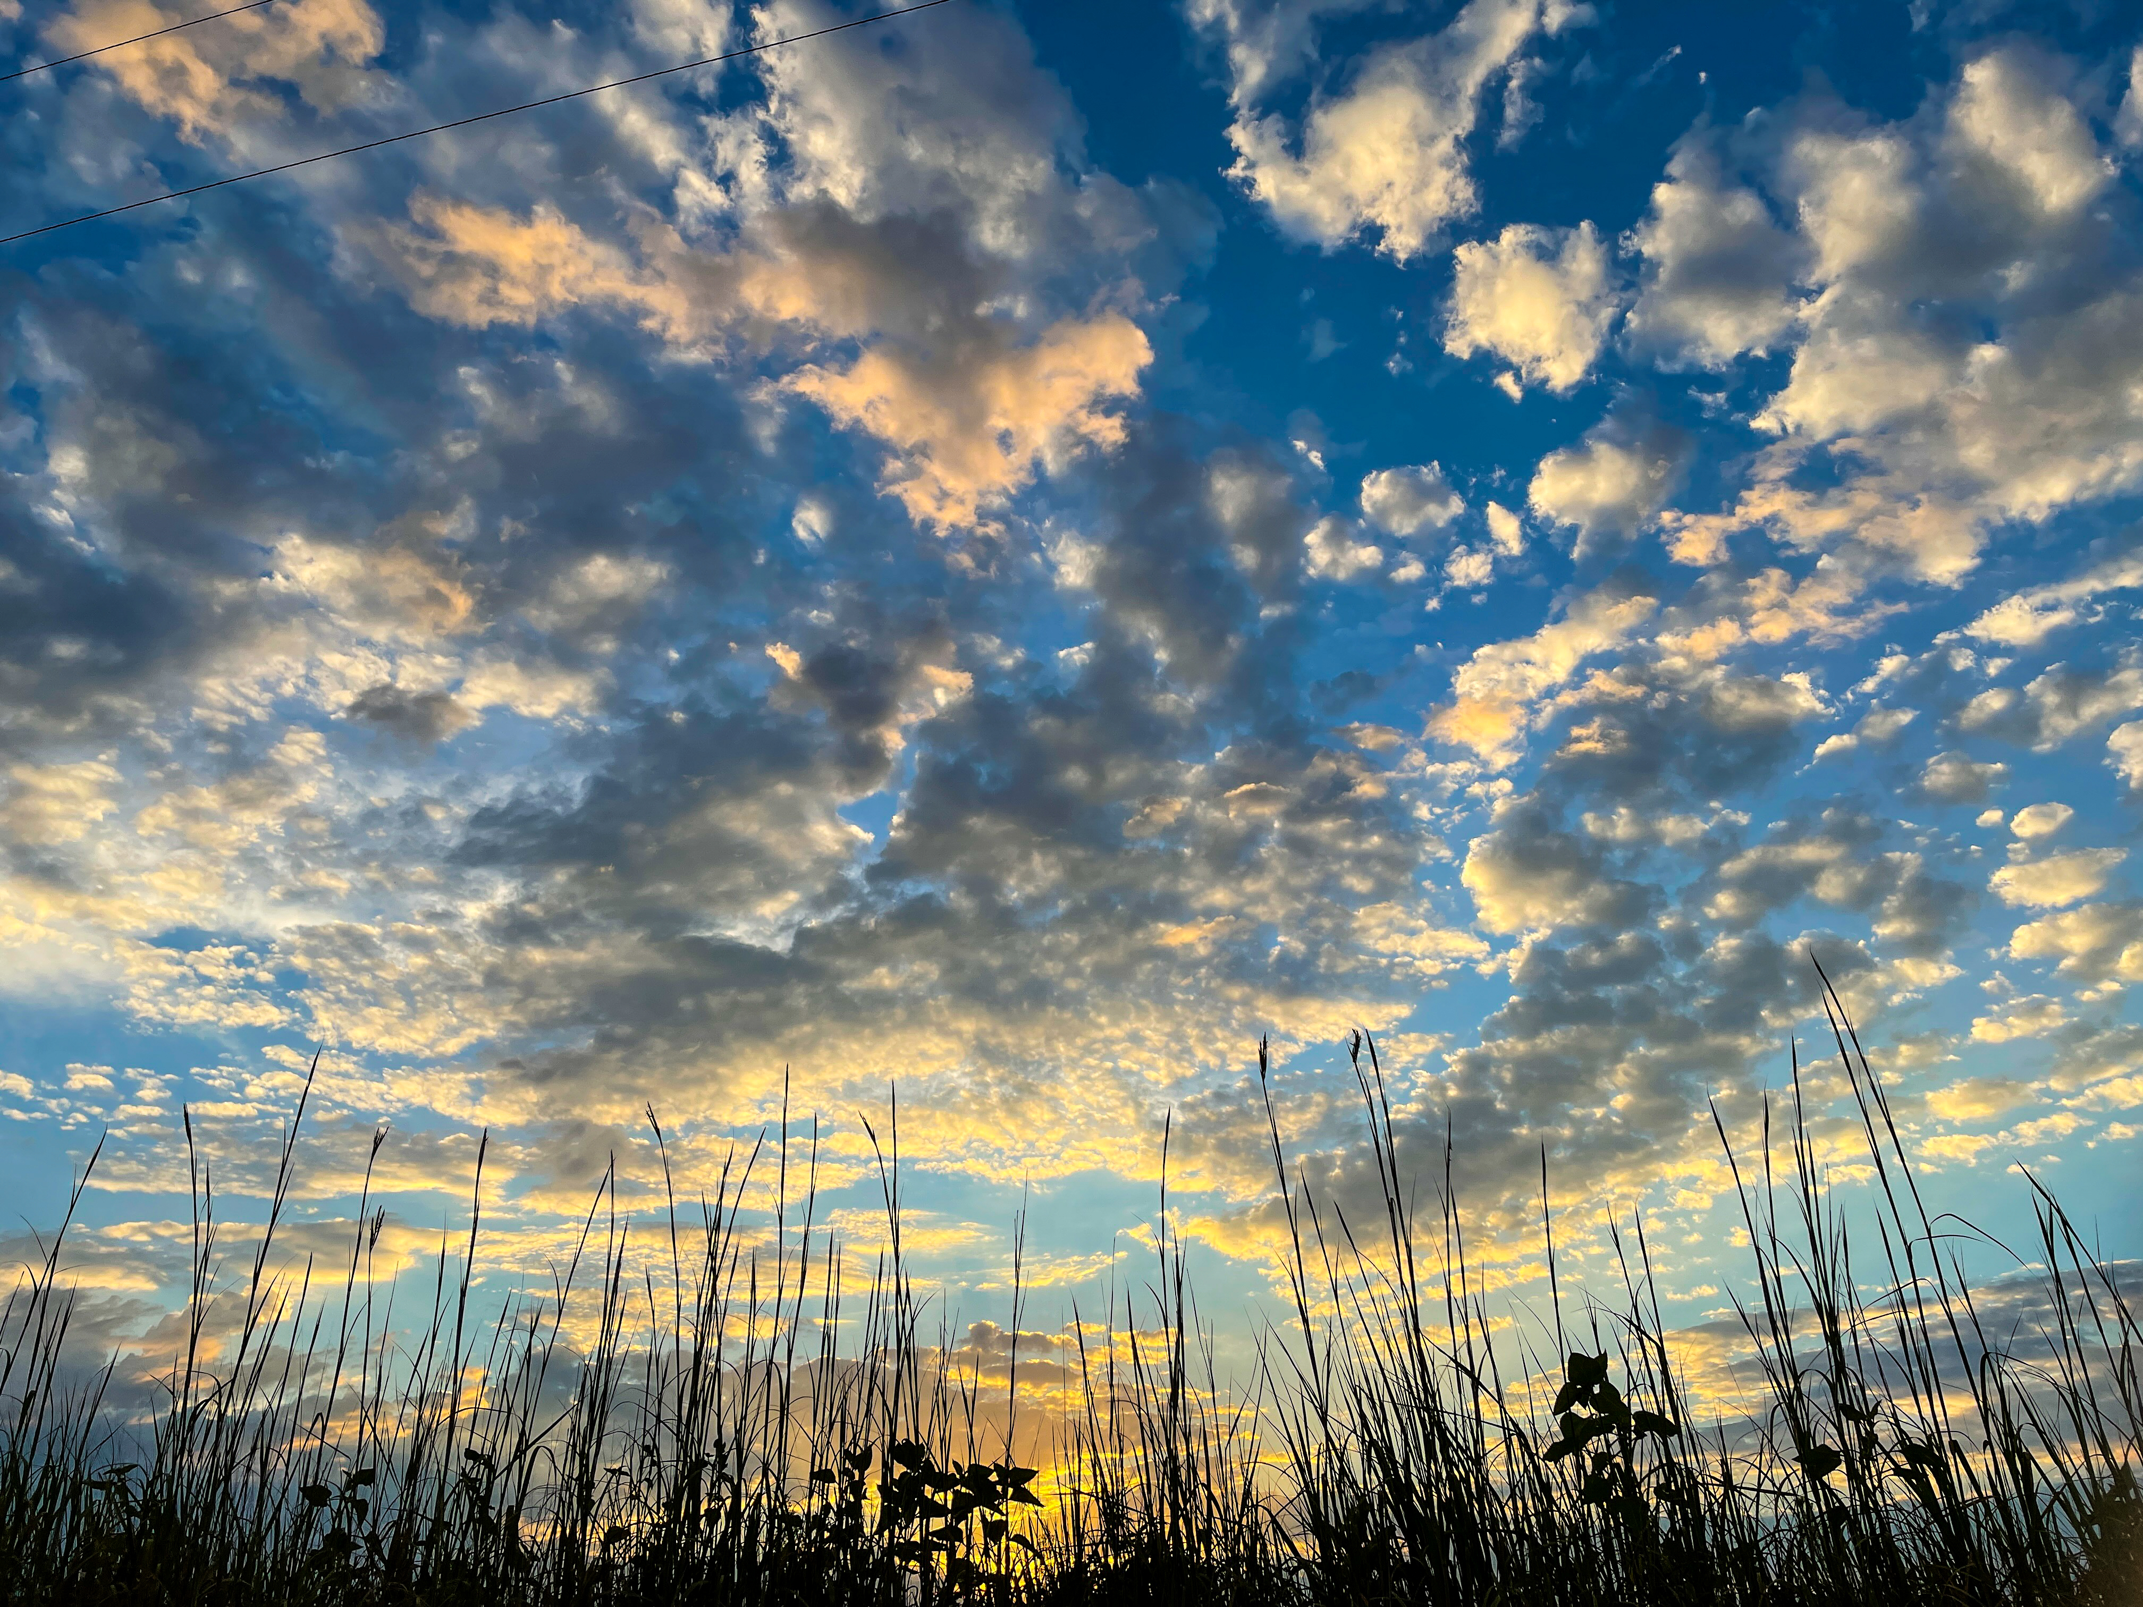
The amount of precipitation the prairie receives during the growing season will determine how tall the prairie grasses will grow.
On the tallgrass prairie, there are years of tall tallgrass and years of shorter tallgrass.
Let’s look at WHEN, during the year, the precipitation arrives at Konza Prairie. From that data, we’ll answer some questions…
Notes:
Photo of tallgrasses silhouetted against the dawn sky – copyright Jill Haukos

Slide 19
Give students Data Set #2 handout

Slide 20
Give students Data Set #3 handout

Slide 21
B. From the graph of the Annual and Monthly Precipitation at Konza Prairie answer these questions:
The tallgrasses begin putting on lots of height in July. Rain that comes in July (navy blue) = tall tallgrass. What year shows the most rain arriving in July?
Did the year with the most rain in the month of July also show to be the year with the highest annual rain?
What 5 years can you predict to be years with tall tallgrasses? (use Data Set #3 for this)
Answer = 2020
Answer = no
Answer = 2020 (7.36”), 2010 (6.13”), 2008 (6.06”), 2015 (5.76”), and 2021 (5.24”). All measuring rainfall during the month of July.

Slide 22
What 4 months are historically the driest for the prairie? (take the average total precipitation for each month to determine this)
5. What 5 months are historically the wettest for the prairie? (take the average total precipitation for each month to determine this)
6. Does the prairie get most of its rain during the growing season?
January – 0.72”, February – 0.98”, December – 1.43”, November – 1.47”
The winter months when the prairie is dormant
May – 5.23”, June - 4.85”, August – 4.31”, July – 4.12”, April – 3.49”
Yes – definitely!

Slide 23
B. Open discussion questions:
7. Do you think years that are high in precipitation will ALWAYS result in tall tallgrass? Why or why not?
8. What year do you think had the shortest grass? Why?
9. Can you think of other effects high precipitation might have on a prairie, besides tall tallgrass?
10. How do you think the prairie plants respond to dry conditions?
Notes:
Potential answers:
7. The timing of the precipitation is key to determining the eventual height of the tallgrasses. The rain must come in the summer (June and July) in order for the grasses to get tall.
8. The years with the narrowest navy-blue band probably had the shortest grasses. Those years would be: 2012, 2014, 2017, and 2011
9. Precipitation makes the prairie come to life! There are more flowers, more insects, more birds, more everything. Years with healthy precipitation = happy prairie!
10. Prairie plants will go dormant during extended dry conditions. Their leaves turn brown/yellow and they appear dead. They aren’t dead, just dormant. They are saving their food and water underground for bare survival and can jump right back into growing and doing photosynthesis once it rains.

Slide 24
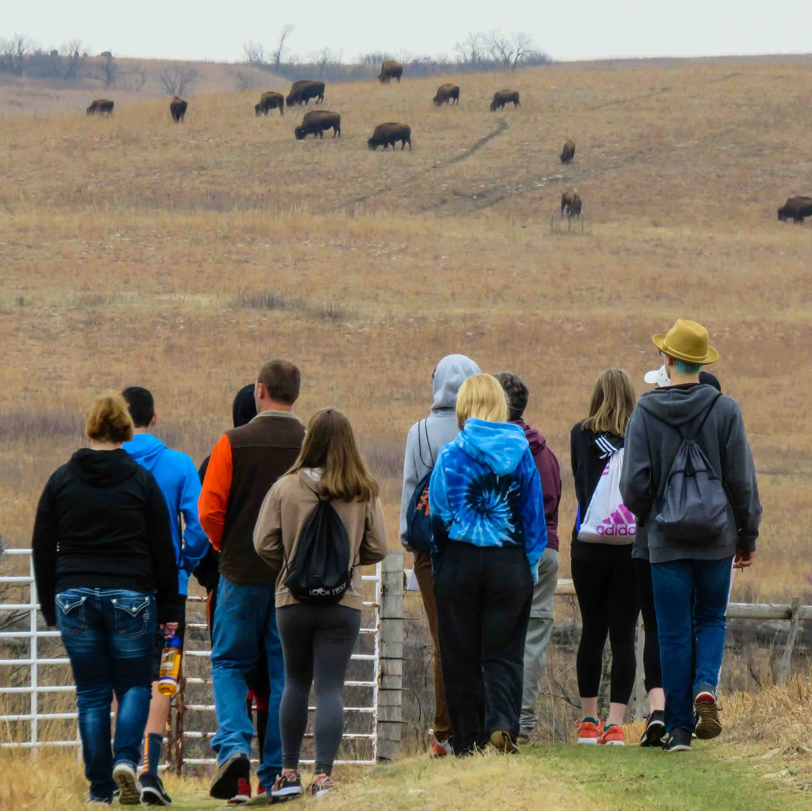
Next – we’ll look at how grazing animals affect the prairie…
Notes:
A student group hiking on Konza Prairie has the bison herd visible in the distance. Photo copyright Jill Haukos

Slide 25
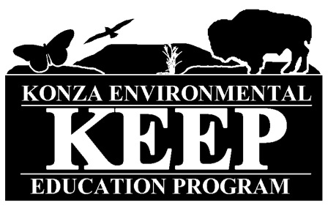
Author:
Jill Haukos
Konza Environmental Education Program
Konza Prairie Biological Station
Manhattan, KS
© 2023

