Slide 1
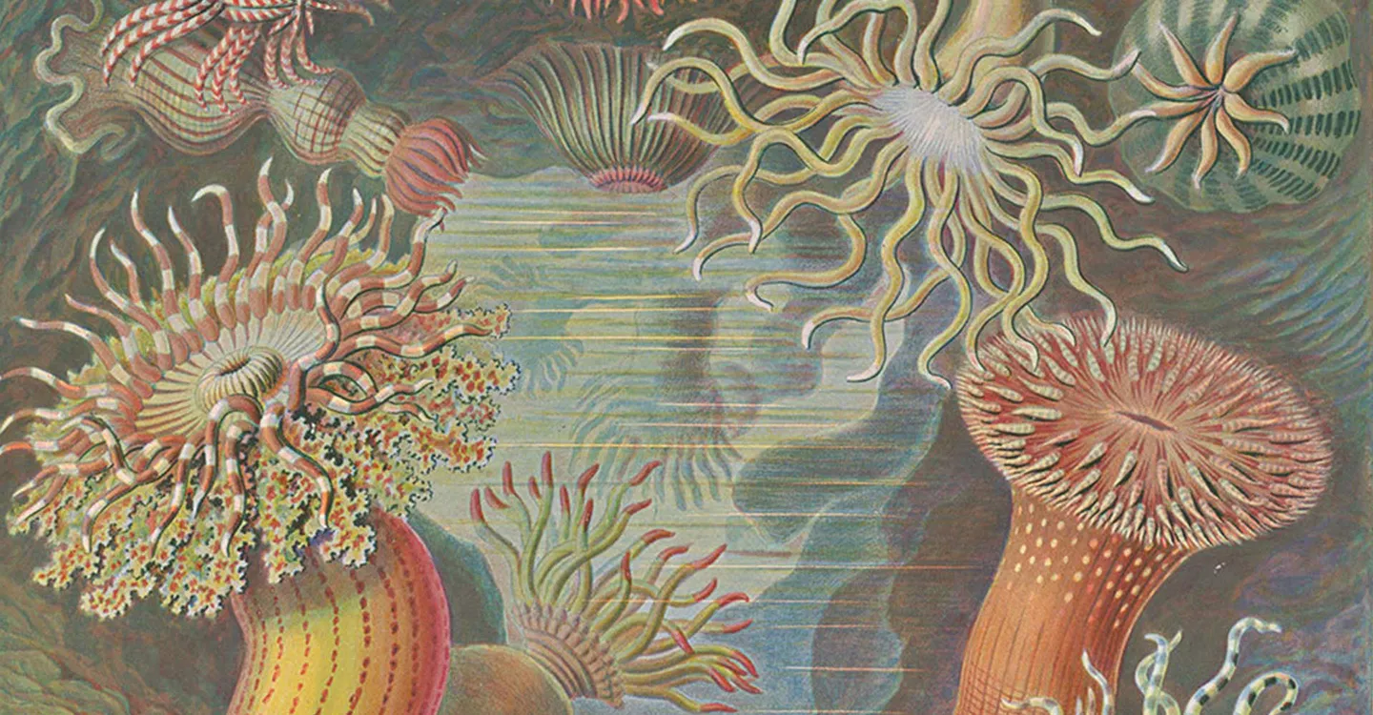
An Introduction to Ecology
John Blair
Illustrations by Ernst Haeckel

Slide 2
What is ecology? What do ecologists do?
a broad scientific discipline aligned with biology
focus is on the interactions of living organisms with each other and with their physical environment
ecology seeks to understand the connections between living organisms (plants, animals, microbes) and the world around them.
relevant to many contemporary issues that are important to humans, but it’s not synonymous with “environmentalism”
ecology can provide the information necessary to manage and conserve the Earth’s ecosystems, the populations they support, and the services they provide for future generations
Notes:
The first professional ecological societies were formed a little over 100 years ago - in 1913 (British Ecological Society) and 1915 (Ecological Society of America).
First Earth Day was celebrated in 1970.
The subdiscipline of ecosystem ecology didn’t become formalized until the mid-1950s, and the first real Big Science initiative (IBP) didn’t start until the 1960’s.
Founded in 1983, the Cary Institute of Ecosystem Studies is one of the world’s leading independent environmental research organizations.

Slide 3
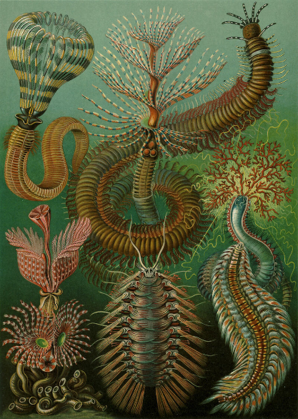
Ecology comes from the Greek word “oikos”, meaning household, or place to live. So, ecology started out as the study of where things live and what they do there…
Coined by Ernst Haeckel in 1866…
“By ecology, we mean the body of knowledge concerning the economy of nature- - the investigation of the total relations of the animal both to its living and to its non-living environment…
…in a word, ecology is the study of all the complex interrelationships referred to by Darwin as the conditions of the struggle for existence.”

Slide 4
The definition and focus of ecology has changed over time…
1920s – scientific natural history
(emphasis on descriptive studies of nature)
1950s – the scientific study of the distribution and abundance of organisms (why do species occur where they do; what causes populations to change over time)
1970s – the study of the structure and function of nature (emphasis on interactions of organisms with the environment)
2020s - ?? (increasing urgency to apply ecological knowledge to solve real world problems)

Slide 5
A simple definition…
Ecology - “the study of the interactions of organisms with their physical environment and with each other”
abiotic (non-living) – soil, water, nutrients, light, etc.
*organisms both respond to, and alter, their environment
Environment
biotic (living) – competitors, predators, prey, mates, etc.

Slide 6
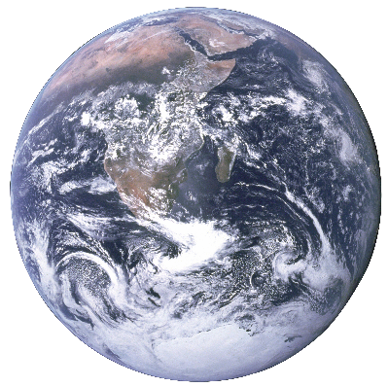
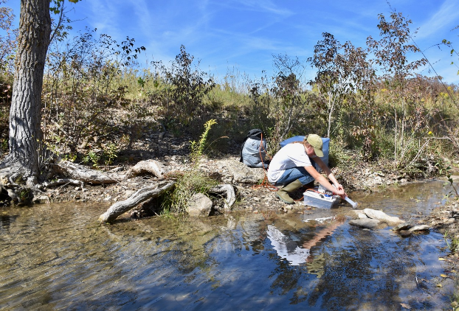
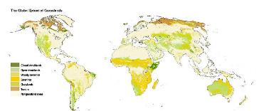
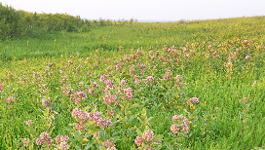
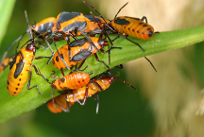
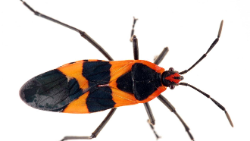
Levels of Ecological Organization
biosphere
biome
ecosystems
communities
population
organisms

Slide 7
Each level represents an ecological unit with unique properties…
population – all individuals of a single species occurring in the same area; potentially capable of interbreeding (a genetic unit).
community - all populations (plants, animals, microbes) occurring in the same area or habitat.
ecosystem - a community plus its abiotic environment (air, soil water, nutrients, detritus).
biome - large regional ecological systems, characterized by climate and vegetation type.

Slide 8

biosphere - all of the earth’s organisms and the physical environment with which they interact.

Slide 9
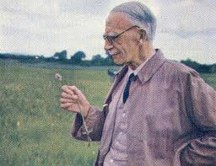
The ecosystem concept
Sir Arthur Tansley 1871-1955
British botanist, founded the British Ecological Society; credited with coining the term ecosystem:
“Though the organisms may claim our prime interest, when we are trying to think fundamentally, we cannot separate them from their special environments, with which they form one physical system.” Tansley 1935
Viewed ecosystems as a fundamental unit in nature

Slide 10
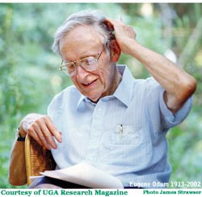
The ecosystem concept changed the way many ecologists think about systems in nature
Eugene Odum at the University of Georgia (1913-2002)
Advocated for ecology as a rigorous, independent science with a focus on whole ecosystems
Ecosystem def. - any unit in nature that includes all organisms in a given area and their abiotic environment, interacting so that energy flows lead to biotic structure and material cycles (Eugene Odum 1971).

Slide 11
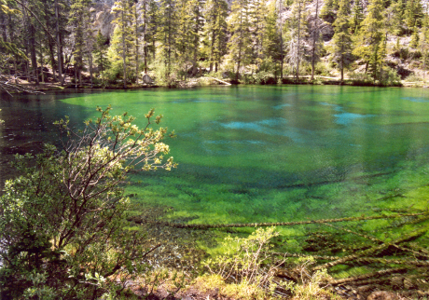
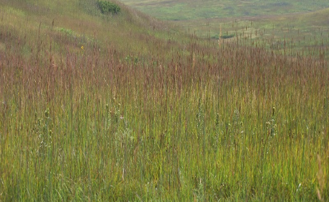

Ecosystems come in a wide range of different sizes
Boundaries of some ecosystems are obvious and others are user-defined and depend on the questions being asked
Notes:
The point here is that the term ecosystem can be used to cover many different kinds of systems, depending on the focus of the scientist asking the questions. An ecosystem can be as small as a single pond, or a small plot of land, or as large as the entire biosphere. Sometimes the boundaries are clear (as in the pond), and other times they are user-defined, or depend on the processes being measured.

Slide 12
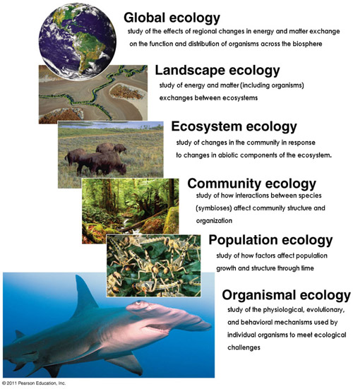
Ecology (and ecologists) is sometimes broken up by the level of organization focused on and the kinds of questions asked…

Slide 13
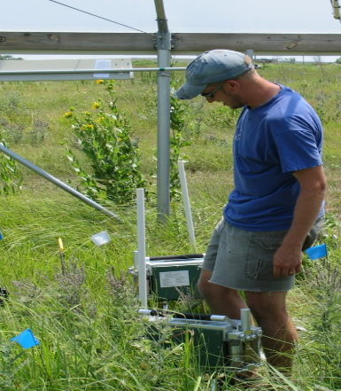
Ecology at the organism level
Physiological ecology - responses and adaptations of individual organism (form, physiology, behavior) to the physical environment (temperature, light, water, nutrients)
How does water temperature affect the metabolic rate of a southern redbelly dace?
How does the photosynthetic rate of a big bluestem plant respond to different light levels?

Slide 14
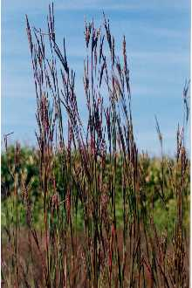
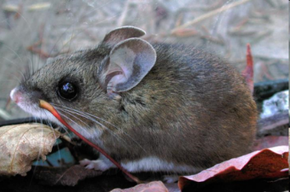
Ecology at the population level
Population ecology - focused on populations, and the factors that affect their distribution and abundance (births, deaths, immigration/emigration) and their evolution (change over time).
How do changes in birth rates and death rates of deer mice alter population size (numbers) across years?
Is seed production or tillering (asexual reproduction) more important for predicting big bluestem abundance?

Slide 15
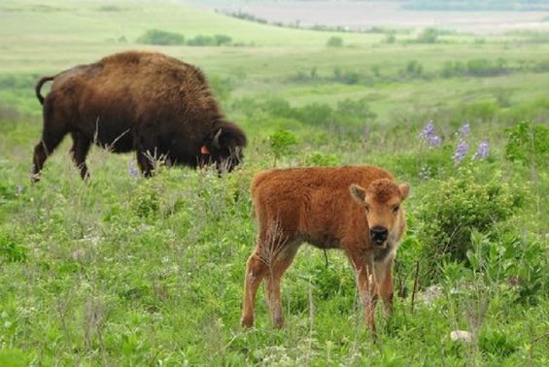
Ecology at the population level
Community ecology – focuses on groups of more than one species, how those species interact (e.g., competition, mutualism, exploitation), and their biodiversity
How does bison grazing affect the composition and diversity of plant species and insect herbivores in a grassland?
Does the presence of bison alter the competition between species of grasses and forbs?

Slide 16
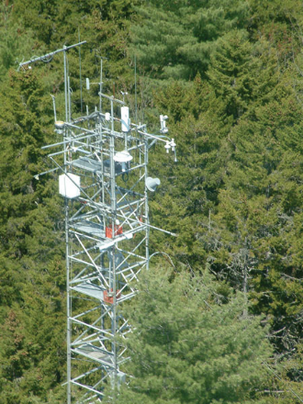
Ecology at the ecosystem level
Ecosystem ecology –focuses on transformations and movement of energy, biomass, nutrients, and water, often among living and non-living components; energy and matter are “common currencies”) to compare/contrast ecosystems.
What controls the exchange of CO₂ between a forest and the atmosphere? How much C is stored in this forest and where?
Will warmer temperatures change the movement of water through the forest? Or the balance of CO₂ uptake and release?

Slide 17
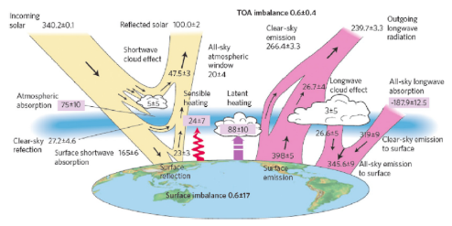
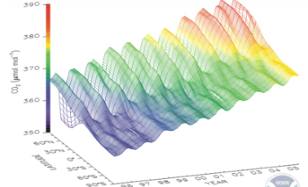
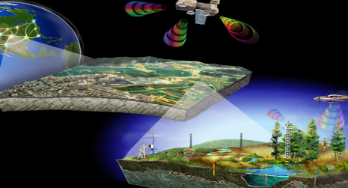
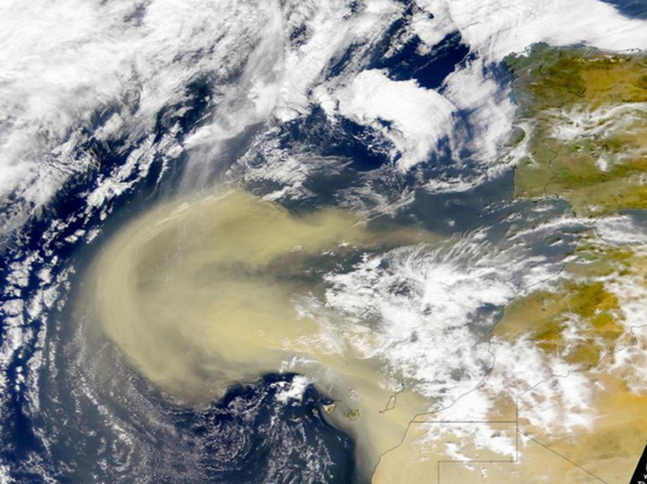
Ecology at the global level
Global ecology –focuses on understanding the Earth system - the entirety of life (animals, plants, microbes) and life-support systems (air, water, and soil) on the Earth.
How do changes in land use alter atmospheric chemistry and global climate?
How does dust from NE Africa alter productivity of tropical forests in South America?

Slide 18
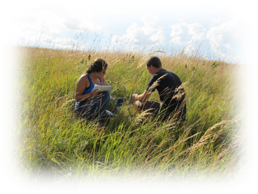
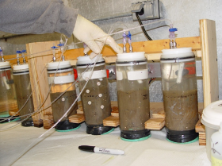
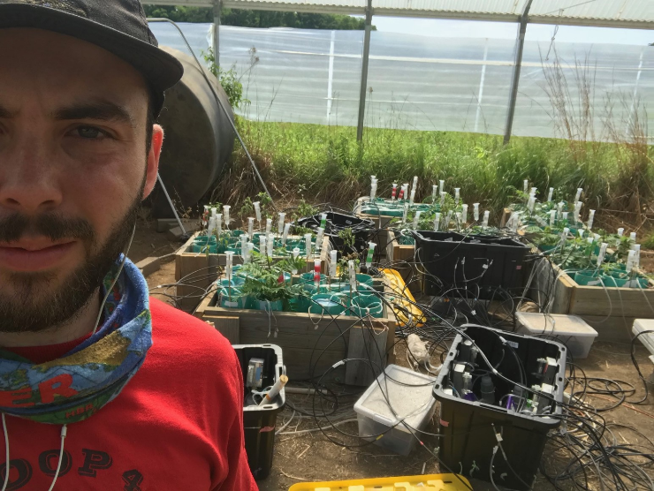
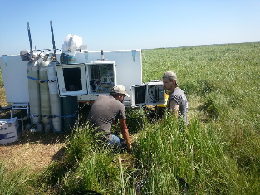
How do ecologists go about “doing ecology”?
    Observation
    Experimentation
    Models
Laboratory studies
Field studies

Slide 19
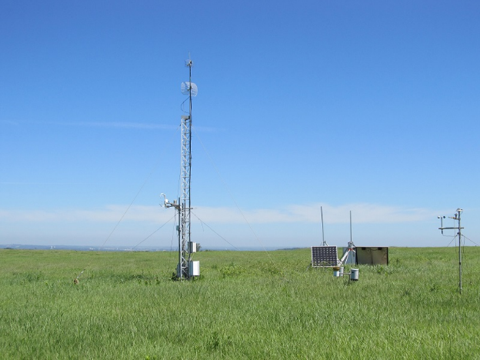
A. Observational studies can be simple or based on sophisticated approaches and instruments…
DNA sequencing from environmental samples for invasive species (eDNA)
Eddy flux towers for measuring net ecosystem C exchange

Slide 20
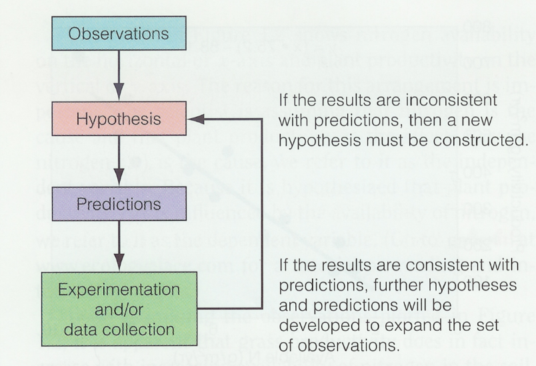
B. Experimentation – manipulating one independent variable at a time (the “treatment), and measuring responses (dependent variables) with replication and controls
science is a “self-correcting” process

Slide 21
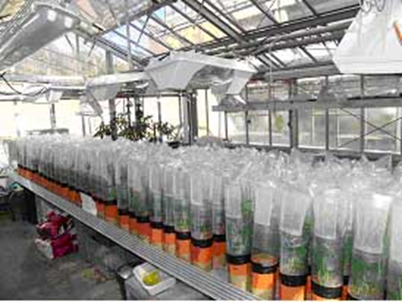
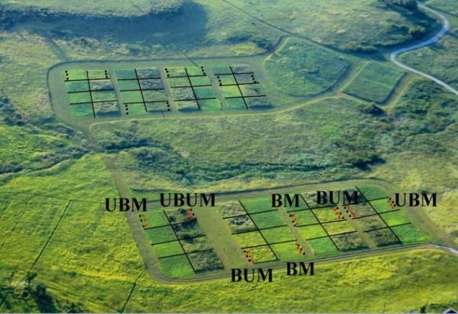
Lab/greenhouse experiment vs. Field experiments
Advantages? Disadvantages? Trade-offs?

Slide 22
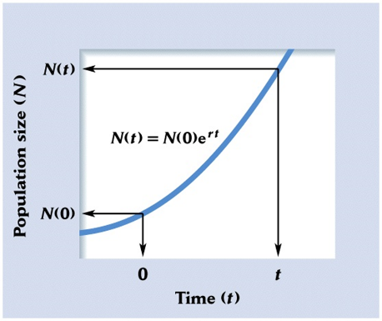
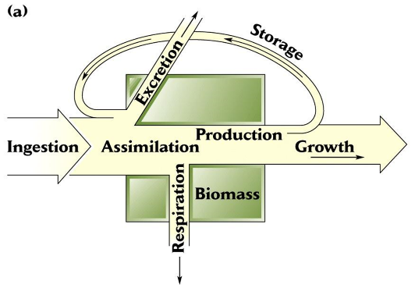
Models - abstractions and simpler representations of nature; - focus on some key components, processes, or behaviors of the system
- useful for making predictions, testing current understanding, and generating new questions

Slide 23
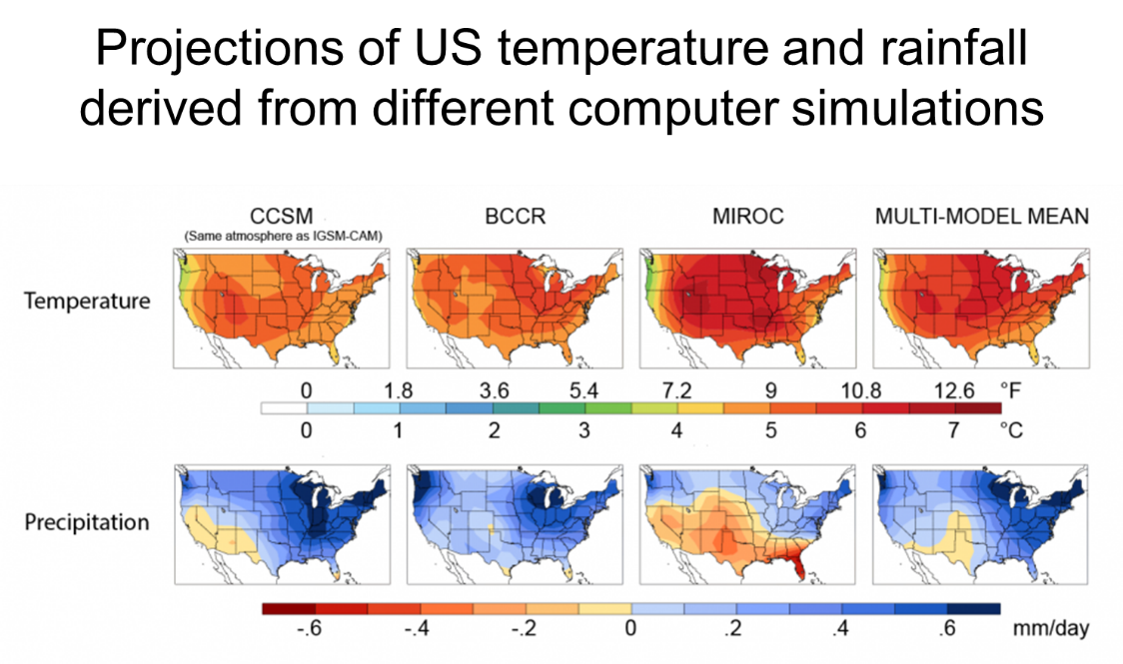

Slide 24
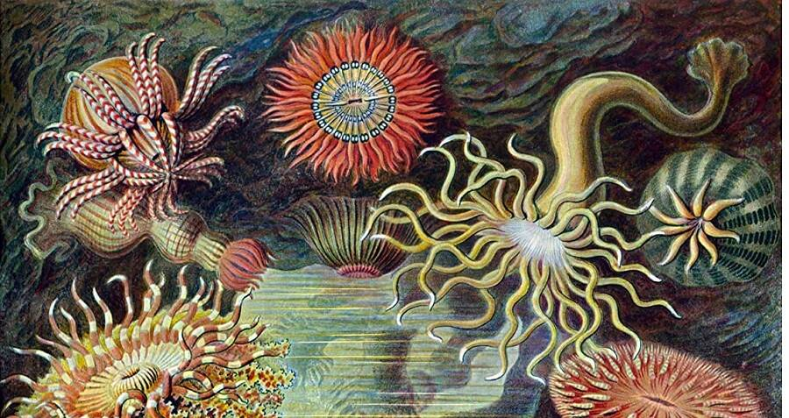
Intermission and Questions

Slide 25
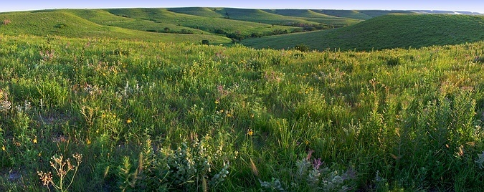





Konza Prairie as a platform for ecological research

Slide 26
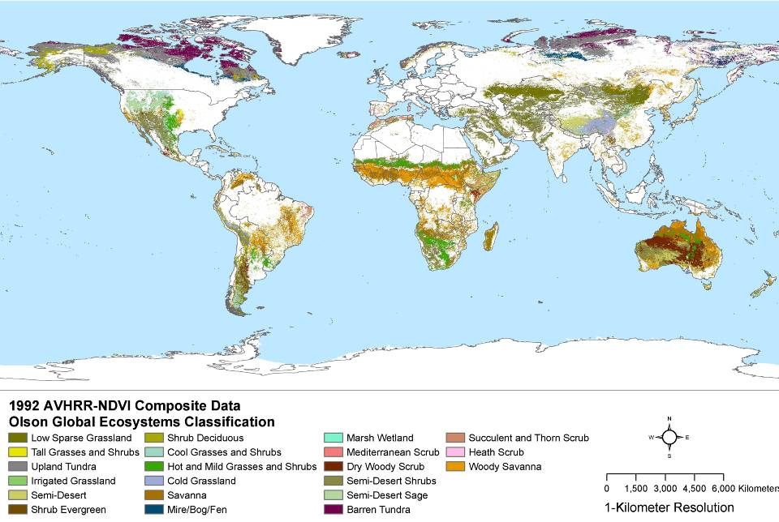
Grassland ecology in a global context…
Grasslands, rangelands, steppe, tundra, savanna and shrub-grasslands cover ~ 30-40% of the Earth’s land surface
T. Riley and J.A. Klein
Notes:
Consider upgrading with grasslands chapter figure

Slide 27
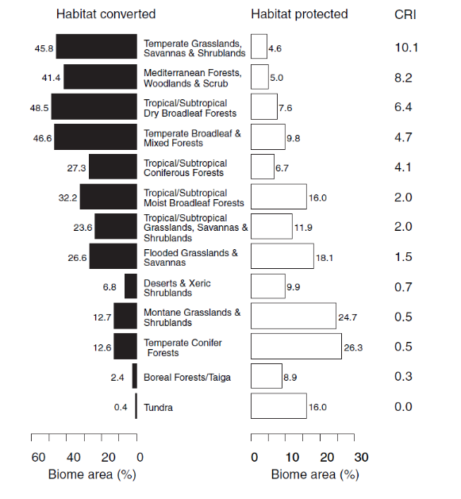
Many grasslands are at risk…
Temperate grasslands have the greatest Conservation Risk Index of all major biome types globally.
CRI (Conservation Risk Index) is calculated as the ratio of per cent area converted to per cent area protected as an index of relative risk of biome-wide biodiversity loss.
Hoekstra et. al 2005. Ecology Letters.

Slide 28
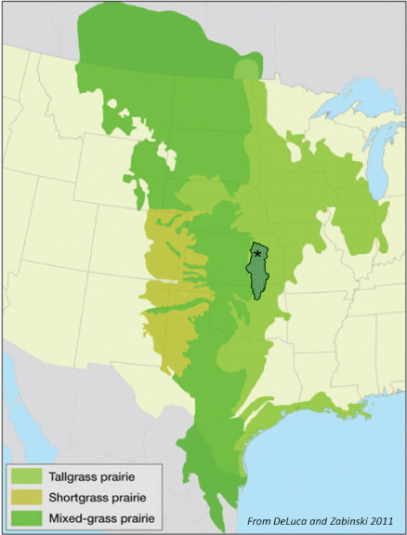
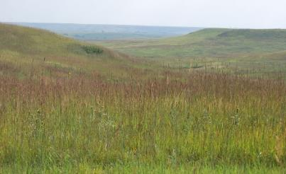
Largest remaining areas of native prairie in Flint Hills
*
Konza Prairie
Biological
Station and LTER site
Flint Hills
Ecoregion
From DeLuca and Zabinski 2011

Slide 29
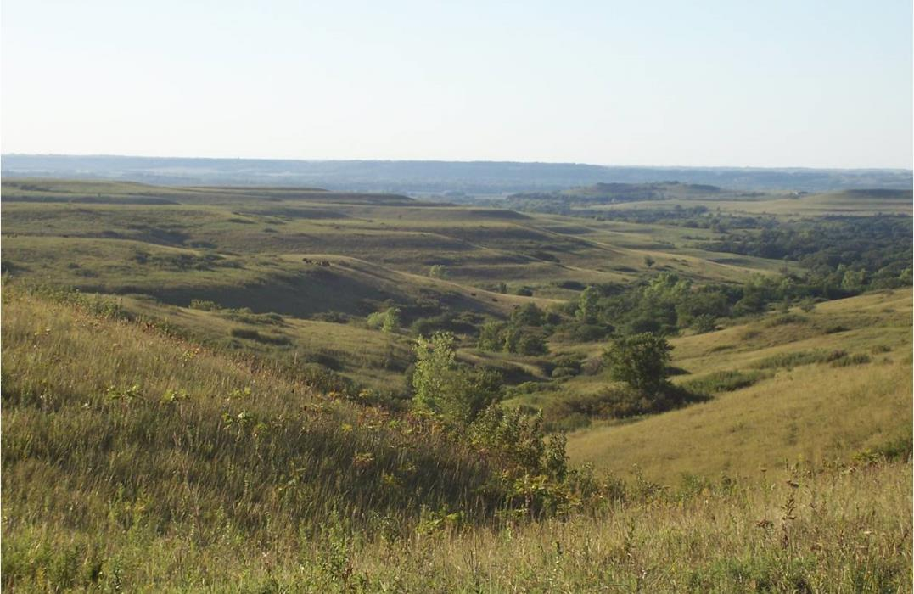
KONZA PRAIRIE BIOLOGICAL STATION
8,600 acre ha preserve jointly owned by KSU and The Nature Conservancy
Established in 1971
Operated as a field research station by the KSU Division of Biology
Dedicated to a three-fold mission of research, science education, and conservation

Slide 30
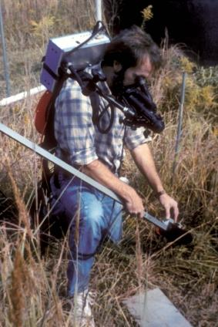
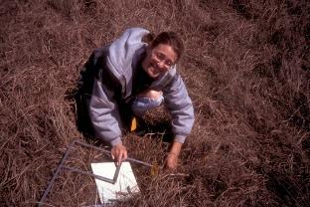
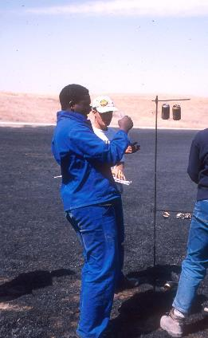
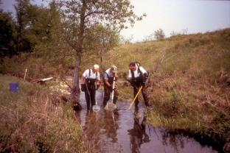
Konza is a unique outdoor laboratory that provides opportunities for grassland ecology and for basic biological research on a wide range of organisms and ecological processes
KPBS hosts scientists and students from institutions around the country and the world

Slide 31

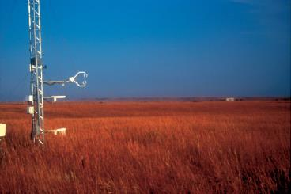
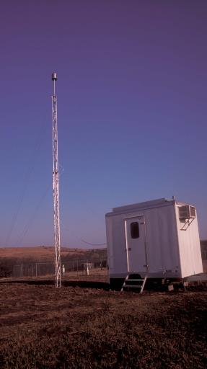
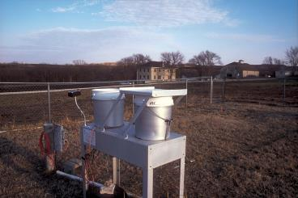
Konza also serves as a benchmark for assessing environmental changes and their impacts on grassland populations, communities, and ecosystems
Ameriflux
National Atmospheric Deposition Program
Clean Air Standards and Trends Network
USGS Hydrologic Benchmark Network
NOAA Climate Reference Network
National Ecological Observatory Network
and others…

Slide 32
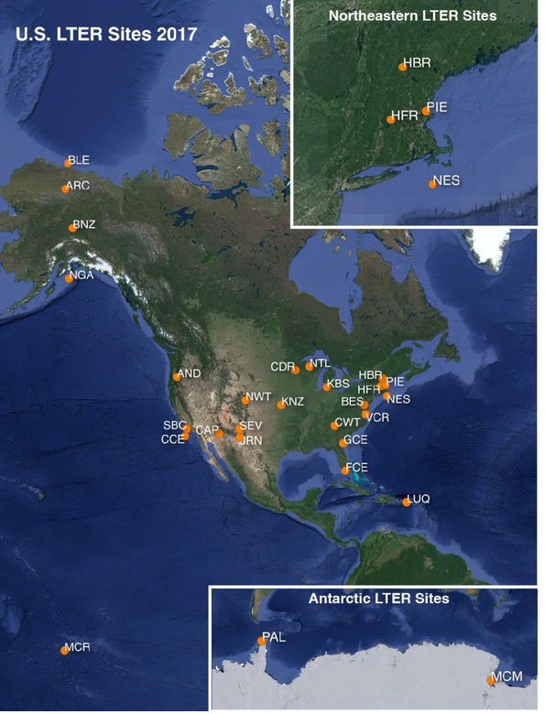
Long-Term Ecological Research (LTER) Network
est. in 1980 to support ecological research over long temporal and broad spatial scales
28 sites funded in 6 year increments by the National Science Foundation
Konza is now in Year 1 of LTER VIII funding cycle (2020-2026)
http://www.lternet.edu

Slide 33
All of the LTER sites share a common commitment to long-term research in five core ecological areas:
Patterns and controls of primary productivity
Spatial and temporal dynamics of selected populations and communities
Accumulation and storage of organic matter
Nutrient inputs and dynamics
Ecological responses at all levels to disturbances

Slide 34
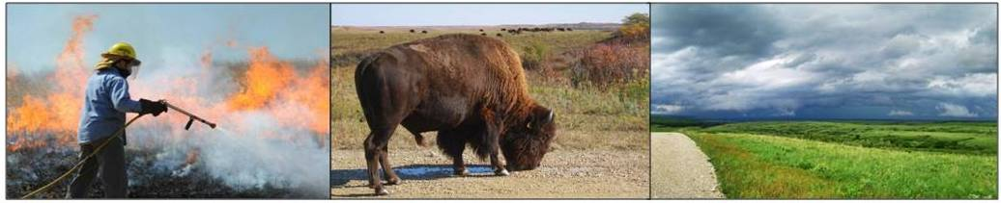
A major focus of the ecological research at Konza Prairie Biological Station is on fire, grazing, and climatic variability as essential and interactive factors responsible for the structure and function of this ecosystem.

Slide 35

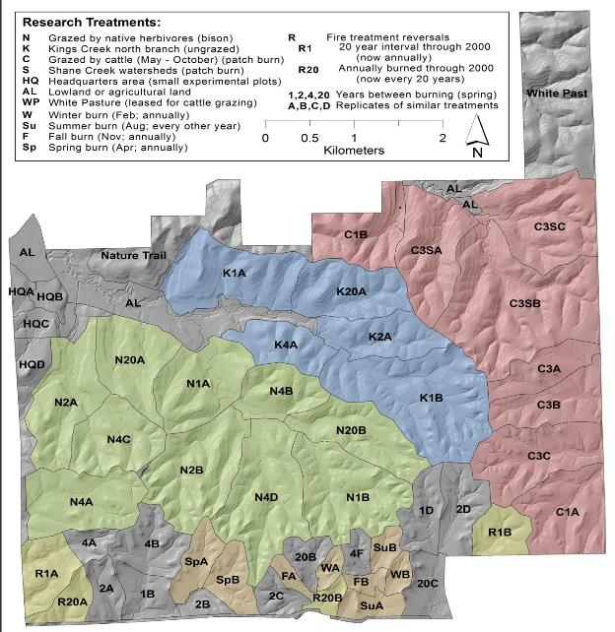


Konza Prairie Experimental Design

Slide 36



Stream and groundwater sampling locations
USGS station
weirs
wells
USGS stream gage (1980)
weir construction (1987)
groundwater wells (1988-93)

Slide 37

A variety of short- and long-term manipulative studies complement the watershed treatments…

Slide 38

Long-term ecological studies, like those at Konza and elsewhere, are increasing critical for…
  developing and testing ecological concepts and ecological theory
  understanding and predicting the consequences of global change
  developing more effective strategies for conserving and manageing natural reources in a changing world

